Slide 1



Transit Workforce Center
National Technical Assistance Center
for Transit Workforce Development
Transit Champion Breakfast
May 24, 2023

Slide 2
The True Value of Transit

Slide 3
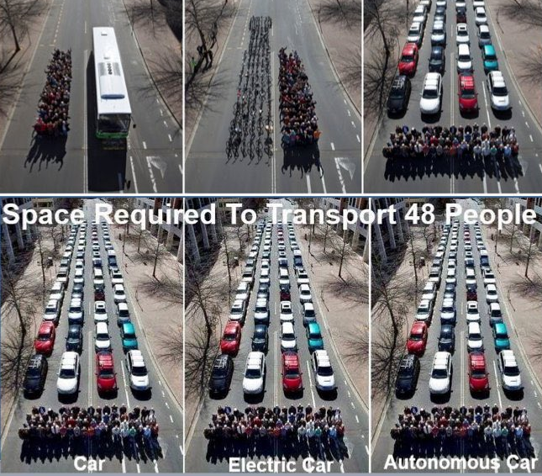
Reduces Congestion and Accommodates Population Density
Notes:
You serve the community by clearing the roads and making communities greener
Cars (whether electric, autonomous etc.) take up the most space

Slide 4
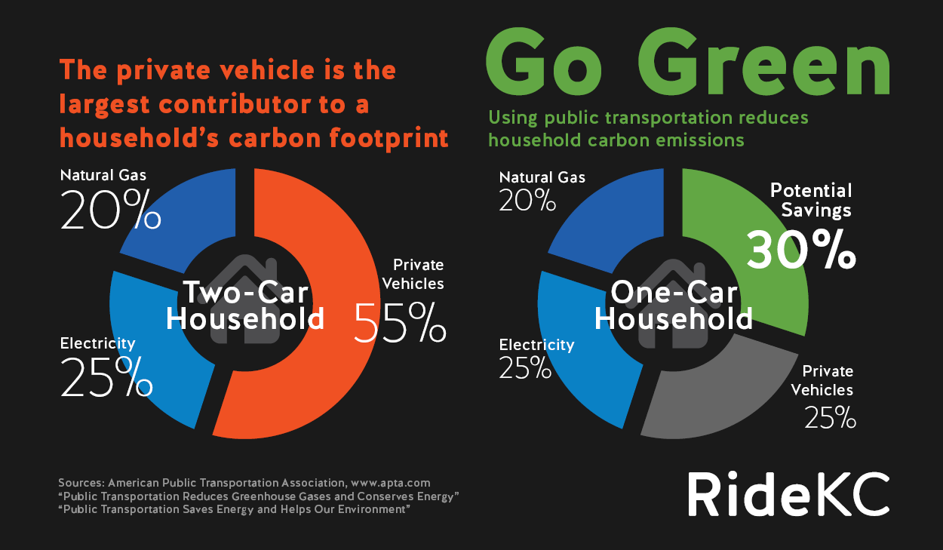
Environmental Good: Low Carbon Footprint
Notes:
The world has changed a lot in the past few years and will continue to change. Including the climate. Transit is arguably the least damaging form of transportation in terms of carbon emissions

Slide 5
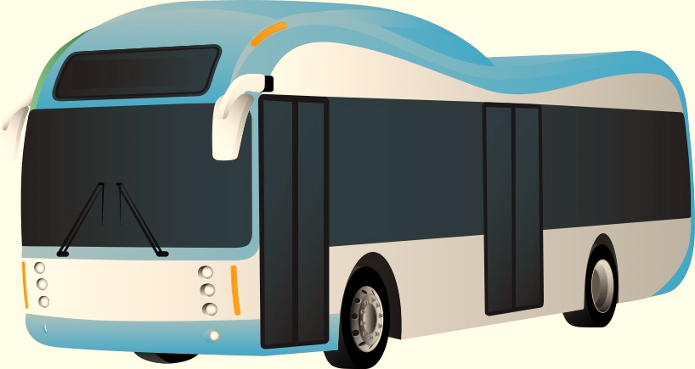
Source of Good Jobs
The need: workers to fill large number of job openings
The challenge: lack of applicants with skills needed
The solution: invest in training

Slide 6
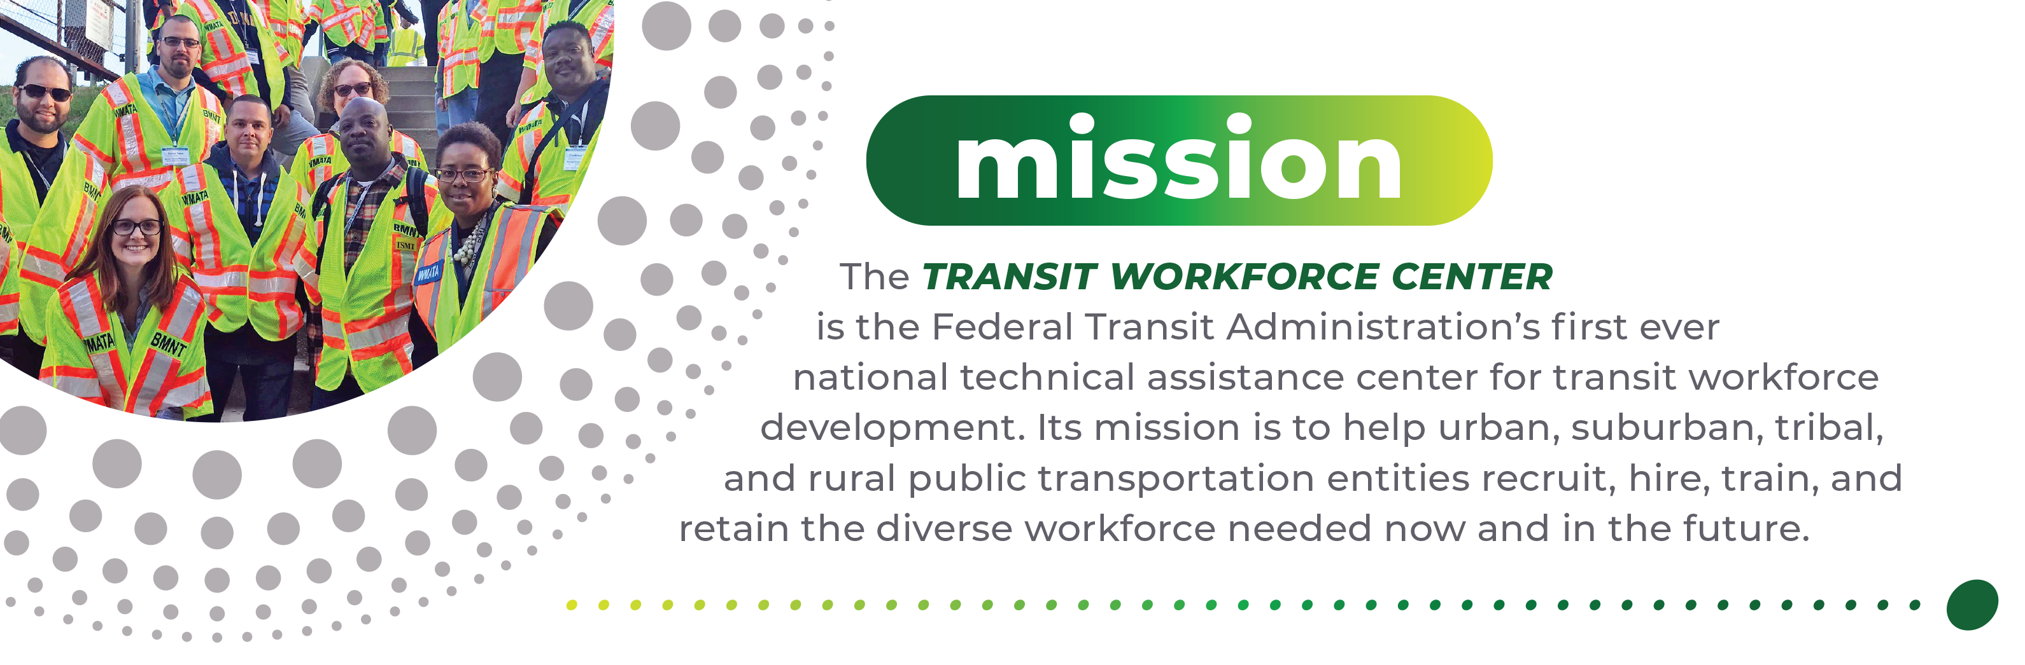
Transit Workforce Center – Mission
Operated by the ITLC, the Transit Workforce Center (TWC) is FTA’s first ever national technical assistance center for transit workforce development.

Slide 7

MC video

Slide 8






Selected TWC Workforce Development Resources, Strategies, and Initiatives
Meeting workforce development challenges
American Transit Training and Apprenticeship Innovators Network (ATTAIN)
Engaging stakeholders
#ConnectingMyCommunity —
National Transit Frontline Worker Recruitment Campaign
Mentoring programs
Zero Emission Bus transition

Slide 9

WIOA funds – 2023 Virginia allotments
$13.6 million - Adult Activities
$13 million - Dislocated Worker Activities
DOL Building Pathways to Infrastructure Jobs
$80 million
FTA Formula Funds
0.5% can be used for workforce development
FTA Low-No Grant Program
2022 Workforce Development funding - $43.4 million

Slide 10
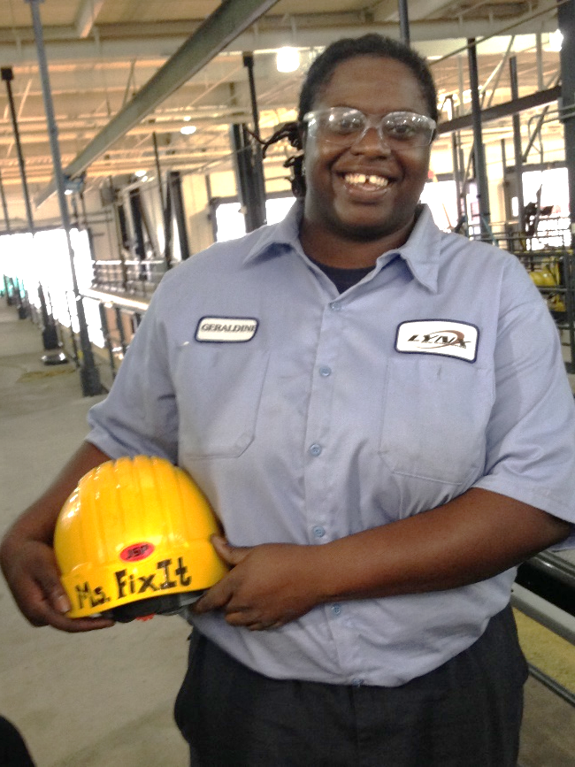






Transit Frontline Occupation Apprenticeships and Mentoring
  TWC assists agencies and labor in advancing frontline worker skills and training through apprenticeship and mentoring programs.
    Bus Operator
    Bus Maintenance
    Signals Maintenance
    Rail Car Maintenance
    Elevator/Escalator Maintenance
    Traction Power Maintenance
Geraldine “Ms. Fixit” Appiah. Rail Car Maintainer, CATS. Photo by Kenyon Corbett

Slide 11
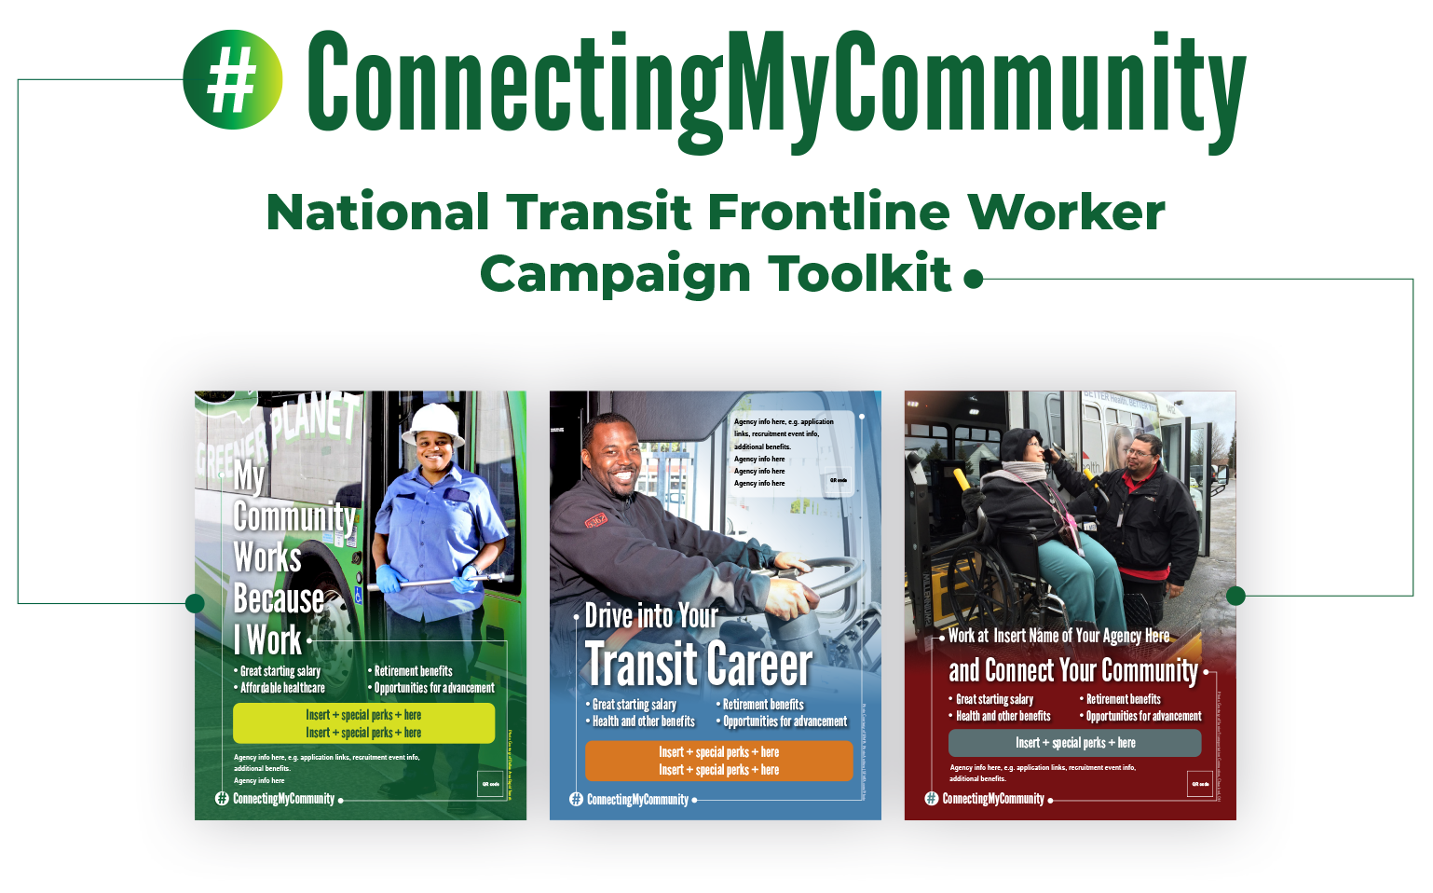

Slide 12
What is the National Transit Frontline Worker Recruitment Campaign Toolkit?
A central repository of:
Recruitment toolkit
+
+
+
=
Sample marketing materials
Effective strategies
Background research and reports
Connections

Slide 13

Thank You!
Jack Clark
Executive Director
jclark@transportcenter.org
www.transitworkforce.org

