Slide 1

Reframing Transit:
Increasing Ridership and Public Engagement

Slide 2

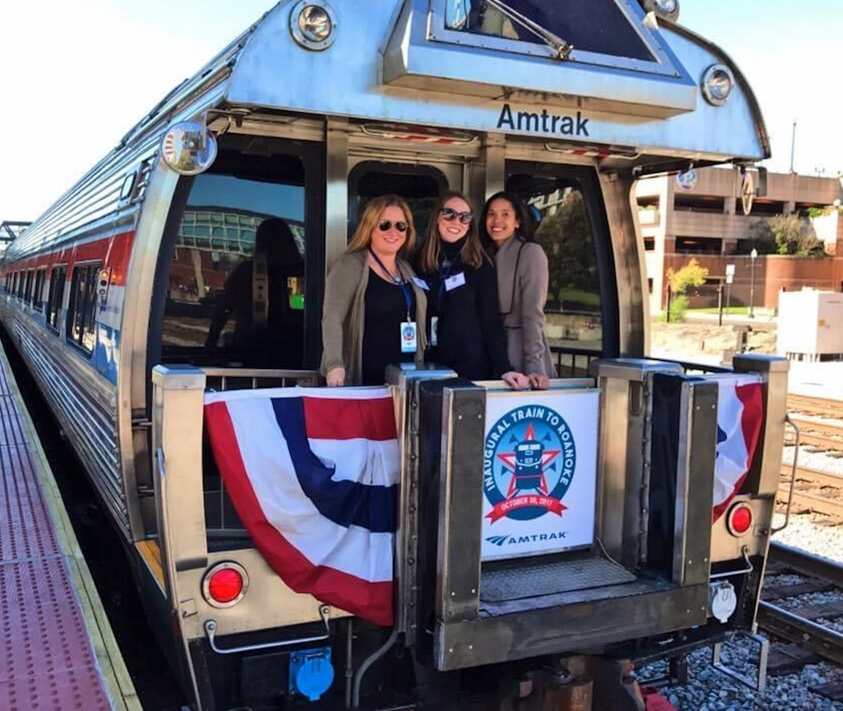
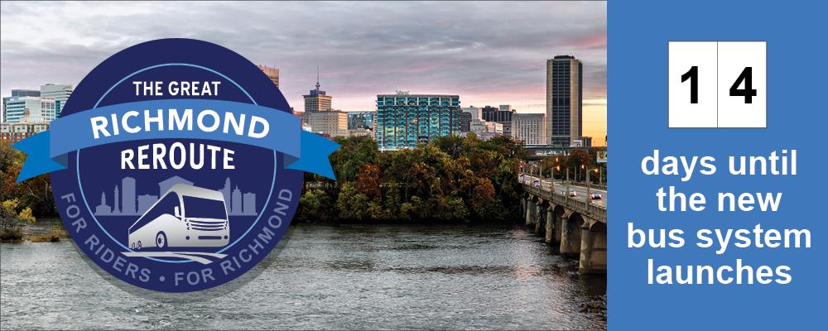
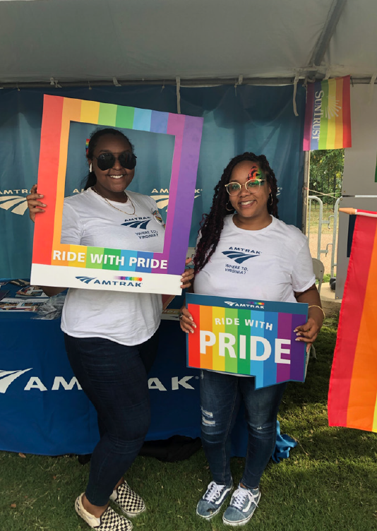
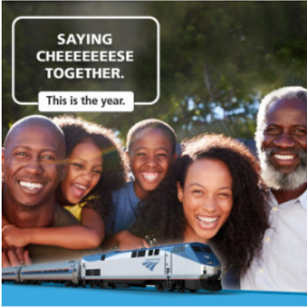
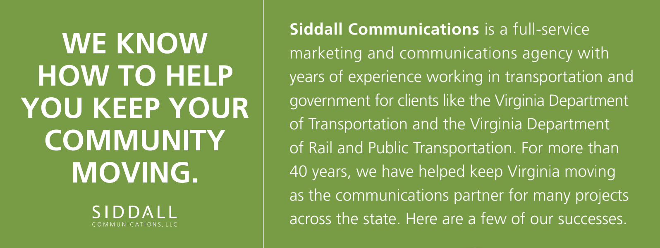
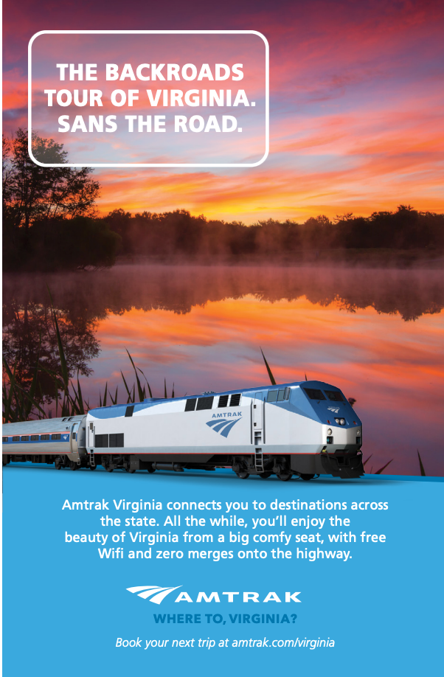
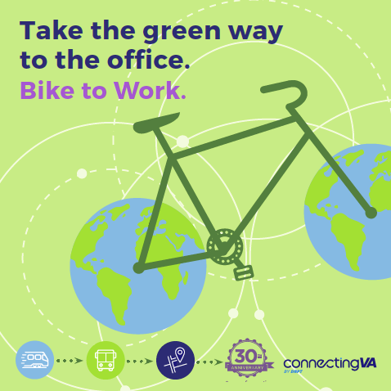
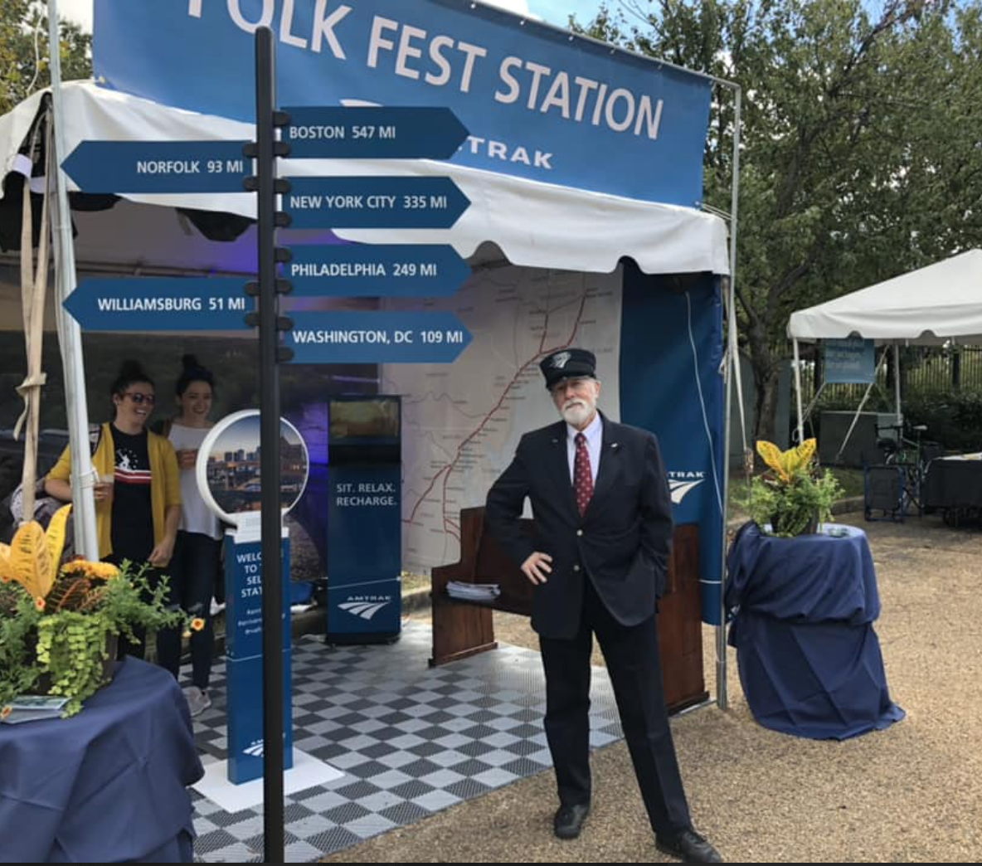

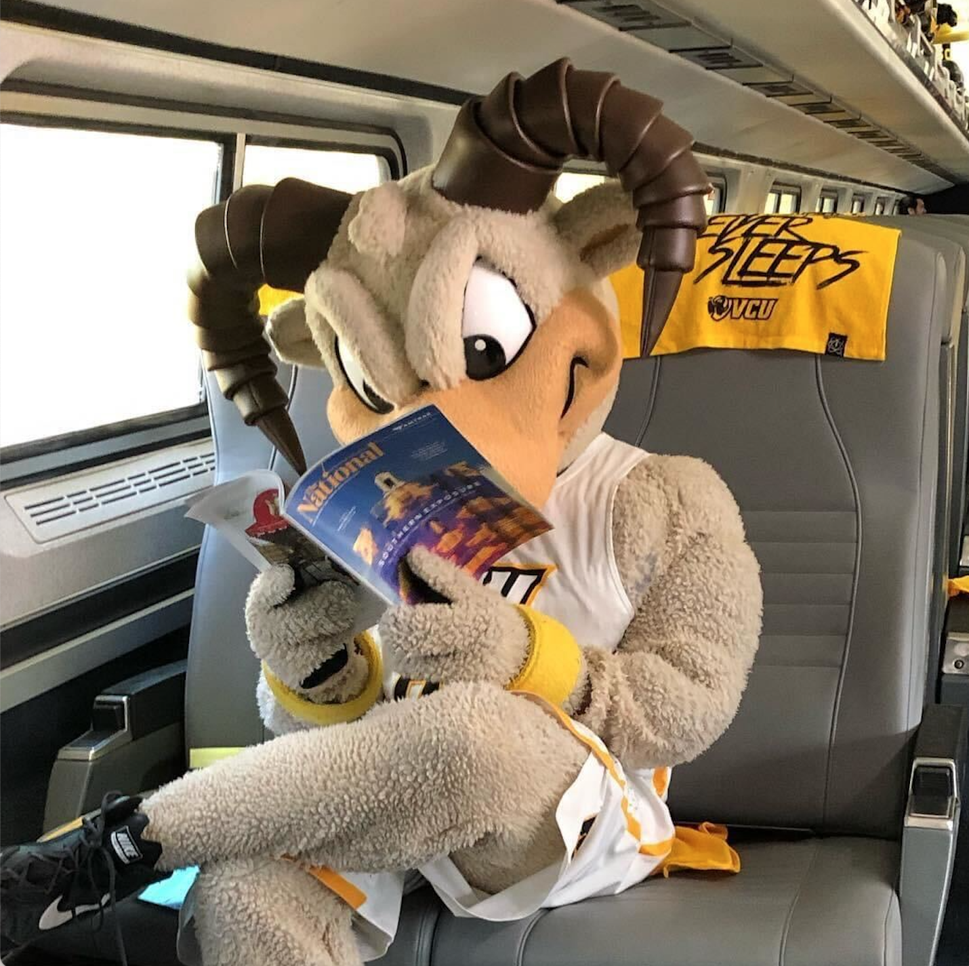

Slide 3
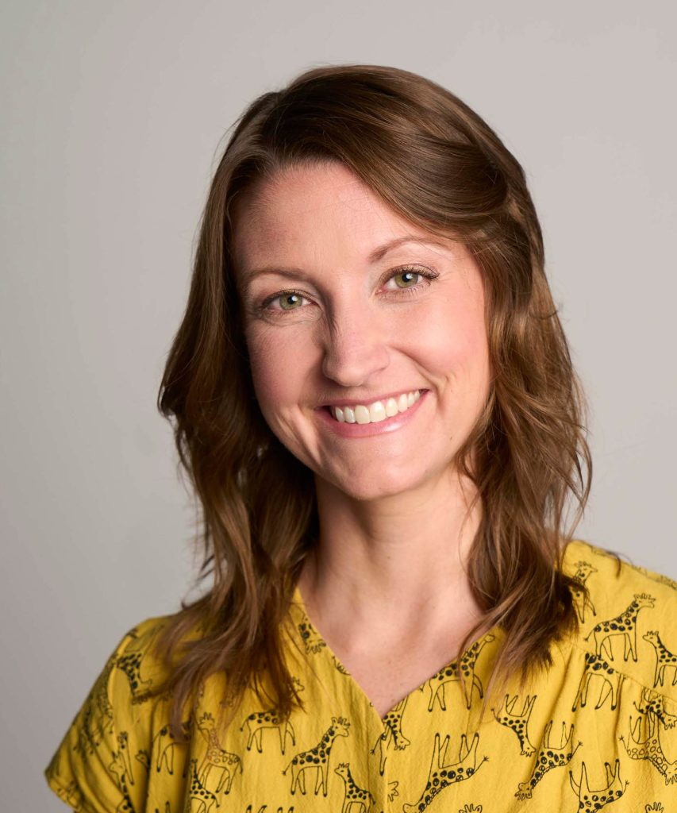
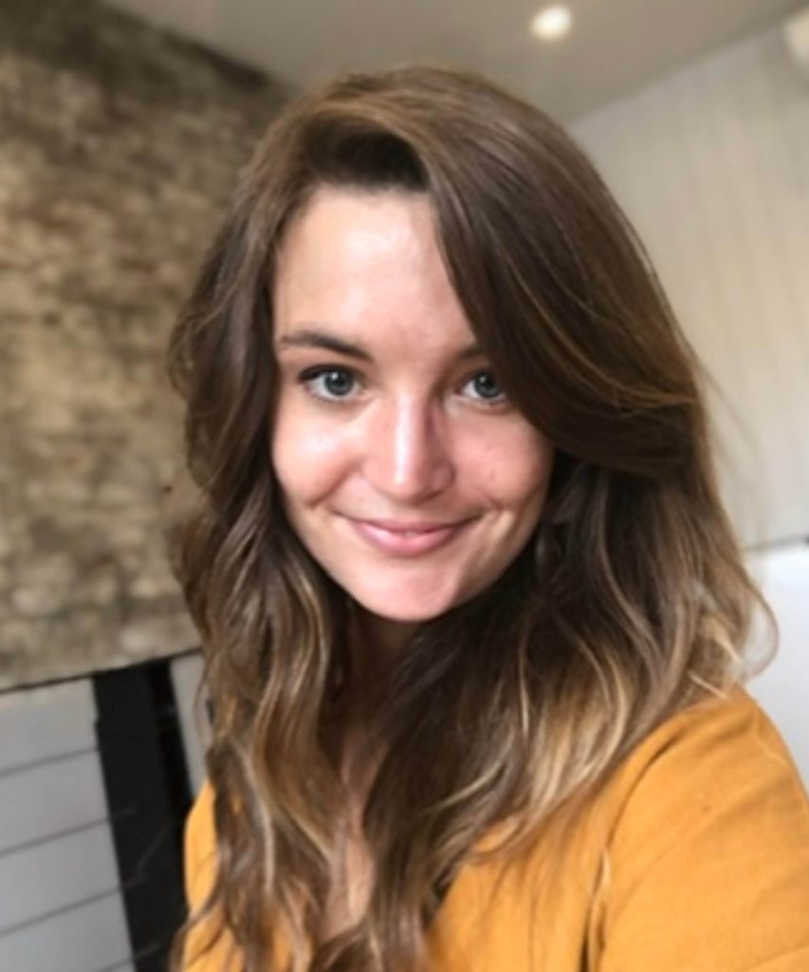
Today’s Presenters
Courtney Standerfer
Kelley Deegan

Slide 4
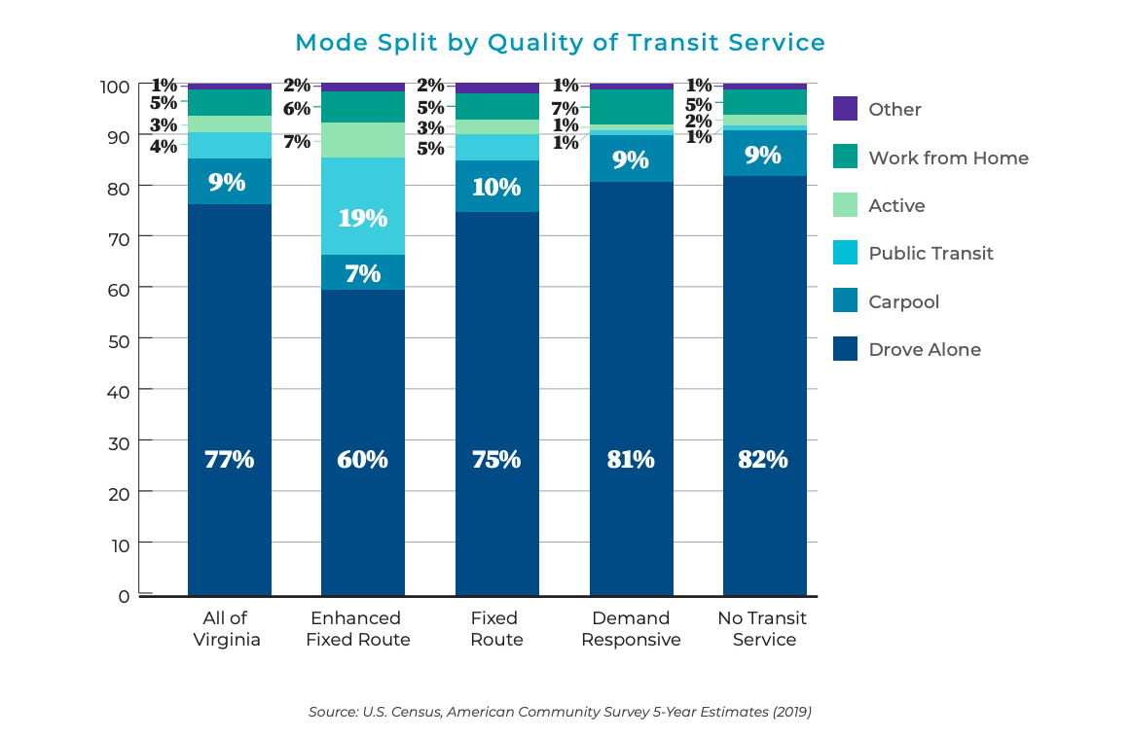
Transit is profitable, eco-friendly, safer than driving, and keeps congestion off our roads
VA Transit
  14.6 Millions of gas saves
  1.1 Billion passenger miles off our roads
Chances of being involved in a crash decreases by more than 90% when taking public transit versus driving
Yet 80% of Virginia workers drive to work alone

Slide 5
Public Transit Challenges
Comfort zones and aversion to change:
  Unfamiliarity with overall transit options and feeling overwhelmed by routes often stops people before they get started
Commute Challenges:
  COVID-related changes to work patterns like hybrid schedules and WFH options have changed commuting patterns, especially for white-collar workers
  Public Transit can feel cumbersome and time-intensive for those used to driving, even if time spent on transit is more productive
Control:
  Transit delays are frustrating at best and penal at worst
Capabilities:
  We live in a car centric culture that makes driving easy and transit difficult outside of larger cities and transit hubs – both infrastructure and program funding are huge hurdles

Slide 6
So, what do we do?
Start small and meet people where they are
  Use research or surveys to pinpoint needs
  Make it approachable (Bike to work events, try transit, rideshare month etc)
  Tailor messages to right audience: ecofriendly, financial benefits, business/lifestyle commute
Improve Awareness
  Easily navigable websites or additional routing info (google maps, etc)
  Are you on the right platforms and using them correctly?
Incentives
  Contesting
  Free fare promotion or trial periods
Partnerships:
  How can other businesses or prominent figures help you promote transit?
  For rideshares, company buy ins are crucial.

Slide 7
Research Best Practices

Slide 8
GRTC Case Study
If people believe that you will deliver a service that helps others and the community at large, they are more likely to be supportive. Connecting directly with the community is key.
Effective communications mitigate these risks, research is essential.
Best practices
  Don’t be afraid to do something non-traditional
  Make it quick and easy for survey participants to respond
  Ensure questions are phrased properly

Slide 9
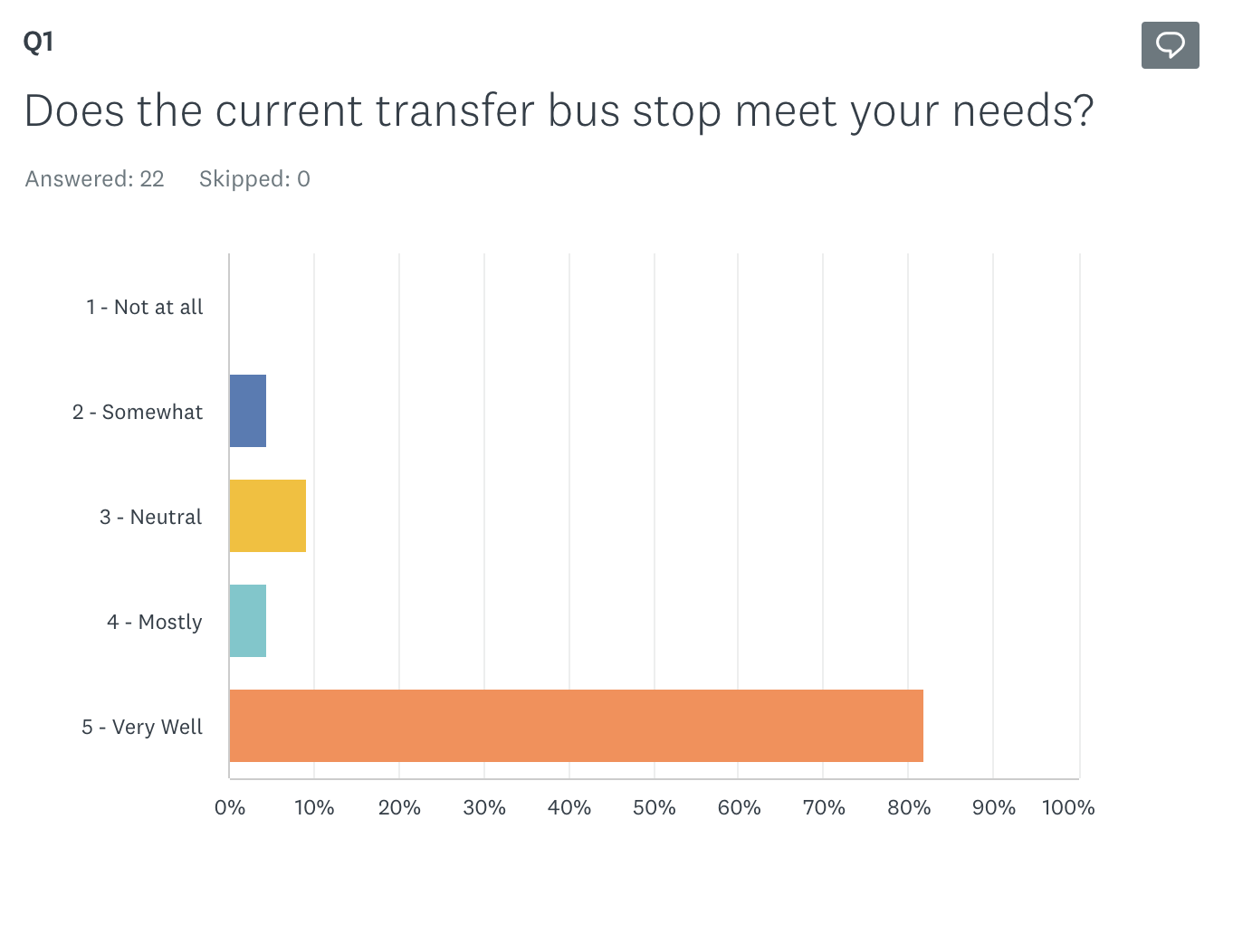
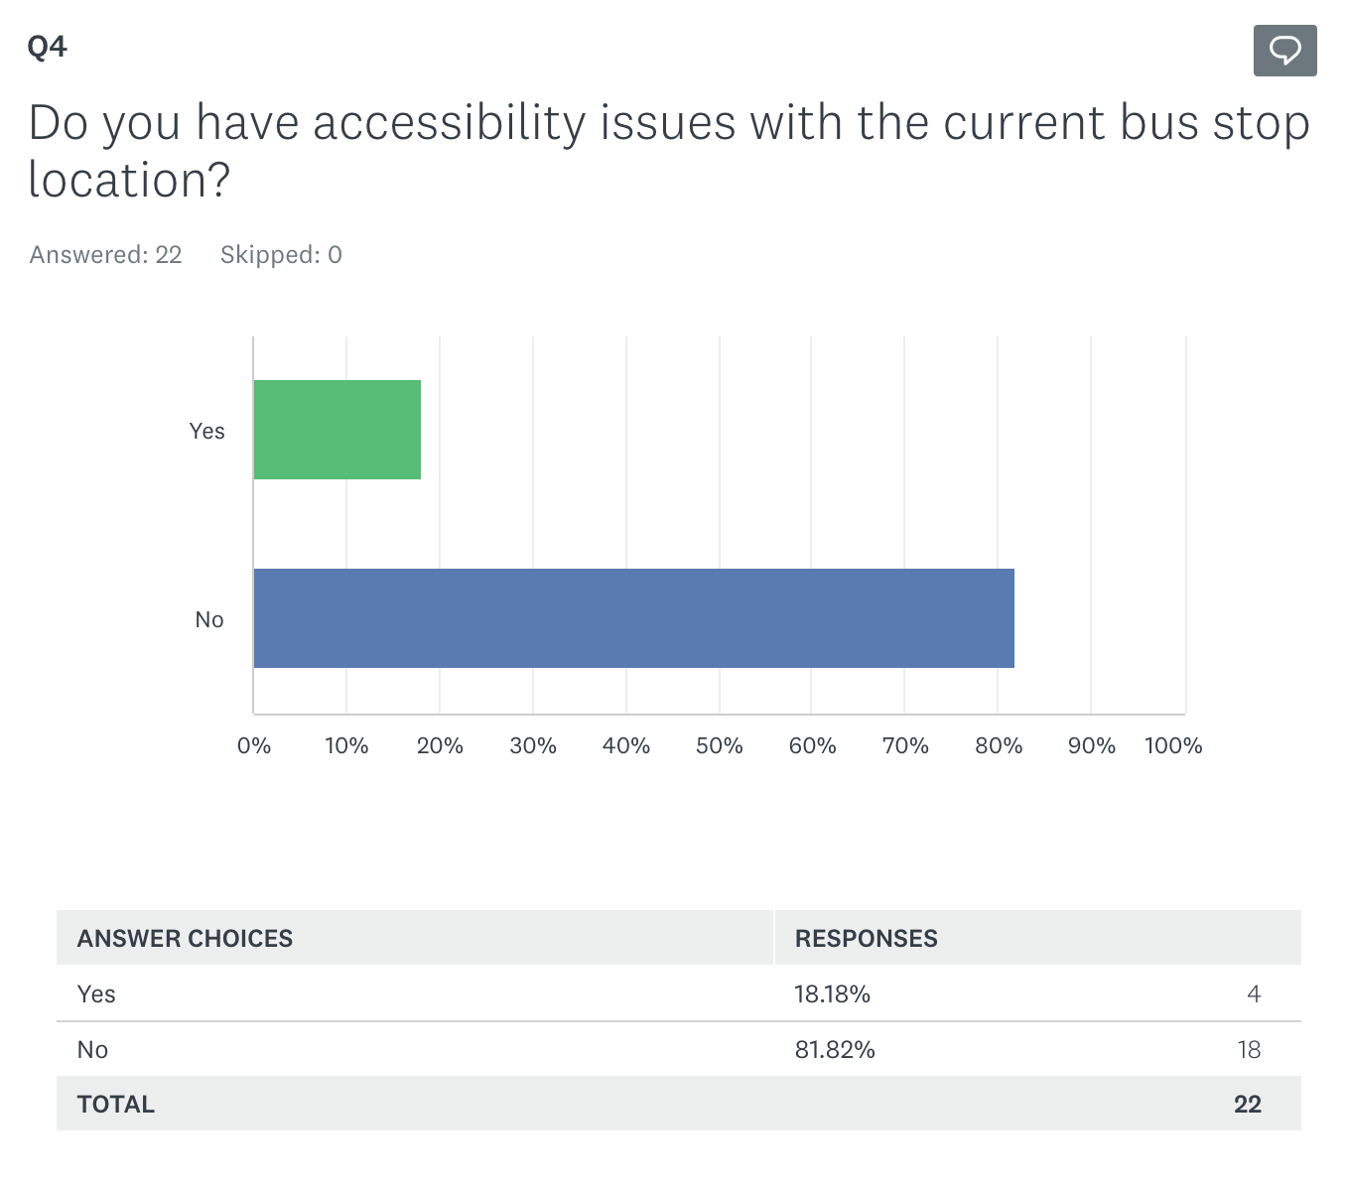
Same response, different narratives

Slide 10
Creating a Strategic Marketing Plan

Slide 11
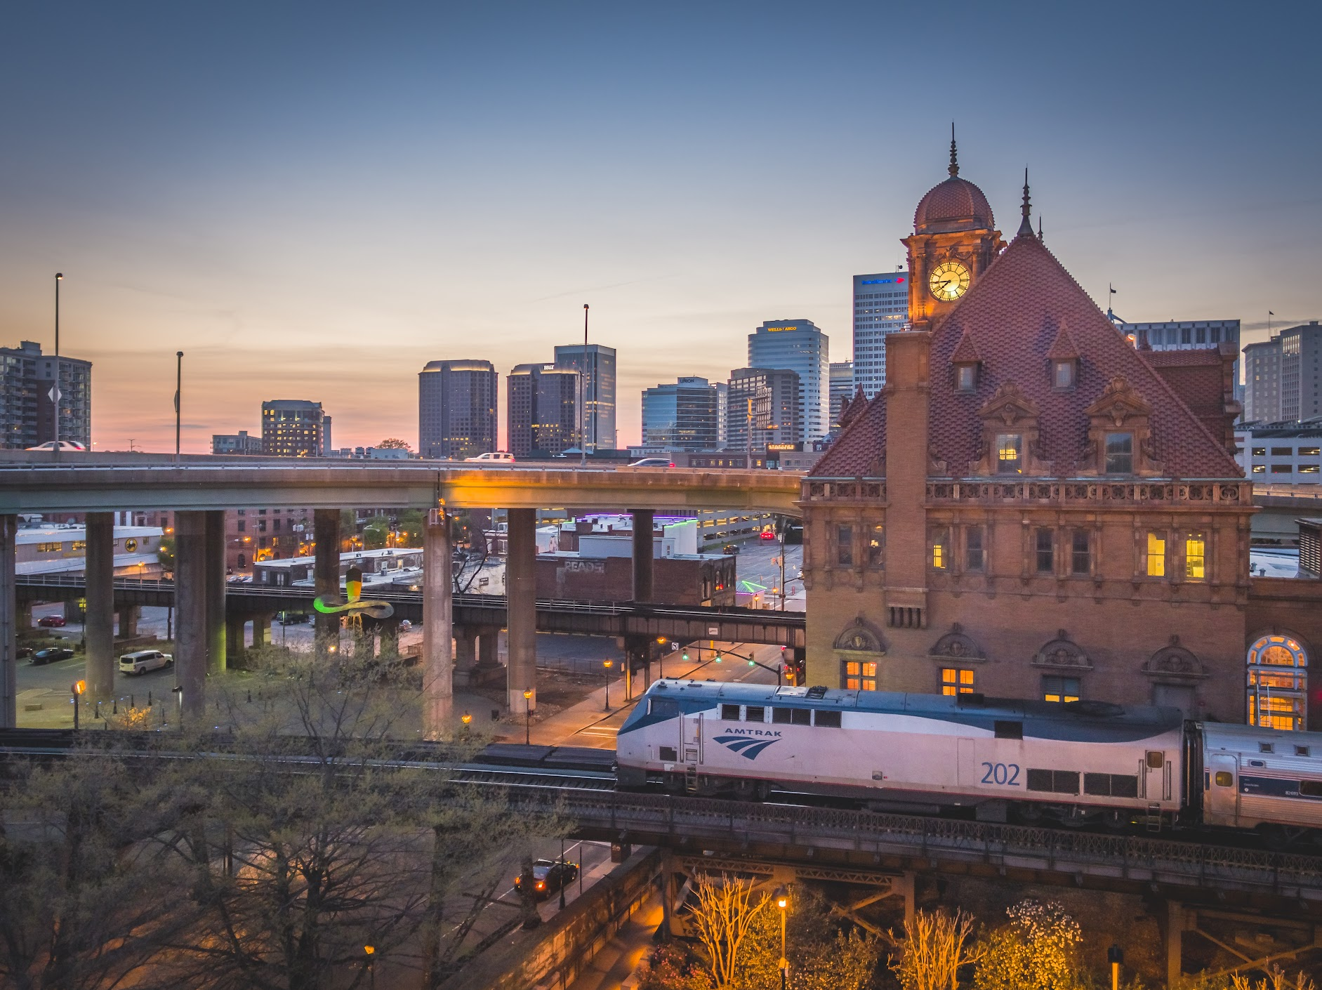

Amtrak Case Study
Back in 2018, Amtrak research showed that ticket pricing was a customer perception preventing train travel.
Additional insights revealed that unfamiliarity with train travel, lack of awareness of destinations and routes, and the benefits of train travel over flying or driving were also key factors.
In March 2023, Amtrak reached it’s highest historical ridership on record.

Slide 12
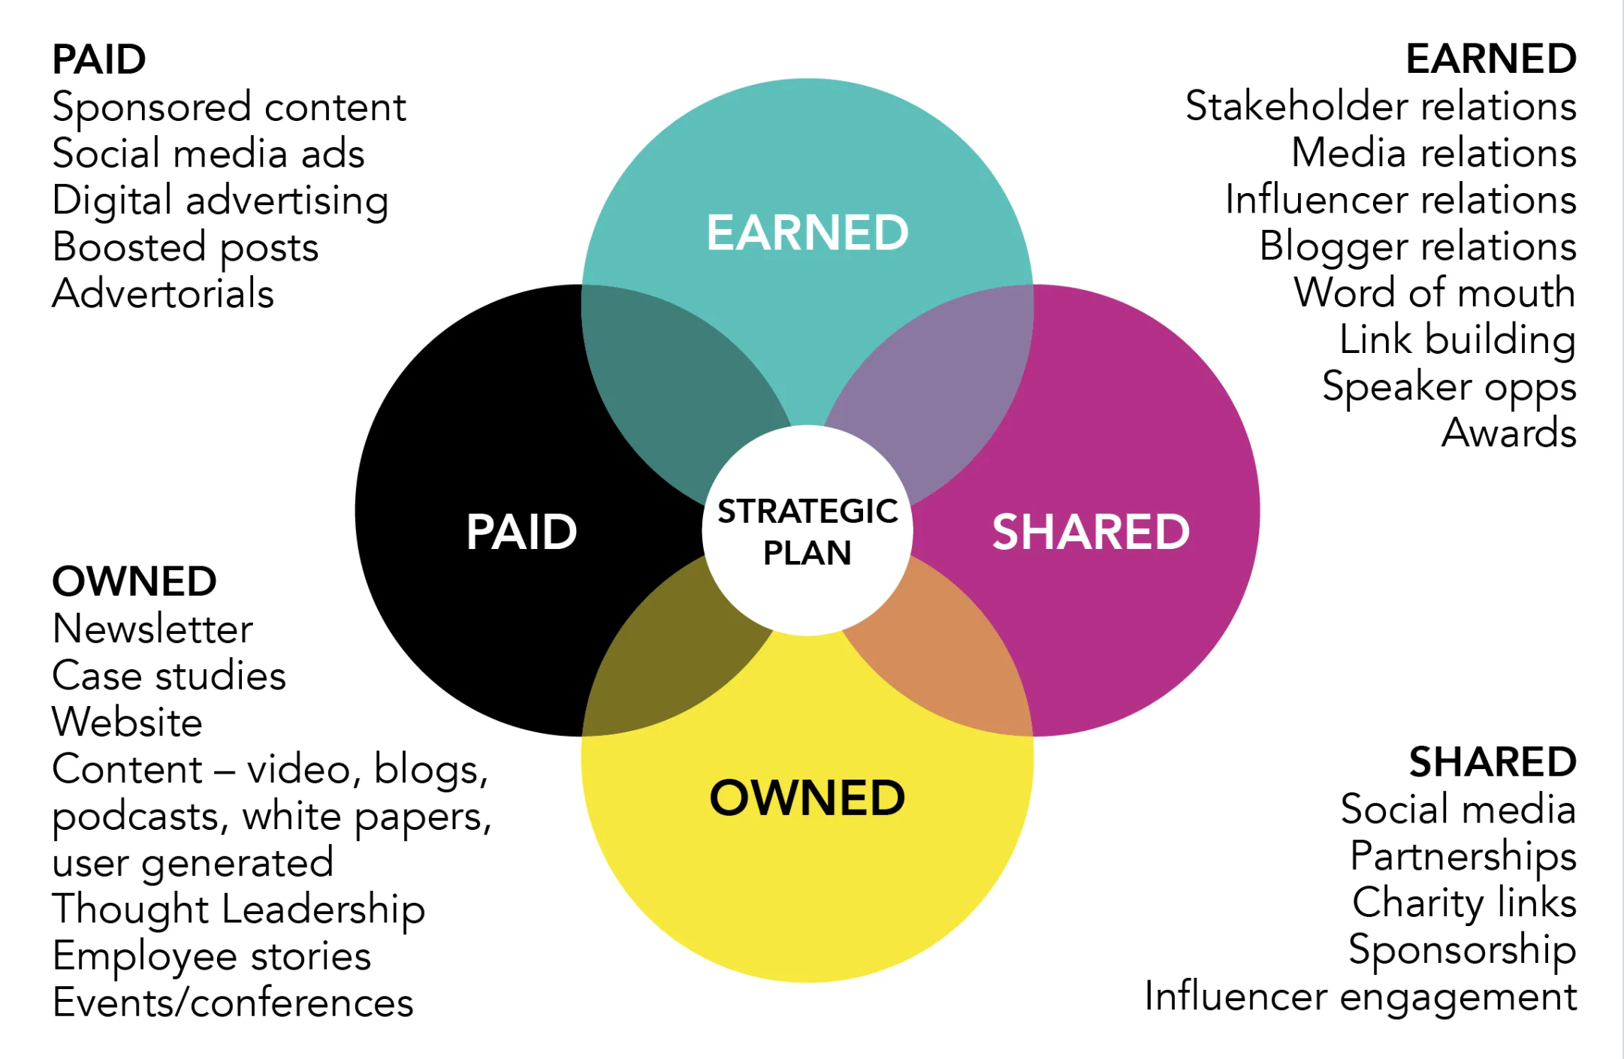
Optimize all media “buckets”

Slide 13
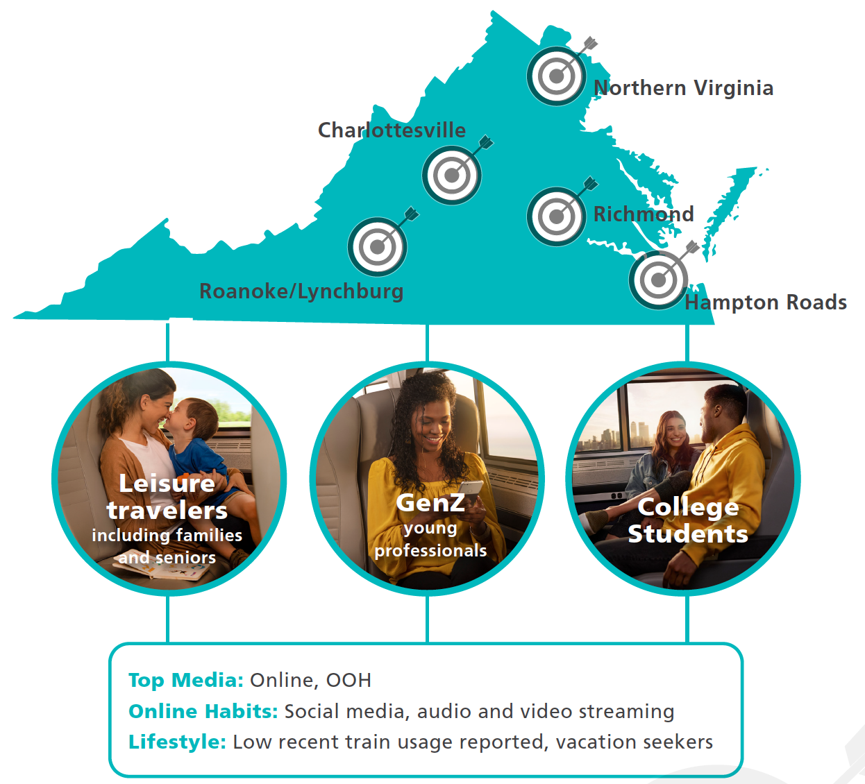
Paid Media
Amtrak VA’s paid media typically focuses on key customers with specific, relevant messaging – primarily discount fares & promotional pricing.
We focus on Business travelers, Leisure travelers - including families, seniors, and adventure travelers – and College Students who attend the vast number of campuses across the commonwealth.

Slide 14
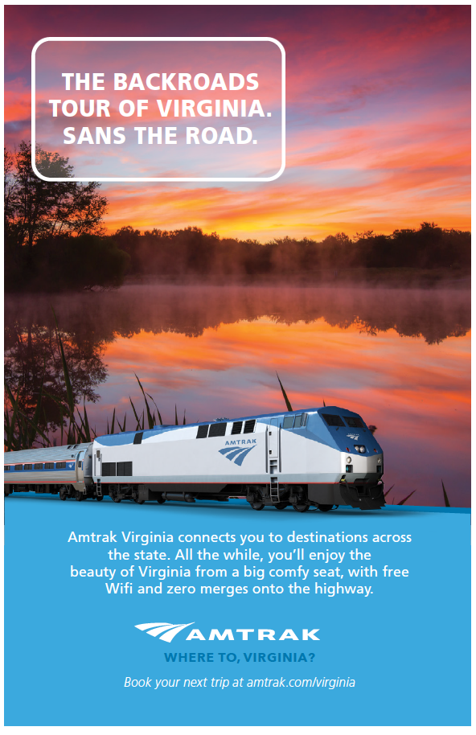

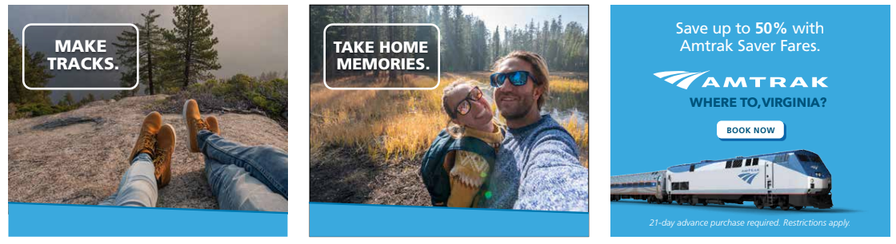
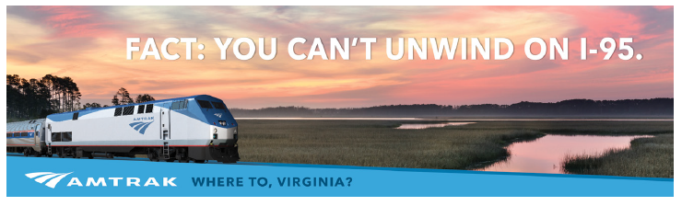
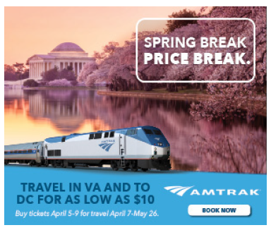
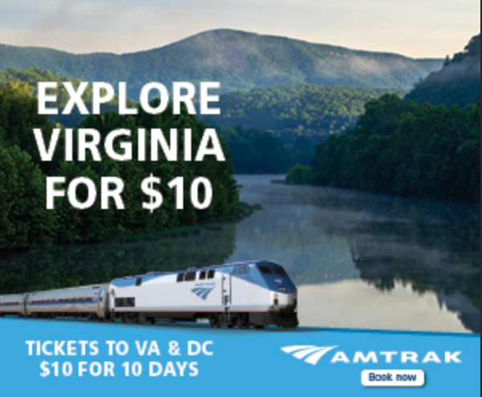
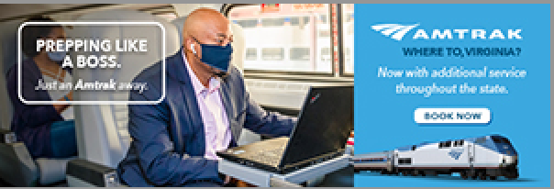
Paid Media

Slide 15
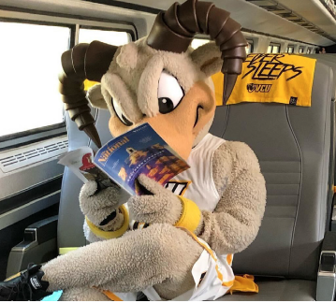
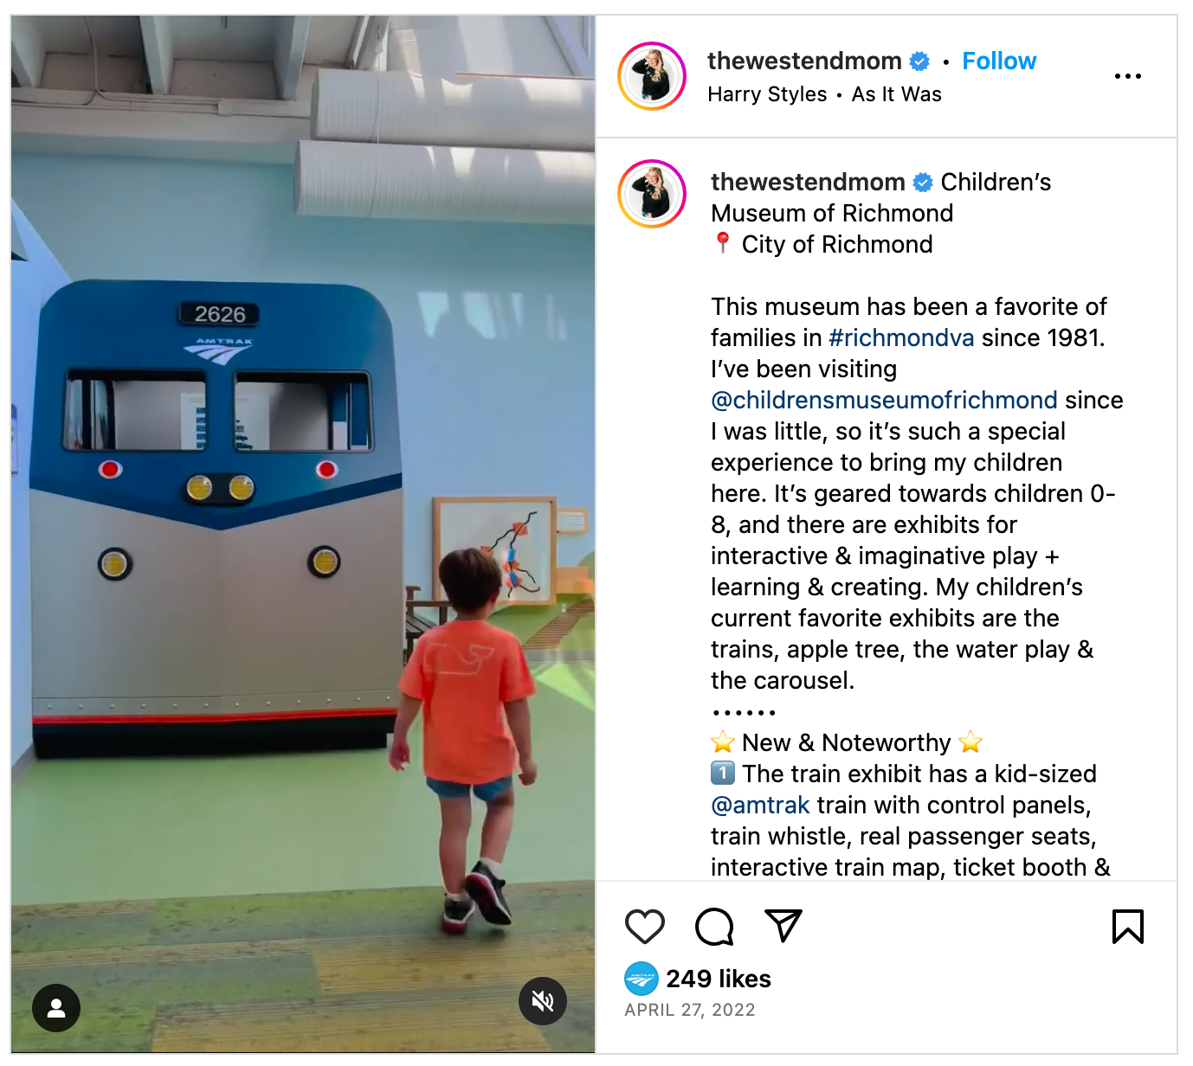
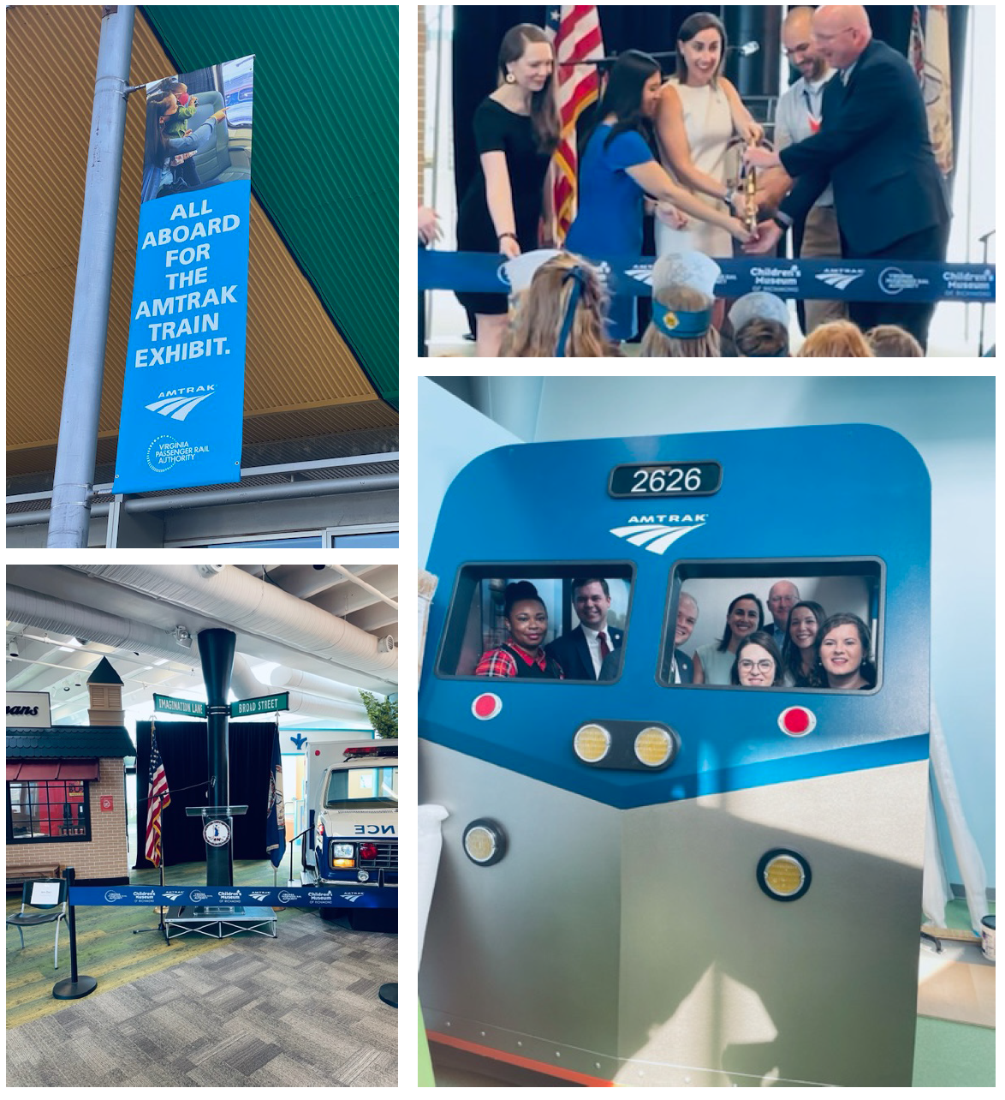
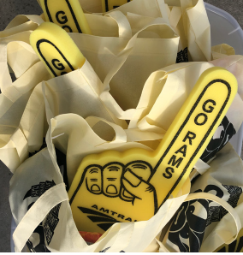
Earned Media
2 of the top Earned Media Opportunities in the past few years:
2019 Ram Car to Brooklyn for the A-10 tournament
  4 million earned impressions
  Sold-out trains & 15% increase in ridership over the previous year
  3 PRSA Richmond Awards
2022 Children’s Museum Of Richmond Exhibit
  Educational, interactive, and FUN installation promoting benefits of rail in Virginia.
  Additionally promotes children’s discount

Slide 16
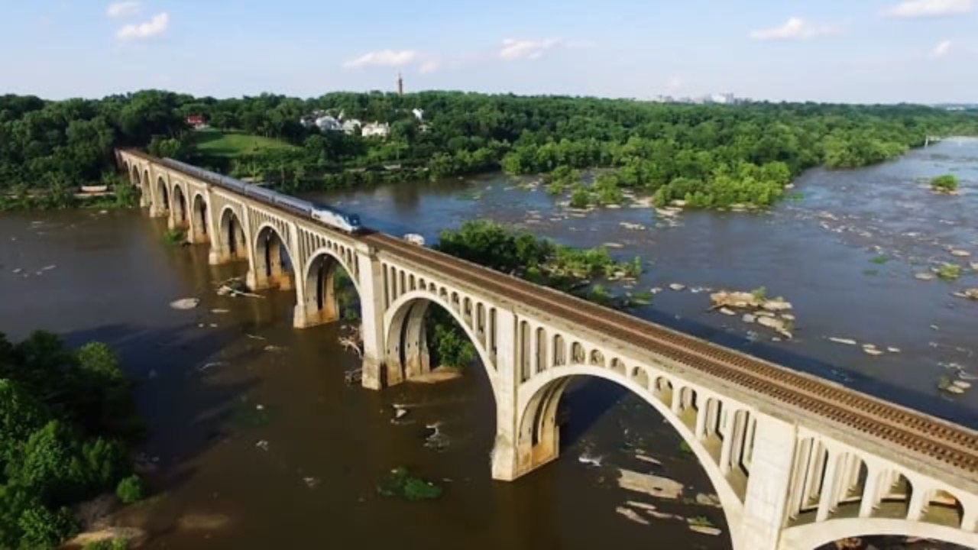
Notes:
Earned media continued…..

Slide 17
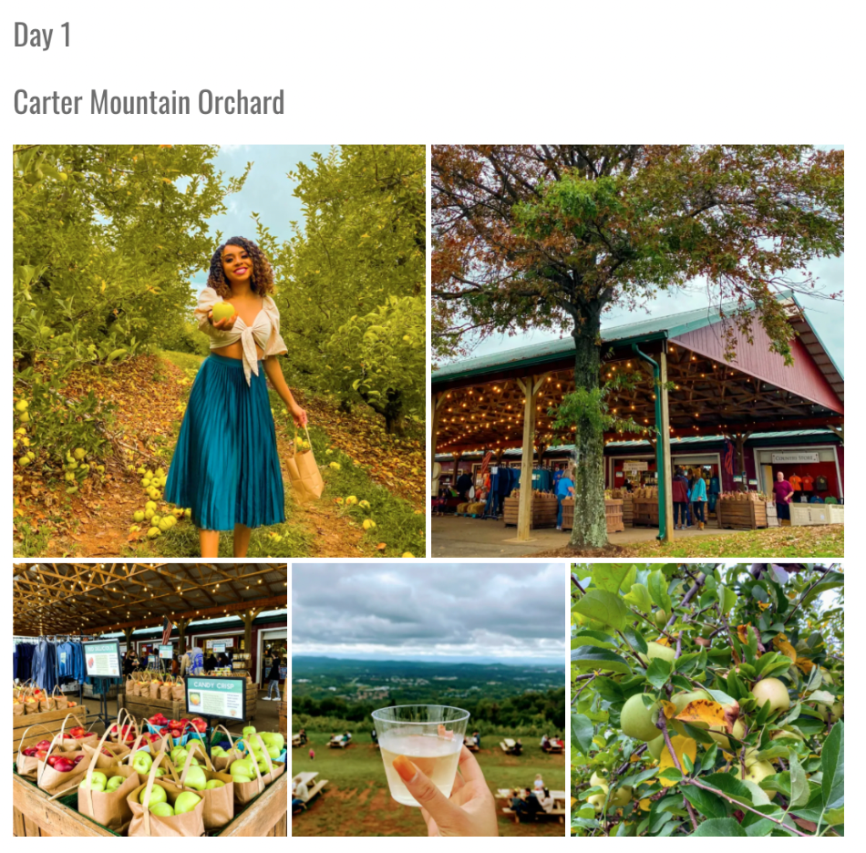
Shared Media
One of the largest initiatives for 2021-2023 has been increasing our influencer outreach in which we collaborate with high-profile individuals to extend the reach of our content.
  2021: Launch of Blogger Ambassador program:
    we work with local tourism organizations to create custom itineraries and experiences to destinations along our routes
    We have won multiple PRSA awards for this program
  2023: Launch of Name, Image, Likeness (NIL) partnership with VCU Basketball player Adrian (Ace) Baldwin, Jr.
  Continuation of community-based sponsorship events

Slide 18
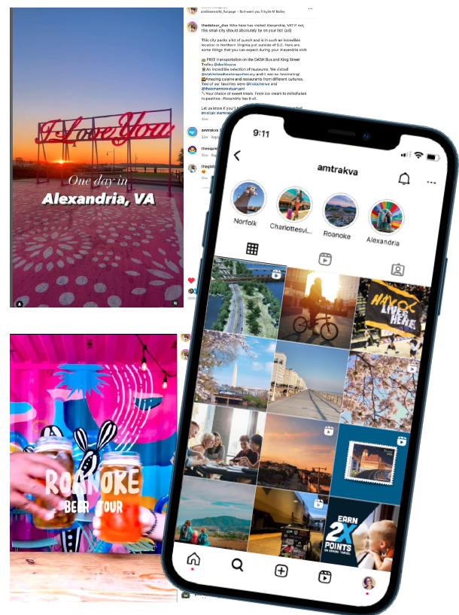
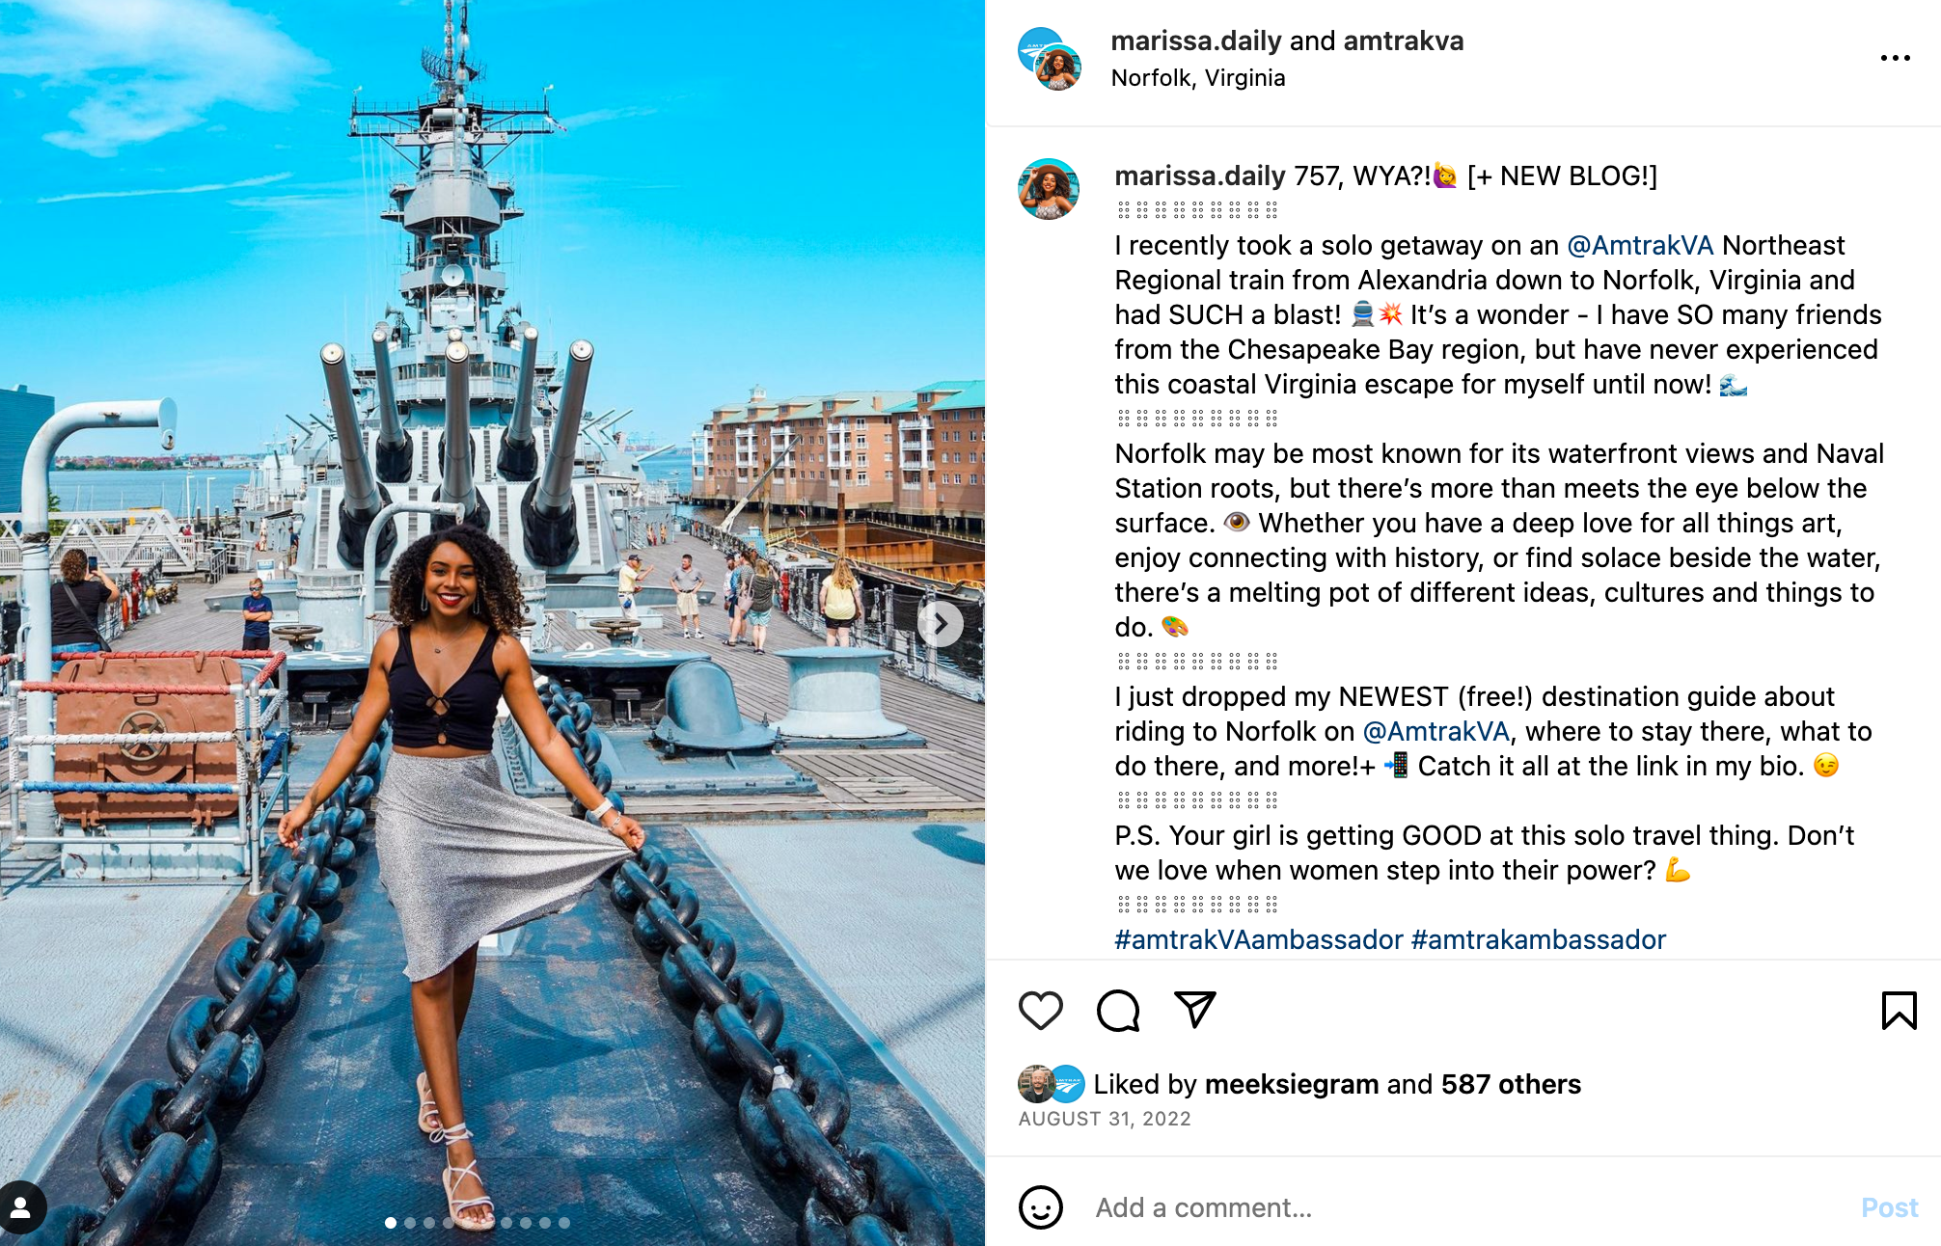
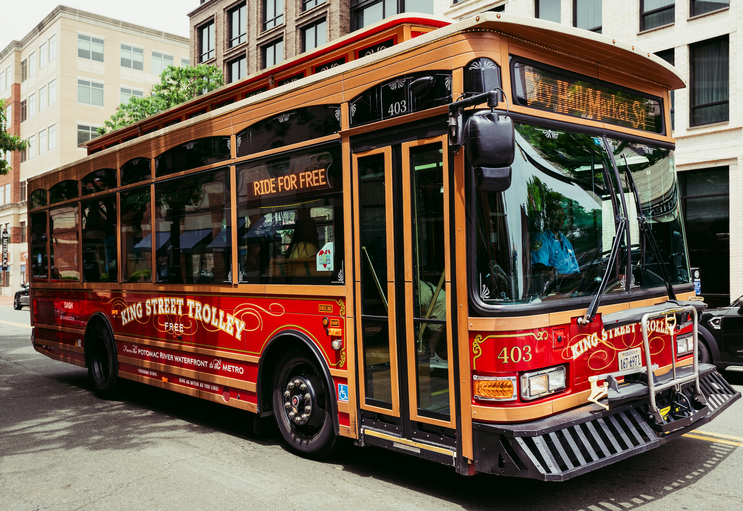
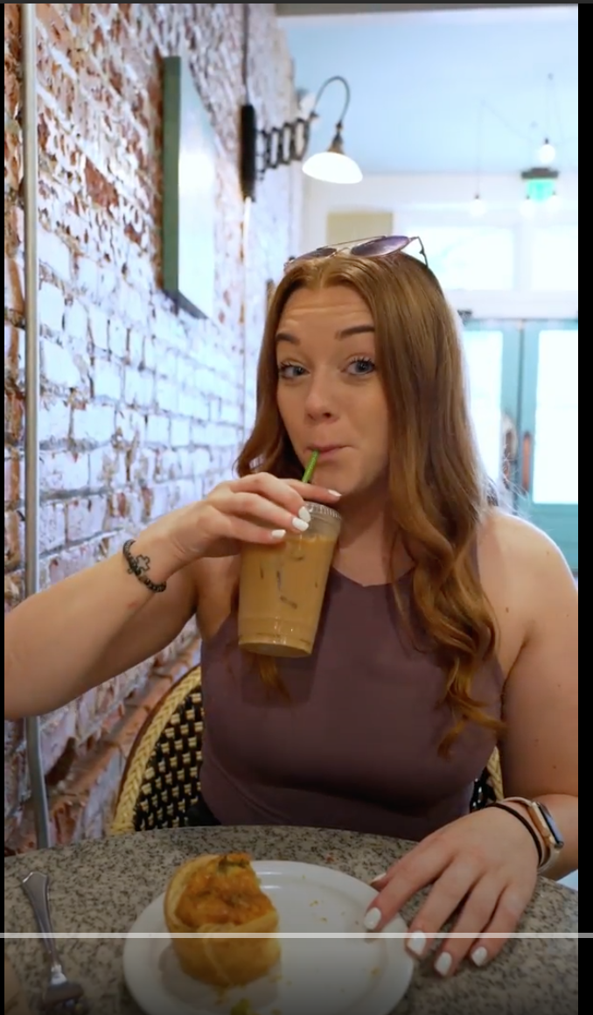
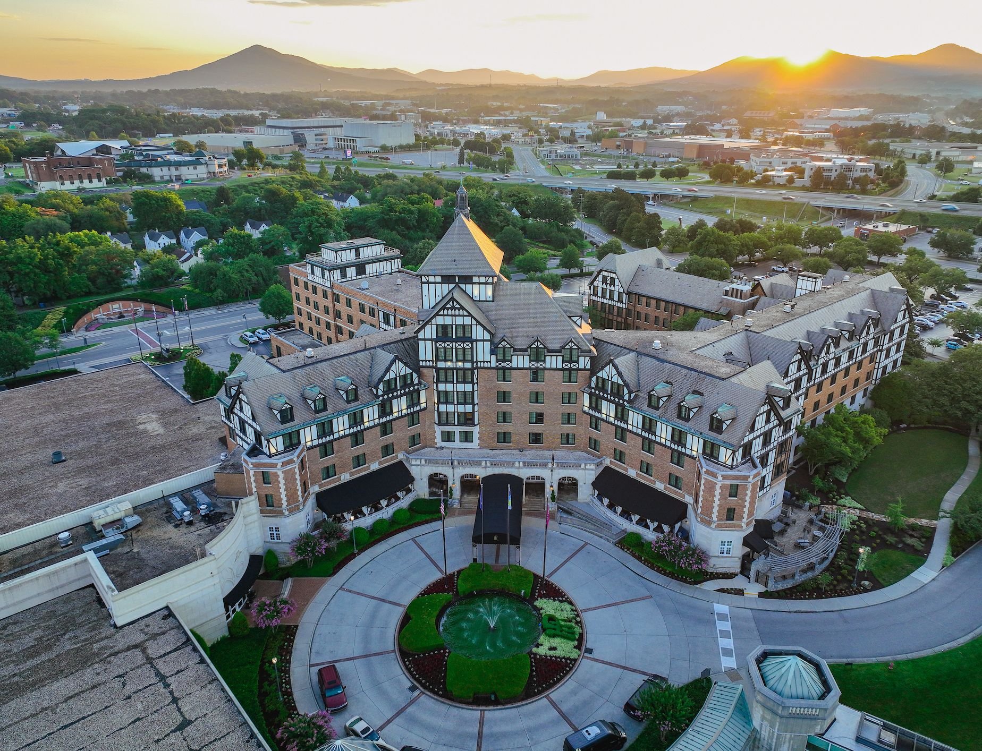

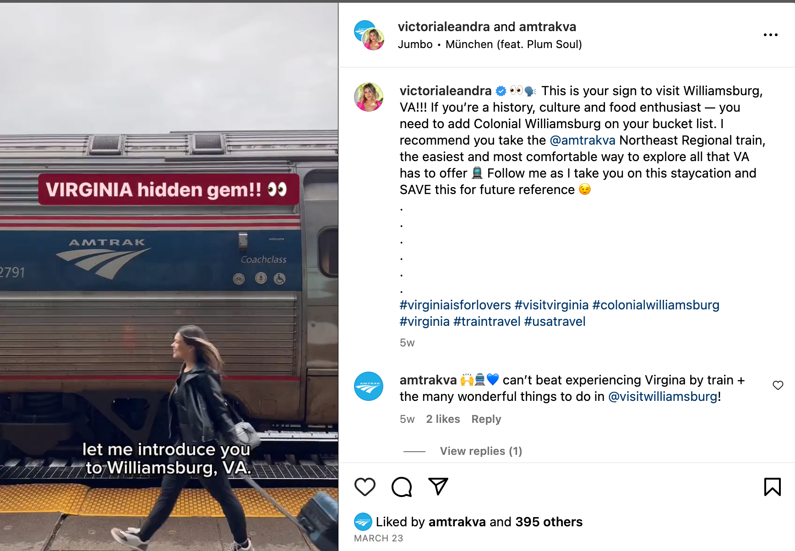
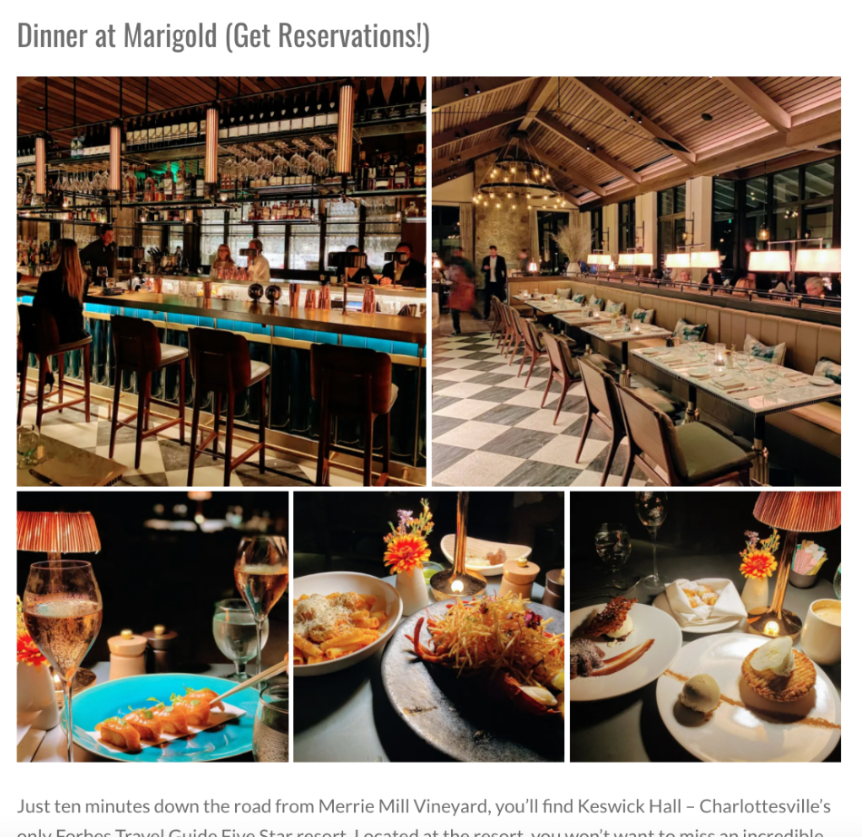
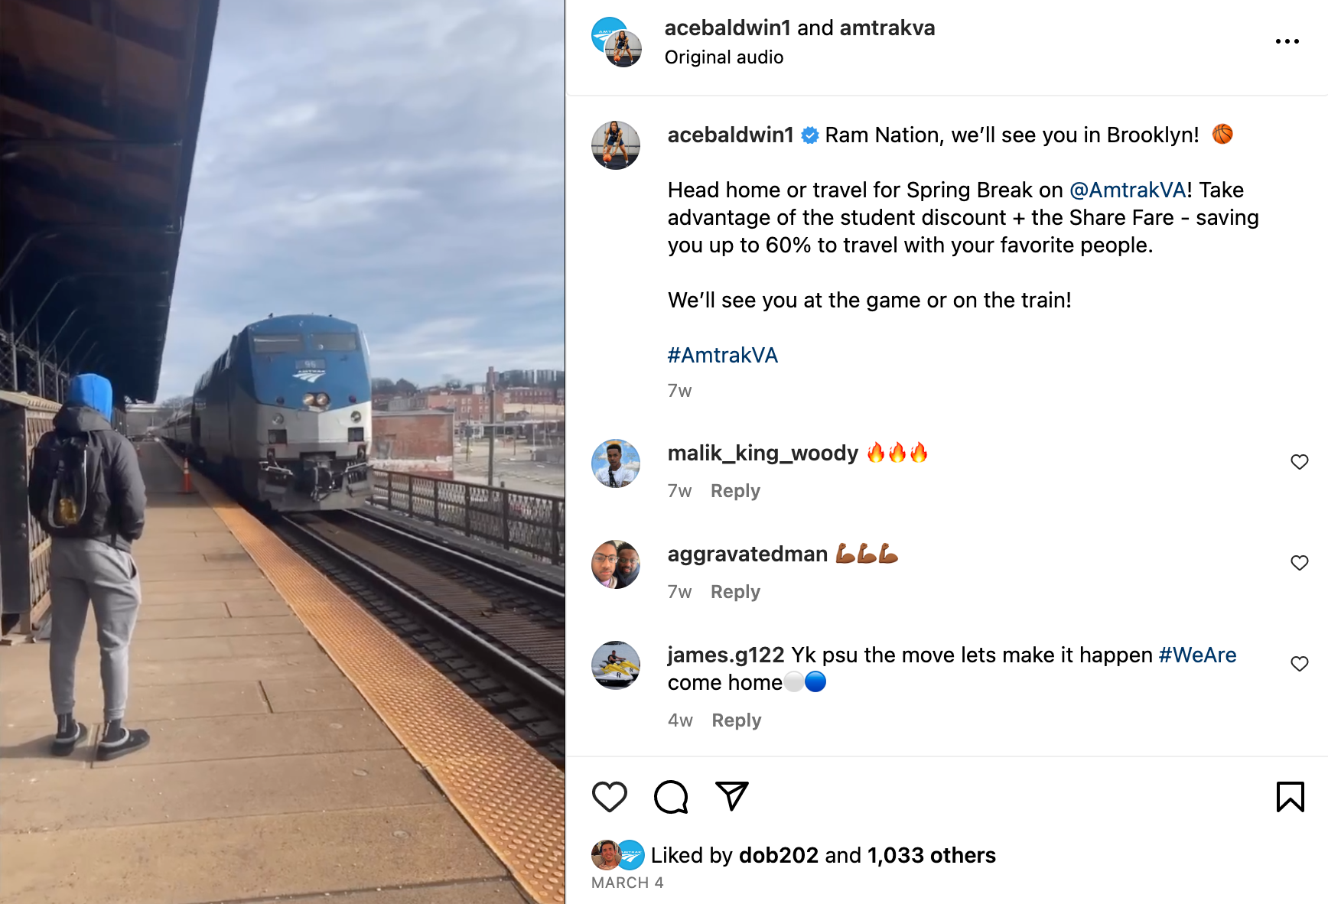
Shared Media

Slide 19
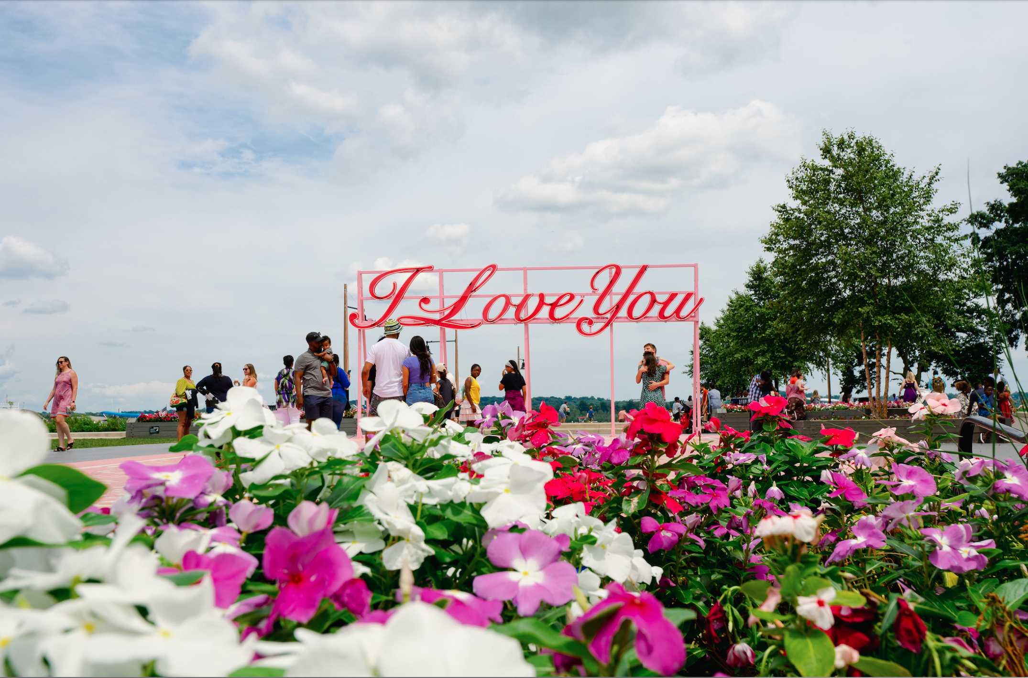
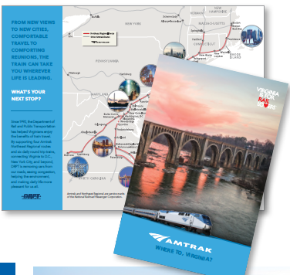
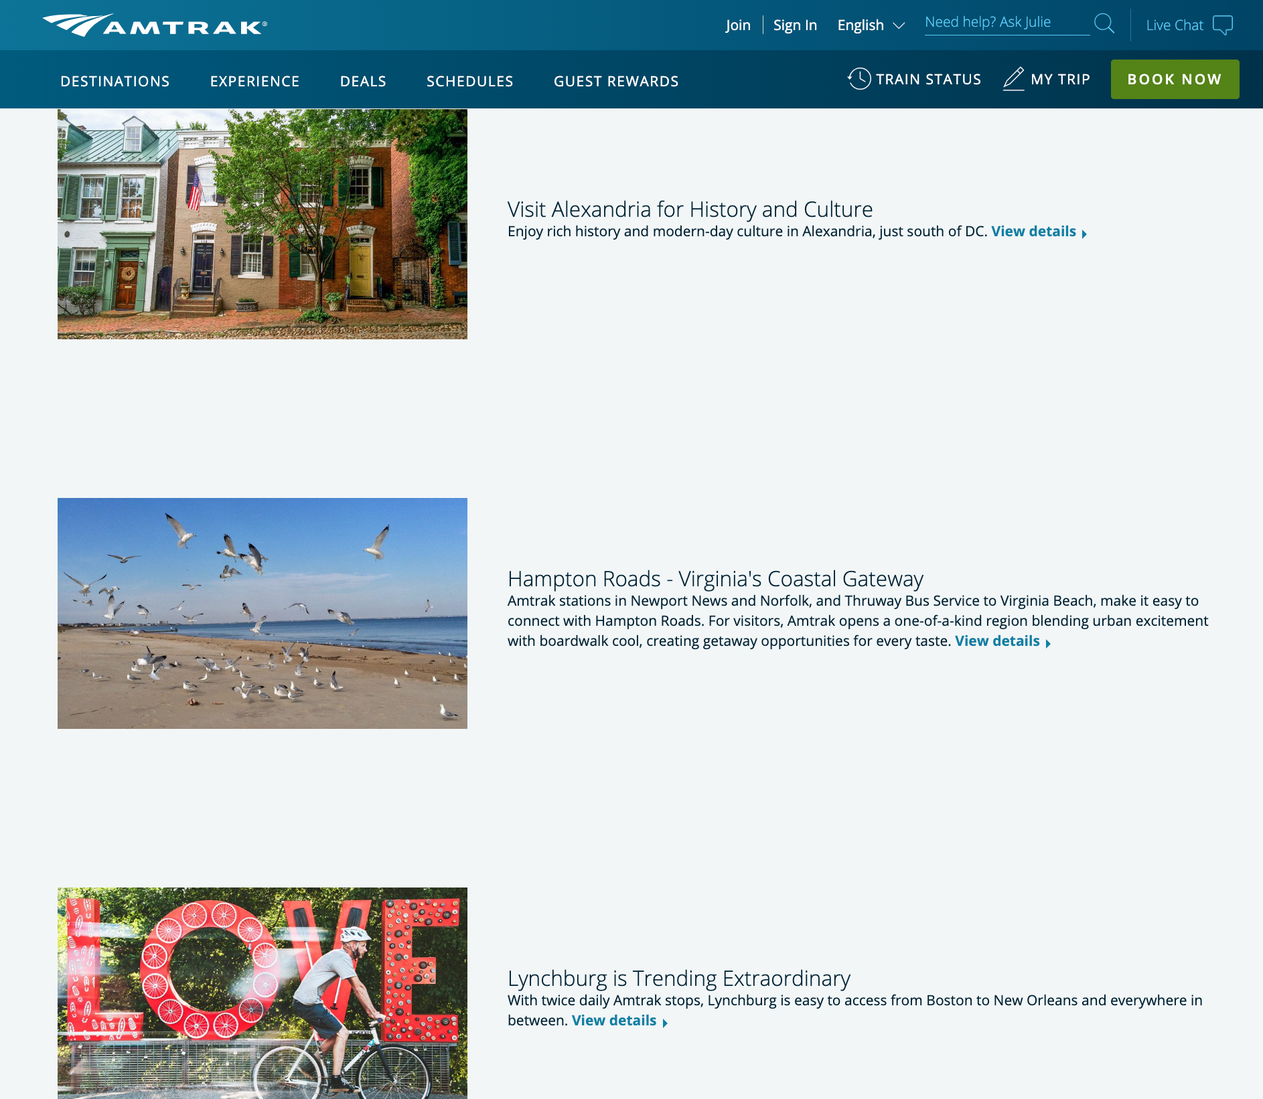
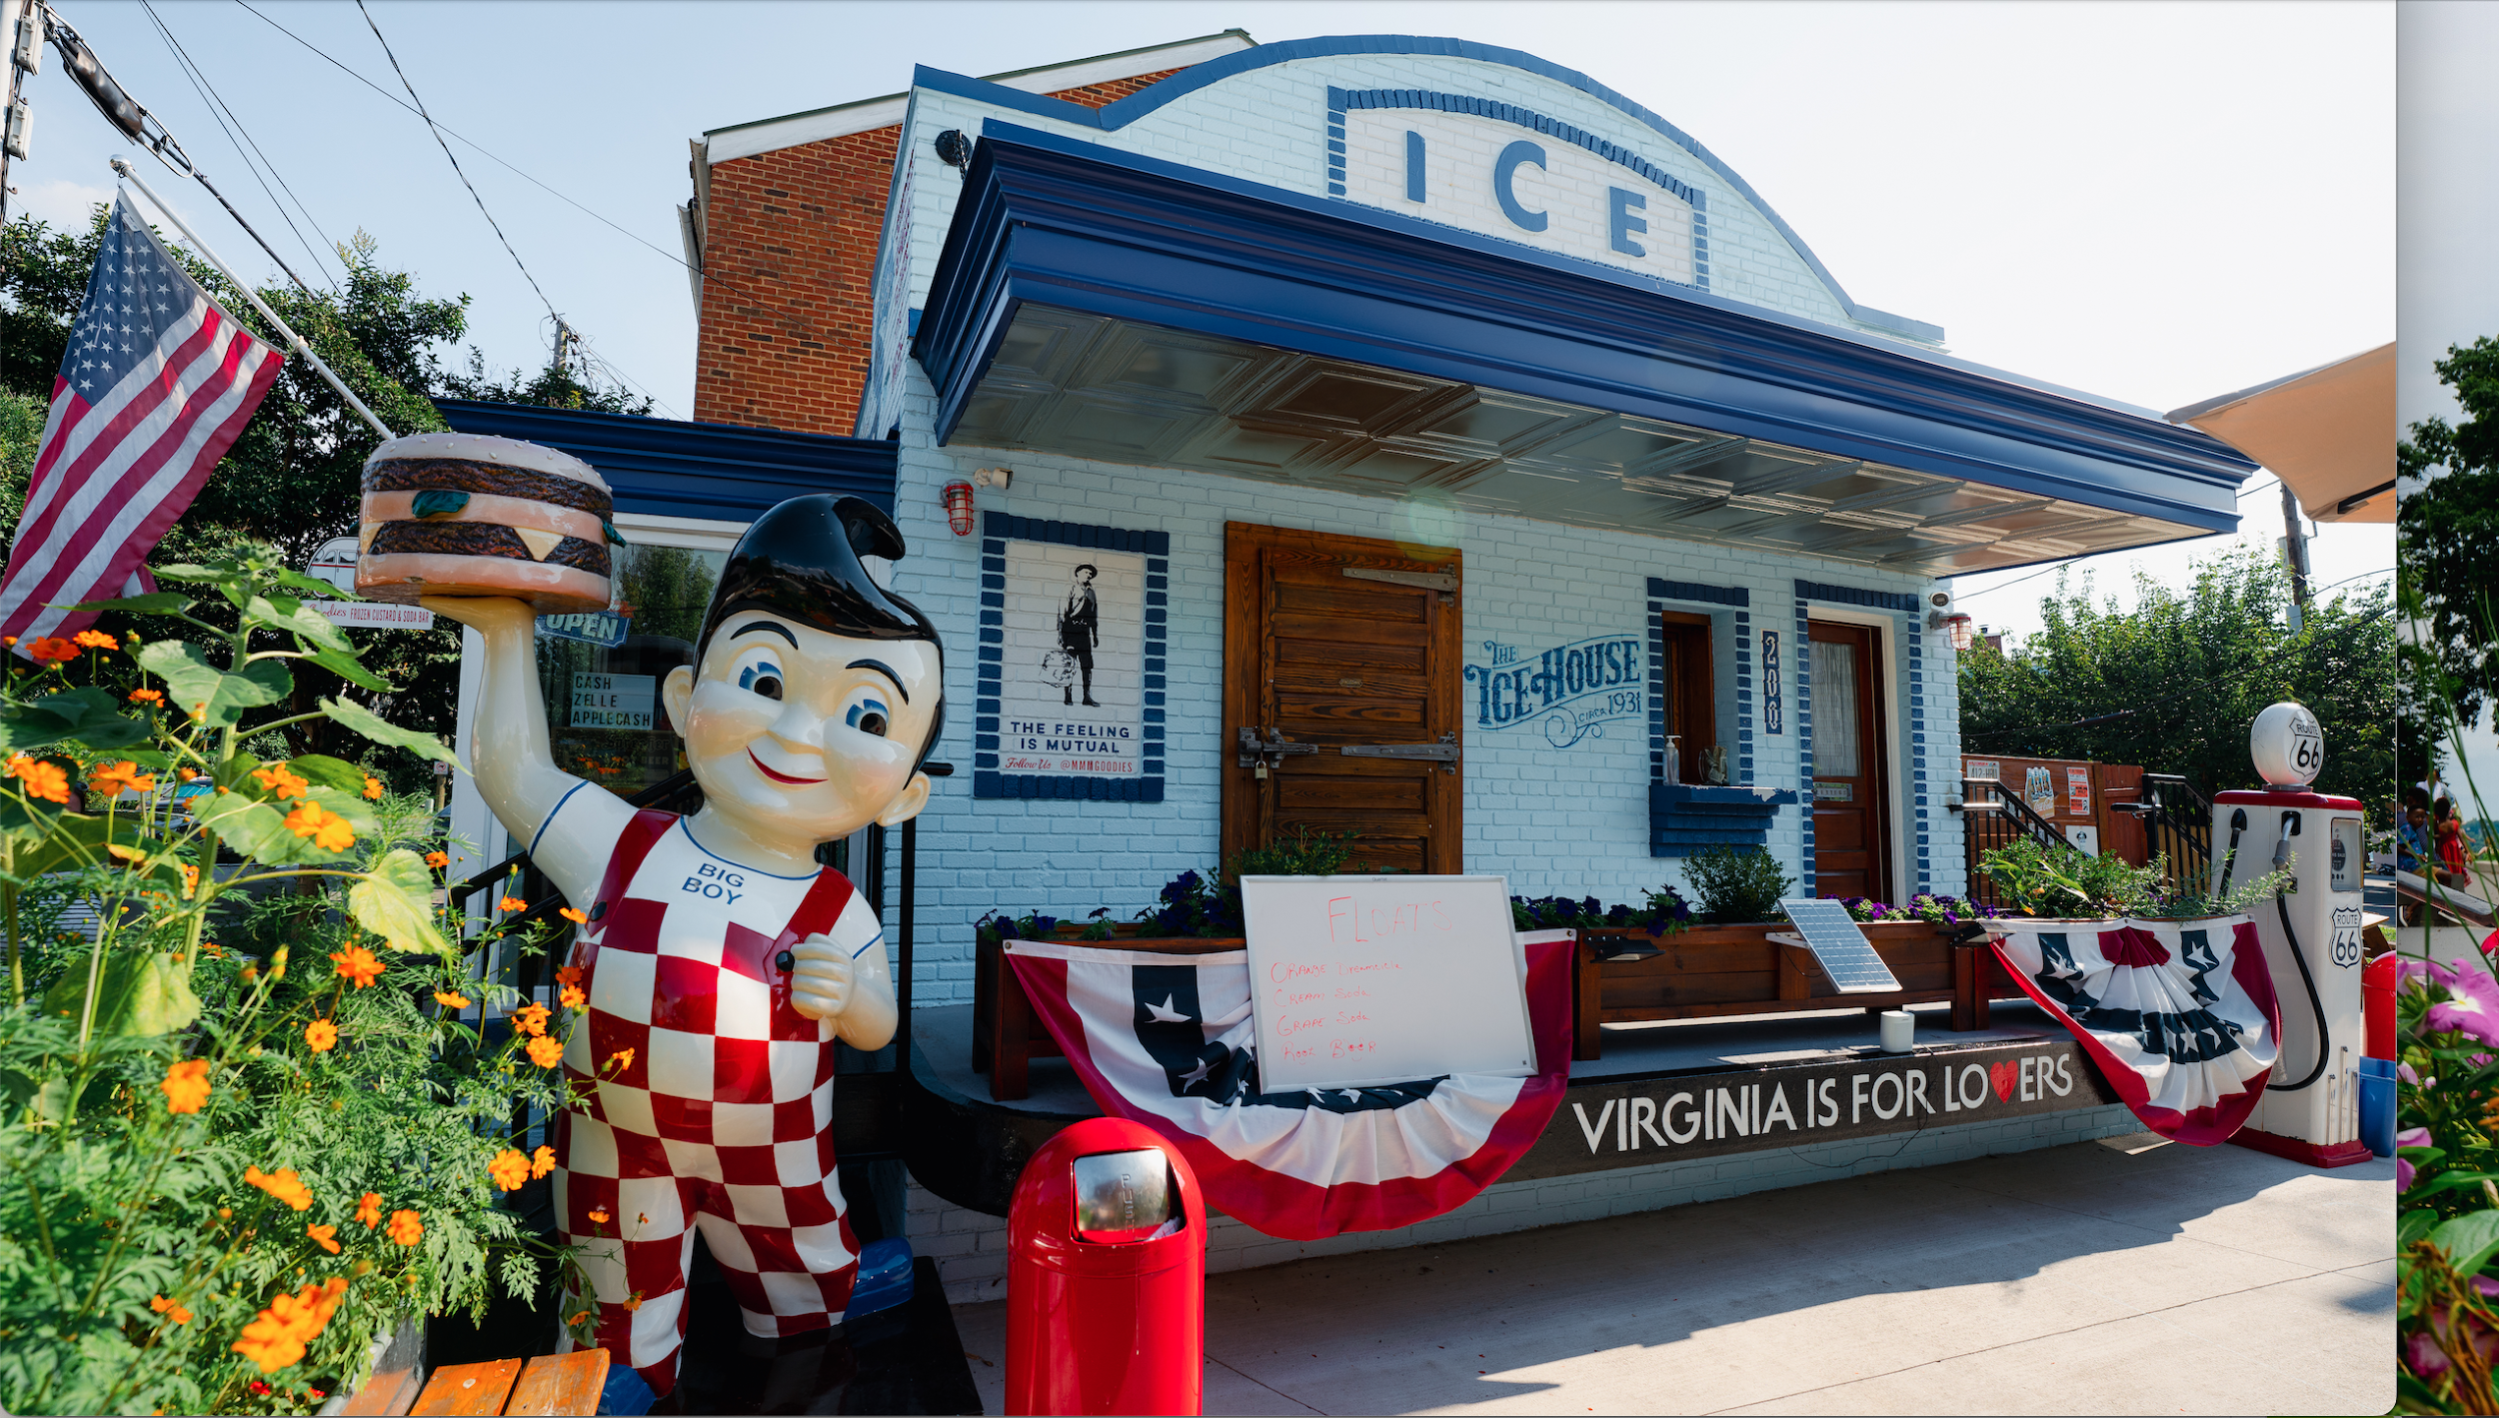
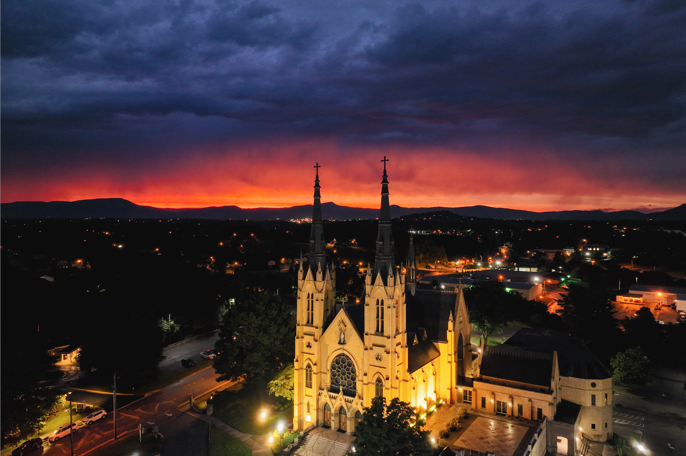
Owned Media
Partnerships with Influencers and content creators has improved our knowledge of destination-based activities we can post on the website and printed collateral.
We retain rights to photos and social media content to be used for future use.
Through higher engagement rates, we also continue to receive more user-generated content and future partnership opportunities.

Slide 20
Getting Started & Additional Resources
Start with branding your product and having a concise way to explain its benefits
For small budgets, let statewide agencies like DRPT do the heavy lifting with paid media
Explore Marketing Leverage Program (MLP) Grants through VTC
Make Shared media a prominent part of your plan
Partner with popular apps or local businesses to provide incentives or leverage for awareness
Network with other transit partners and pool resources

Slide 21
Thank you!
Questions + Discussion

