Slide 1

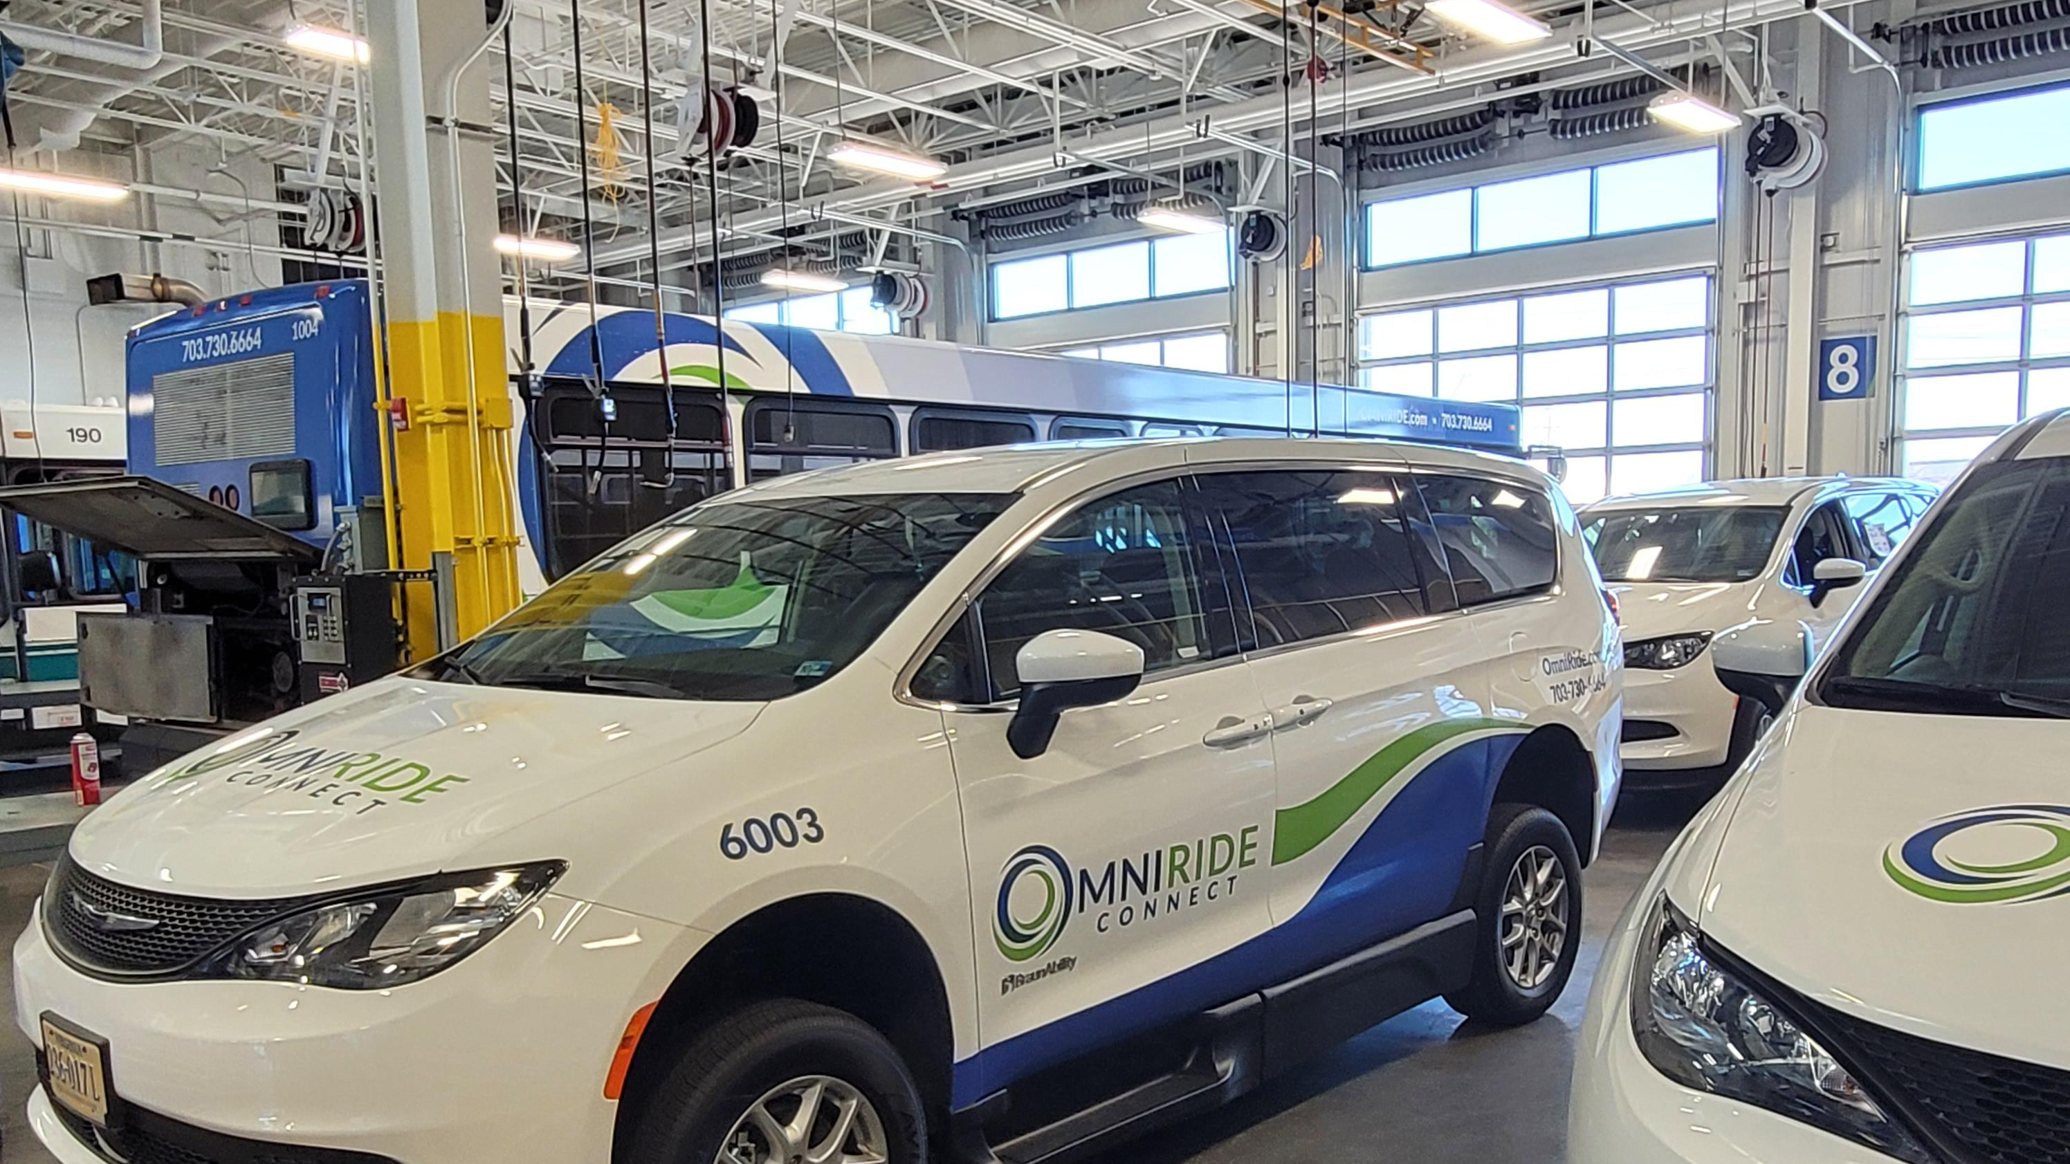
OMNIRIDE:
Operating Environment in a Suburban Setting
Perrin Palistrant
Director of Operations and Operations Planning-OMNIRIDE

Slide 2

OMNIRIDE: Who we are…
Commuter Bus
Local Bus
Paratransit
Microtransit

Slide 3
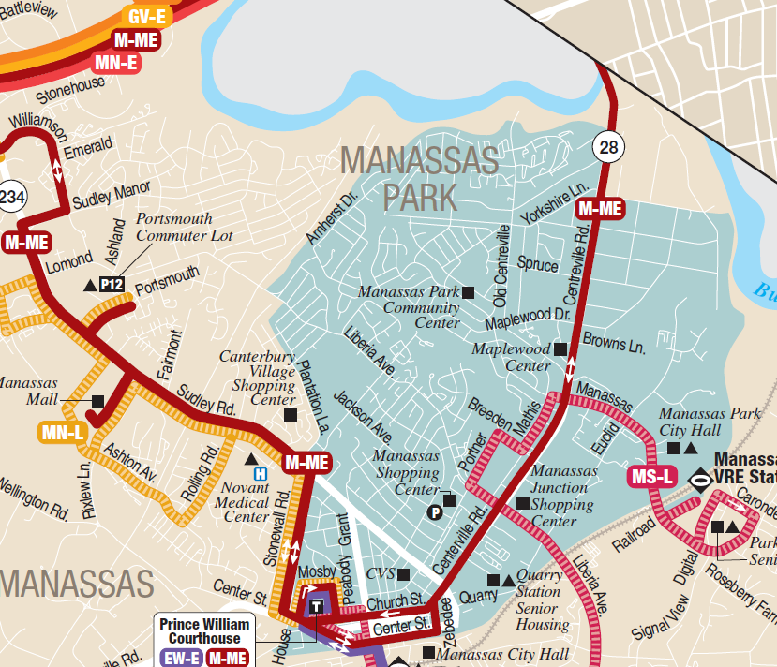
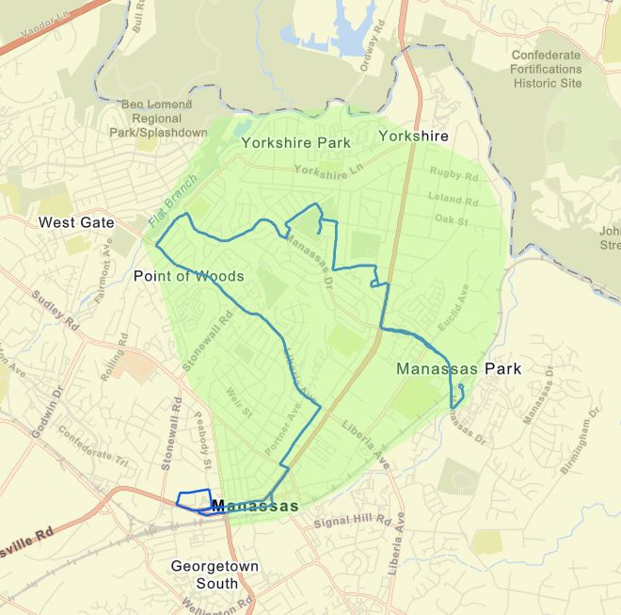
OmNIRIDE Connect Service
Began operation in December 2022
Replaced unproductive Fixed Route
Comingled with Paratransit
Use data to determine further adjustments
RideCo Software
  App based
  Website
  Customer Call Center

Slide 4


Service characteristics
Monday – Friday 6AM-8PM
FREE
Corner to Corner
Receive weekly and monthly reports on productivity and overall usage
Flexible service area

Slide 5
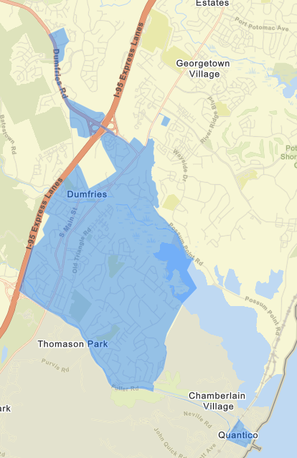
Continued Growth…..
Spring 2023 Launch
1
Operating alongside productive fixed route services
2
Addressing Town of Quantico access
3
Introducing new service area
4

Slide 6
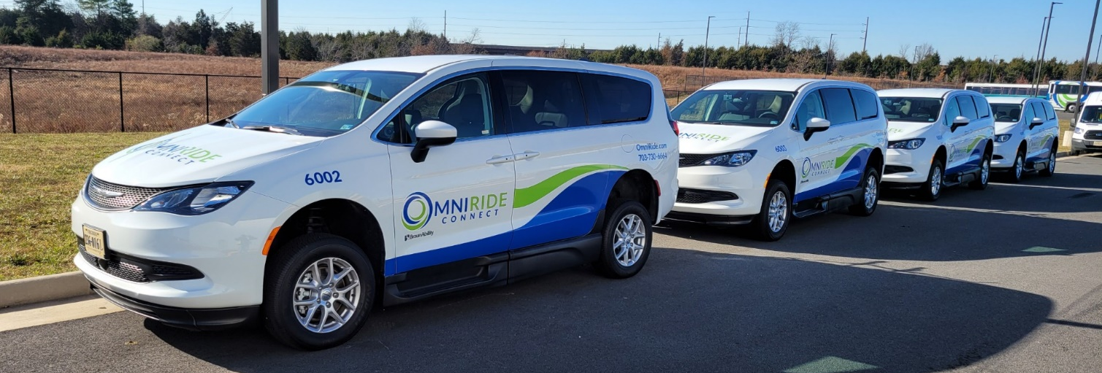
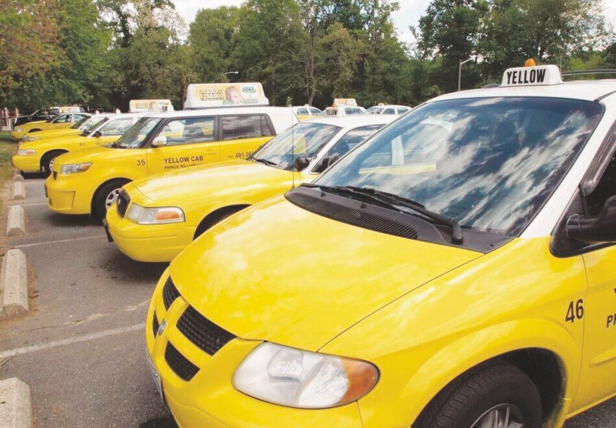
Multiple Options to Operate Service

Slide 7
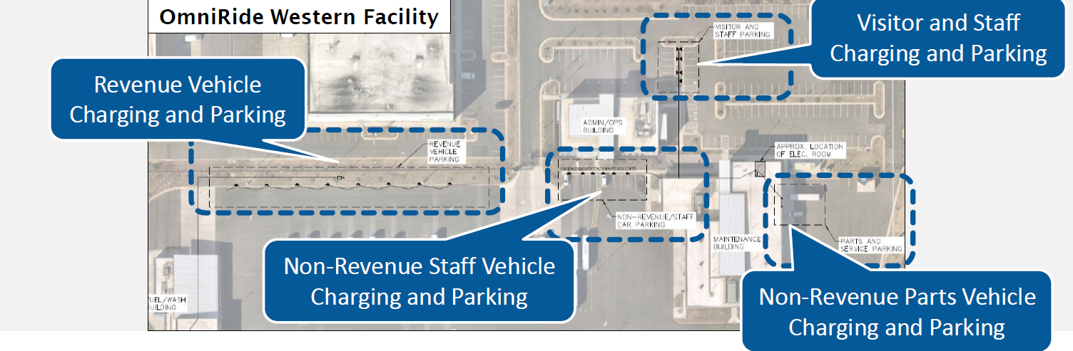
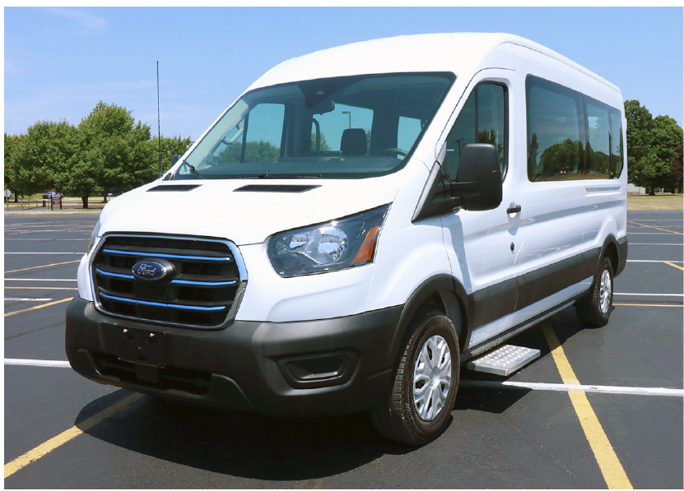
Gateway to zero emissions

Slide 8
ppalistrant@omniride.com703-580-6162

