Slide 1

Hampton Roads Transit
Microtransit Pilot Project

Slide 2




Microtransit Pilot Project
Notes:
HRT seeks to determine the effectiveness and future role of Microtransit in the HRT service area through this Project. Microtransit’s viability requires testing in different use cases to empirically determine how its service characteristics and performance may work as a safe and sustainable new travel option.

Slide 3
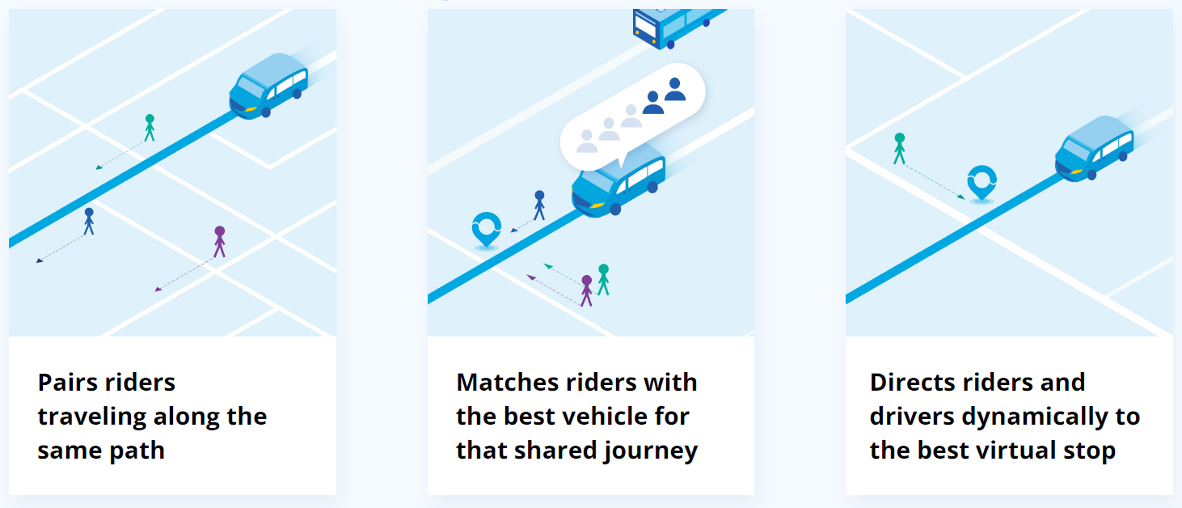
How Does Microtransit Work?

Slide 4

Why Microtransit?
Evolving Marketplace & Expectations…
Agencies adapting to integrate mobility services

Slide 5
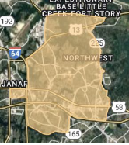
Microtransit Pilot Project
Zone A
Virginia Beach
15 square miles
Connections to seven fixed routes and Norfolk light rail

Slide 6
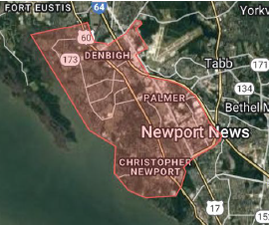
Microtransit Pilot Project
Zone B
Newport News
20 square miles
Connections to five fixed routes

Slide 7
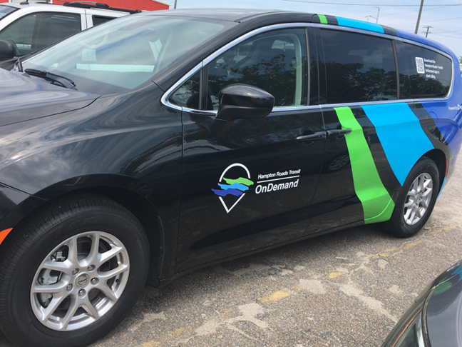
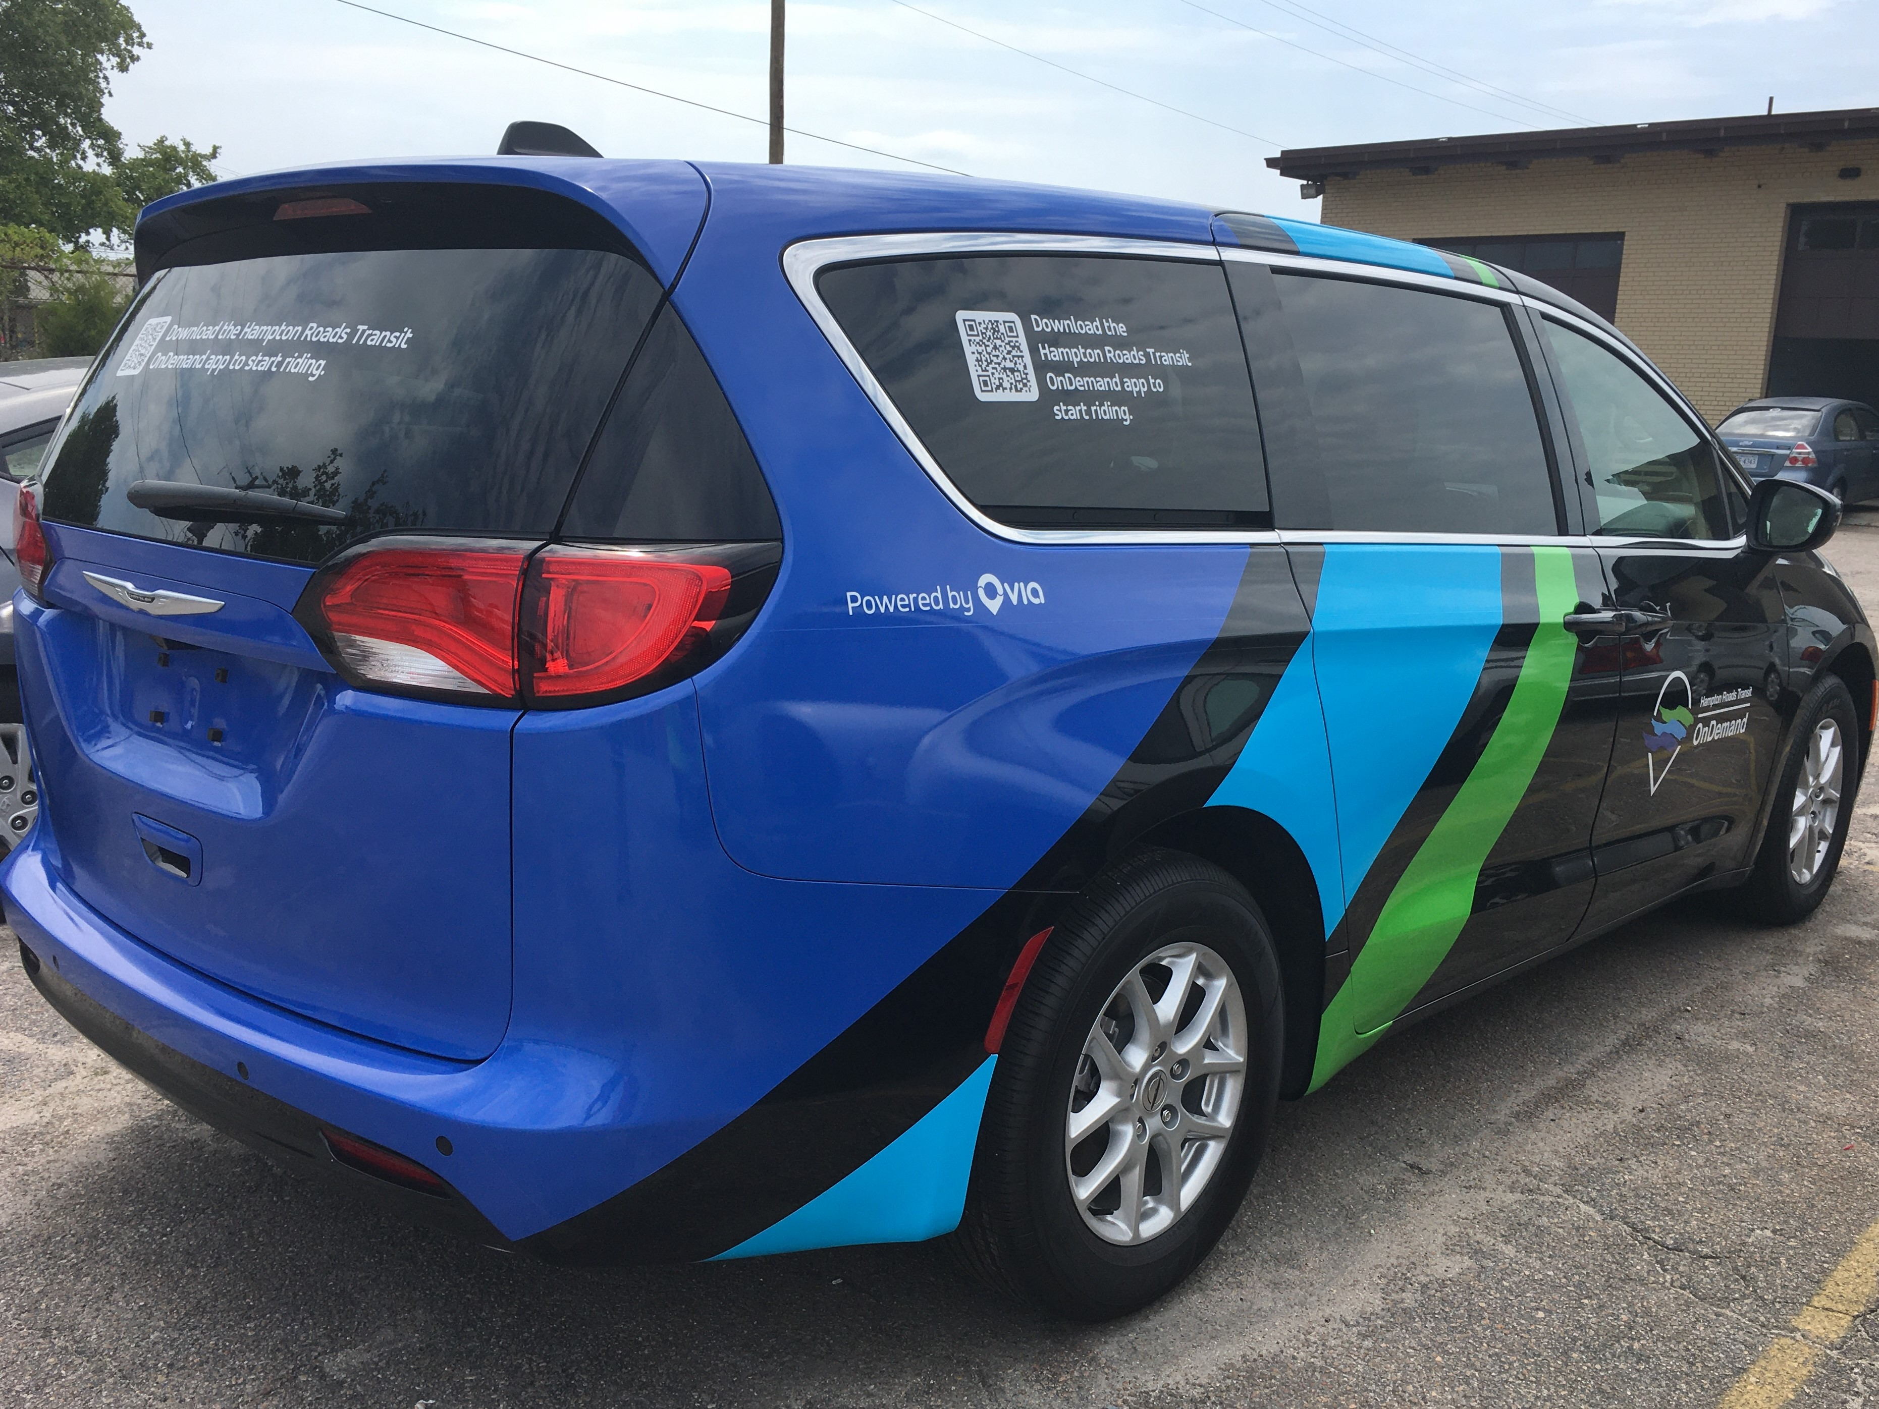
Microtransit Vehicles

Slide 8
Statistics
30,352
Completed Rides
11.3
Minute Average
Wait Time
1,223
Unique Riders
Served
5.4
Average Weekly
Trips Per Rider
78%
Completion Rate

Slide 9
Lessons Learned
Longer pilot
Number of vehicles
WAV’s
ETA Expectations
Successful??

Slide 10
Questions?

