Slide 1


Microtransit – Utilizing Data in Designing a Fully Integrated Network
May 24, 2023

Slide 2





Slide 3
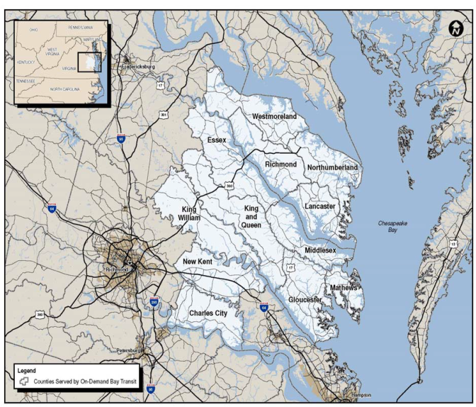

Bay Transit
Public transportation provider for the Middle Peninsula, Northern Neck, and Charles City & New Kent Counties (12 counties)
Demand Responsive Service (systemwide)
• Two Deviated Fixed Route Lines
• Mobility Management
Three Seasonal Trolleys
Microtransit
Averaging 10.1 miles per trip
Notes:
Demand – Response: call to schedule a ride, but not a taxi
Bay Transit operates two deviated fixed-route lines: the “Paper Trail” in West Point, and the “Rivah Ride” in Tappahannock. Before Bay Transit Express, we operated two additional deviated fixed-route lines in Gloucester County.
“Regular” Bay Transit rides cost $2.00 per boarding.

Slide 4
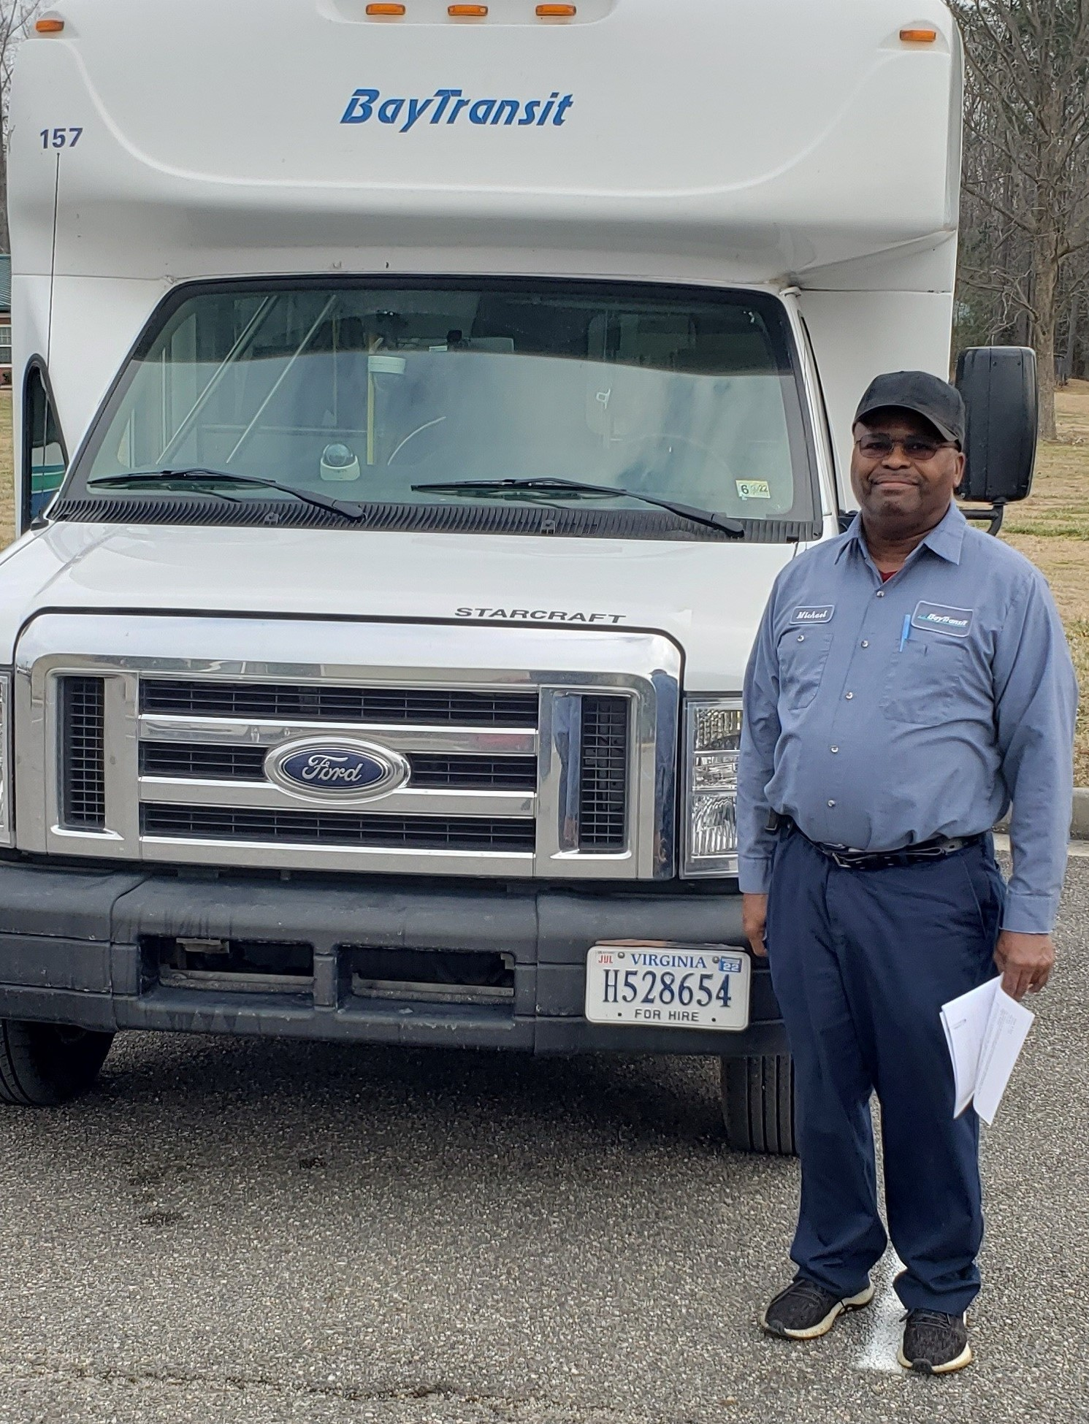
Demand Responsive Service
• 82.6 % of Bay Transit’s services.
• Requires 24-hour reservations
• Standing orders for regular commuters
$2 per ride
Notes:
Demand – Response: call to schedule a ride, but not a taxi
Localized connector services refers to the deviated fixed routes like the HiveXpress in Gloucester, in and around town West Point, the Rivah Ride in Tappahannock and the Courthouse Circulator in Gloucester.
Citizens can more readily access the services they need and connect to “regular” Bay Transit buses to get to where they need to go.
Localized connector services only cost 50 cents per boarding.
“Regular” Bay Transit rides cost $2.00 per boarding.

Slide 5
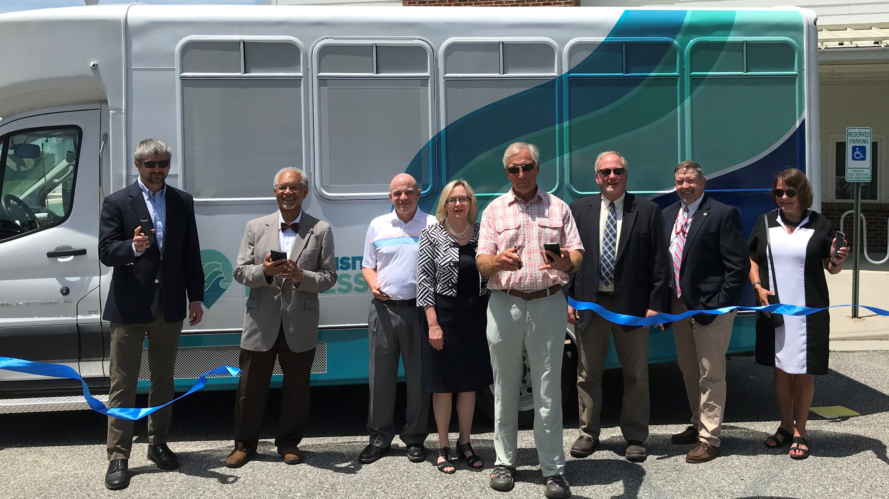
Bay Transit Express
Launched on June 28th, 2021
Notes:
Service was initiated with an existing spare Bay Transit vehicle.

Slide 6
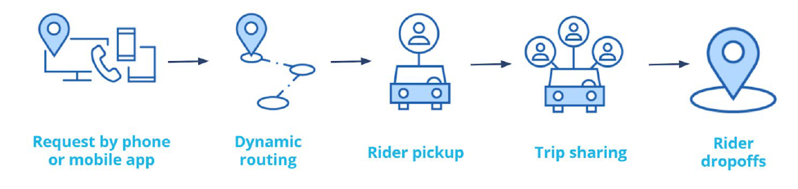
Microtransit Process Flow
Notes:
Via developed an app specifically for this service branded as Bay Transit Express

Slide 7
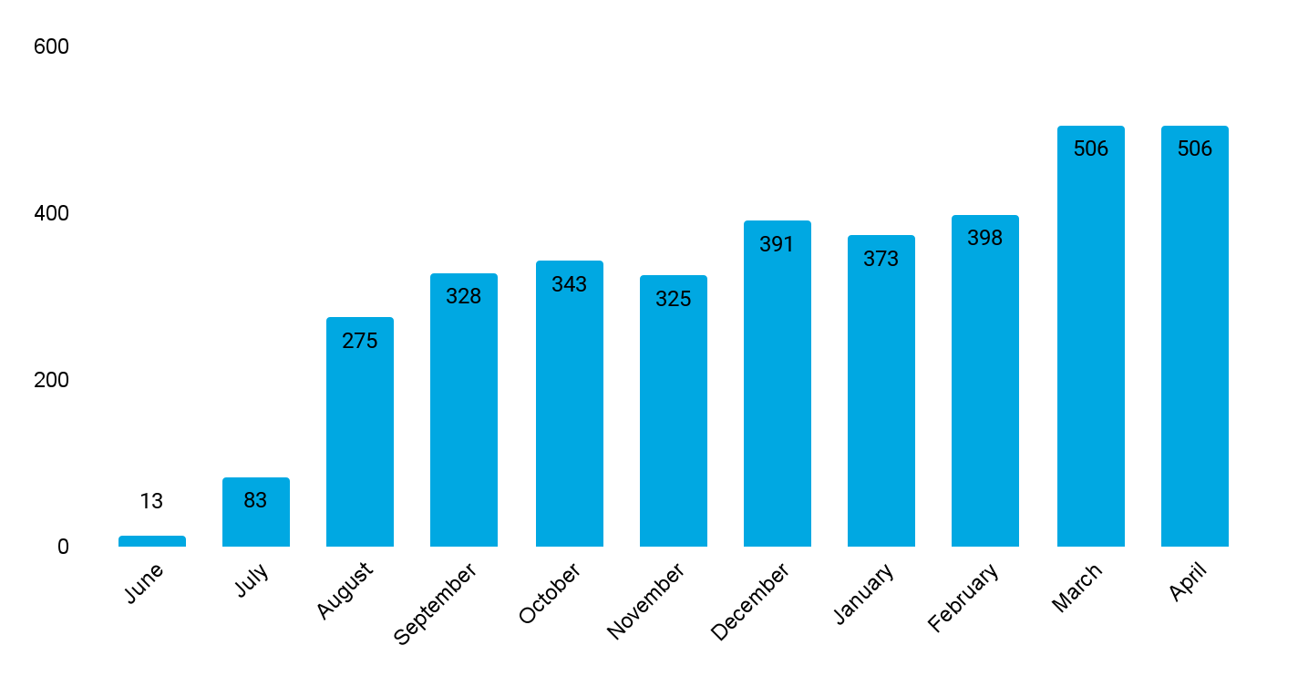
Growth in Monthly Rides
Through April of 2022
Notes:
By March and April of 2022, monthly ridership on Bay Transit Express was meeting or exceeding the monthly ridership on the deviated fixed-route service in Gloucester, the HiveXpress.

Slide 8
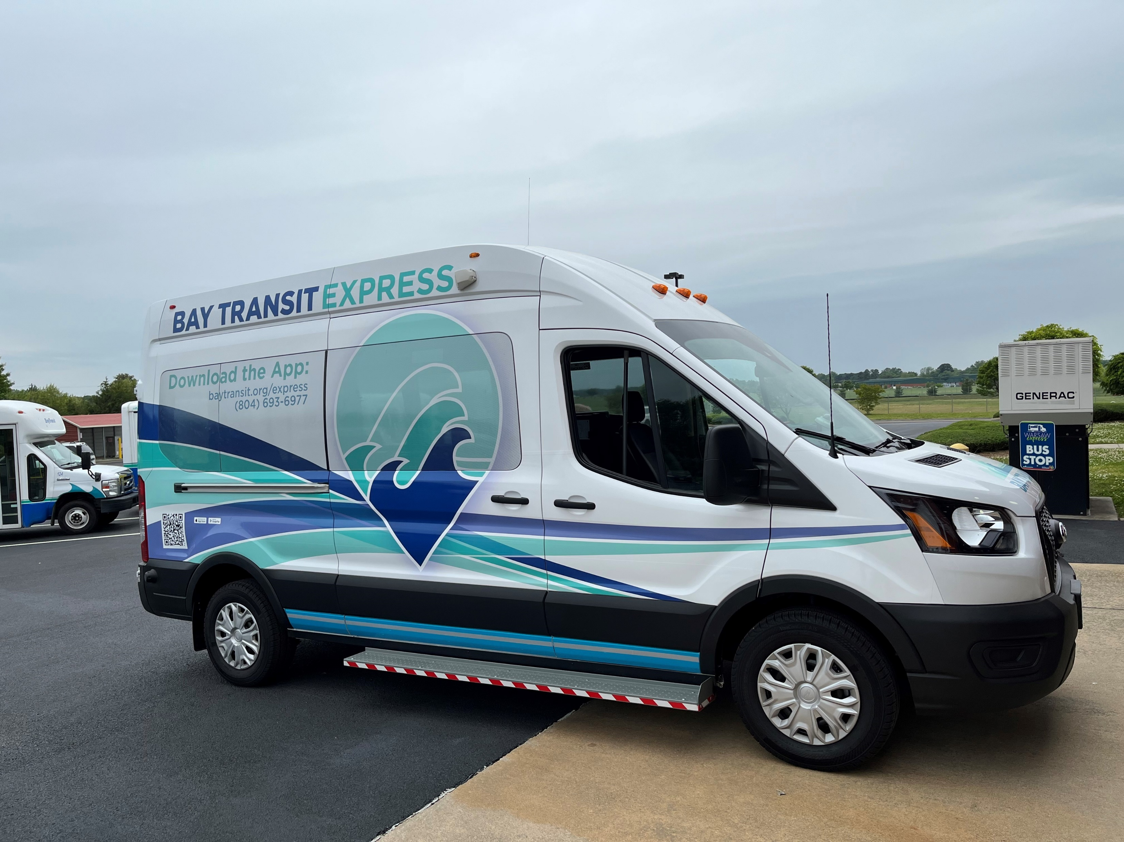
Bay Transit Express
Started Using More Fuel-Efficient Vehicles in May of 2022
Notes:
In addition to being more fuel efficient, the new Bay Transit Express vehicles can be driven by an operator who does not have a CDL license, which helps us with finding drivers.

Slide 9
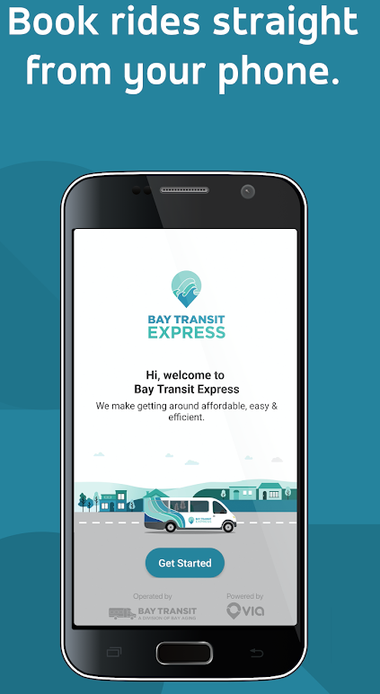
Challenges
• Significant percentage of Gloucester County residents are seniors who may not be comfortable using app-based services.
• Covid restrictions made it impossible to provide hands on instructions on downloading the app and using the service.
• Marketing must be done through multiple concurrent channels to ensure that it reaches diverse audiences.
Notes:
Today, about 53% of reservations to ride on Bay Transit Express are made by calling the Gloucester office and 47% are booked through the Bay Transit Express app.

Slide 10
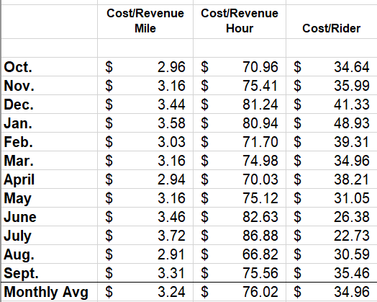
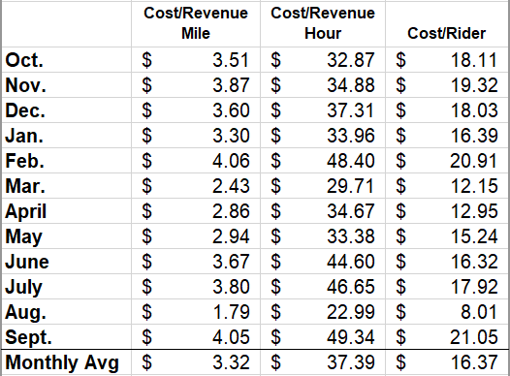
Measuring Program Efficiency: FY22 Deviated Fixed-Route versus Bay Transit Express
Notes:
The FY 2022 average monthly cost per revenue hour for Bay Transit’s deviated fixed-route services was more than double the cost per revenue hour for Bay Transit Express. This was also true for the FY 2022 average monthly cost per rider. Bay Transit Express’ average cost per rider, at $16.37/ride, was $18.59 less than the average cost per ride on Bay Transit’ deviated fixed-route lines.

Slide 11
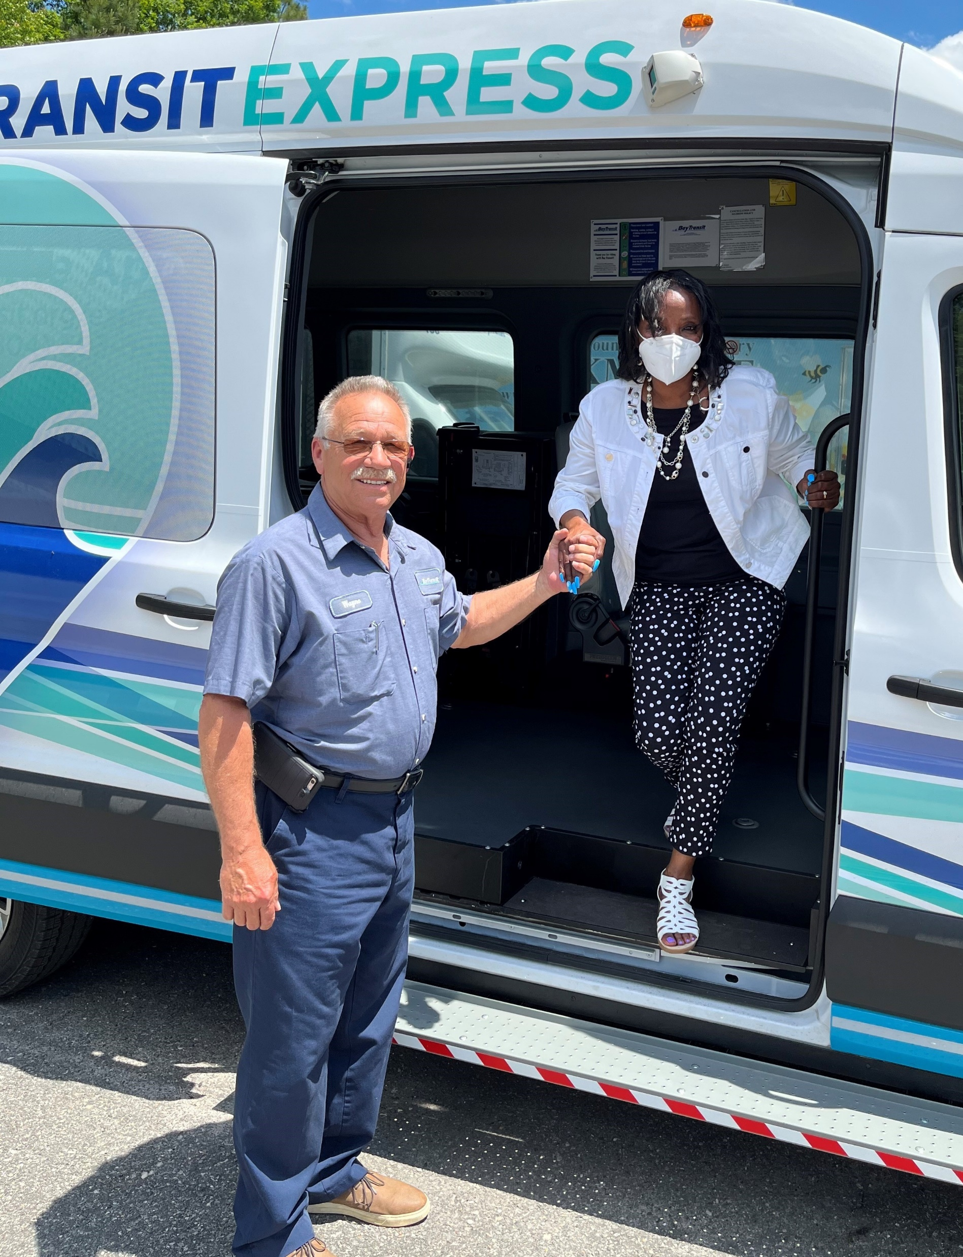
Next Steps: Expansion
Expand Bay Transit Express service zone to Gloucester Point.
Simultaneously, discontinue our hiveXpress deviated fixed-route service in Gloucester County .
Add a second, new Bay Transit Express van into service.
Look for opportunities to take advantage of the more cost-efficient, microtransit service to replace other deviated fixed-route lines in Tappahannock and West Point.

Slide 12
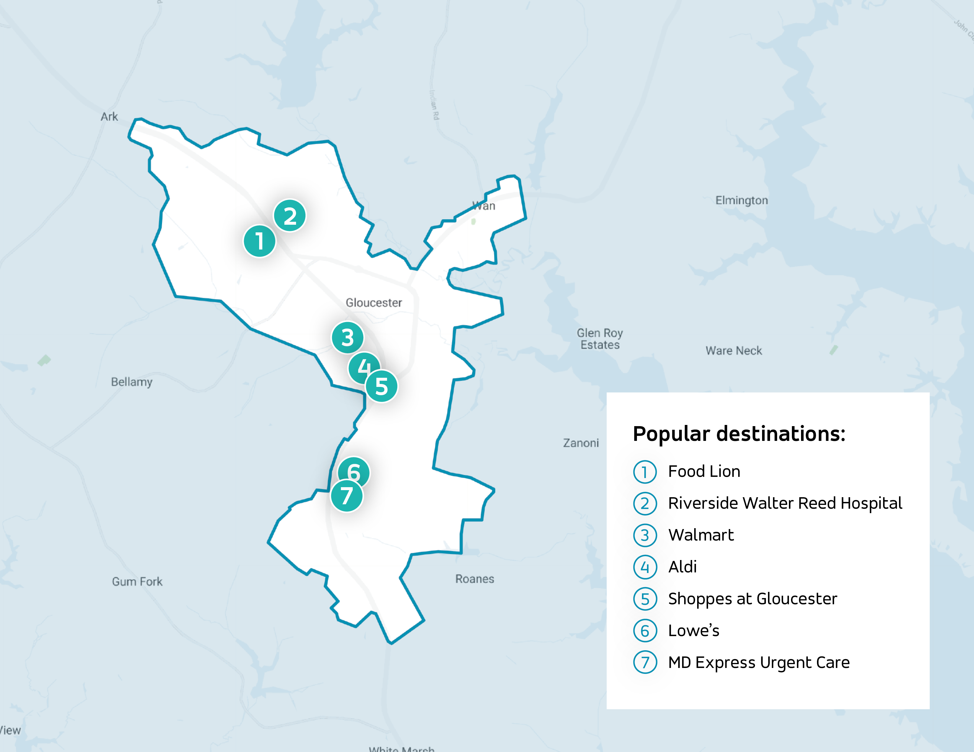
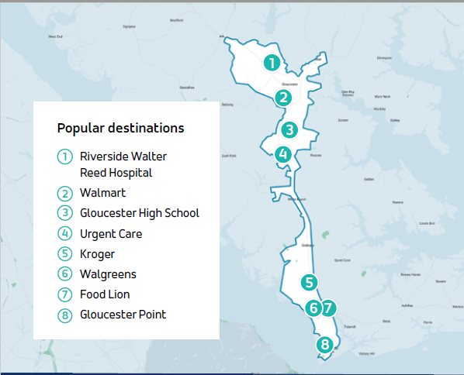
Initial Service Zone and Expanded Service Zone

Slide 13
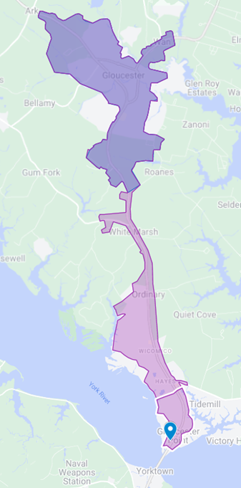
Next Steps: Market Expanded Service
Targeted marketing to businesses, apartment complexes, and mobile home parks in the expanded service zone.
Distributed hundreds of updated promotional postcards to the residents of income-restricted apartments and mobile home parks.
Promoted the expanded service zone and reduced fare through local newspapers and radio stations.
Notes:
We also marketed to businesses and residents in the existing service zone to ensure they knew about the expanded service and lower fares. At Daffodil Gardens I and II, Bay Aging’s income-restricted senior apartments in Gloucester, we held in-person promotions to encourage the residents to download the Bay Transit Express app and book their trips online.

Slide 14
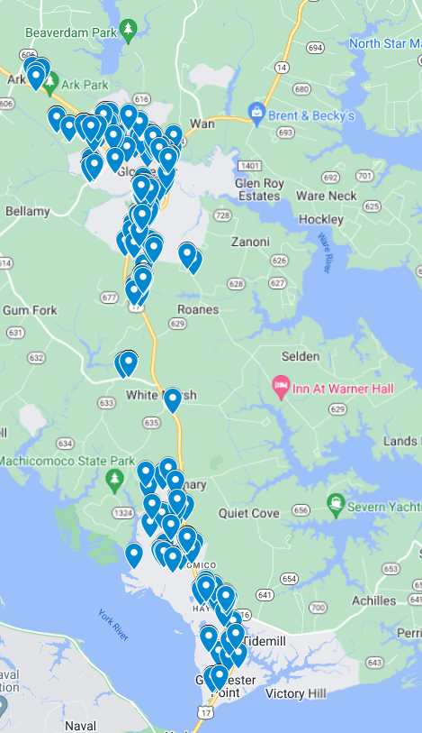
Measuring Utilization at Locations Where Promotional Postcards Were Disseminated
Daffodil Gardens I & II, Bay Aging’s Income Restricted Senior Apartments
Wicomico I and Wicomico II
• Woodsville Mobile Home Park
• Beacon's Bay Mobile Park
Notes:
Zero Vehicle Households: About 6% of Virginia residents (over 200,000 households) do not have access to a private car.2 Households without a privately-owned vehicle are more likely to use public transit than those with access to one or more vehicles. Zero-vehicle households are typically young or low-income people, or those living in apartments.

Slide 15
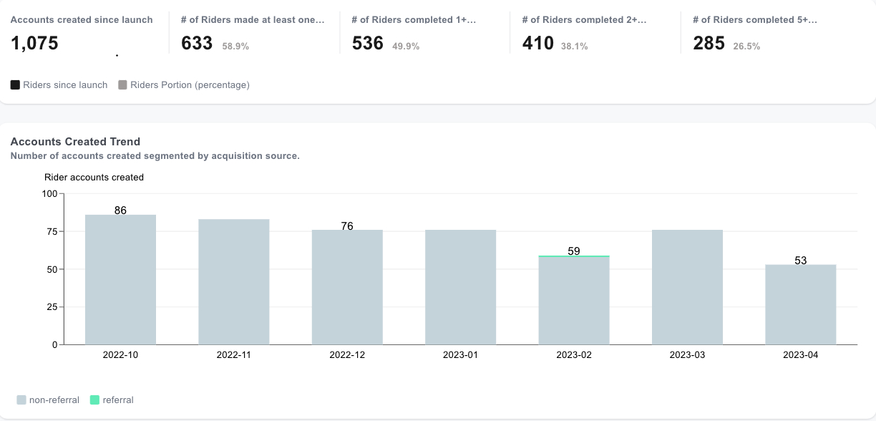
Account Creation Drives Ridership Growth
Notes:
Over one in four Bay Transit Express riders have taken more than five rides since creating their accounts.

Slide 16
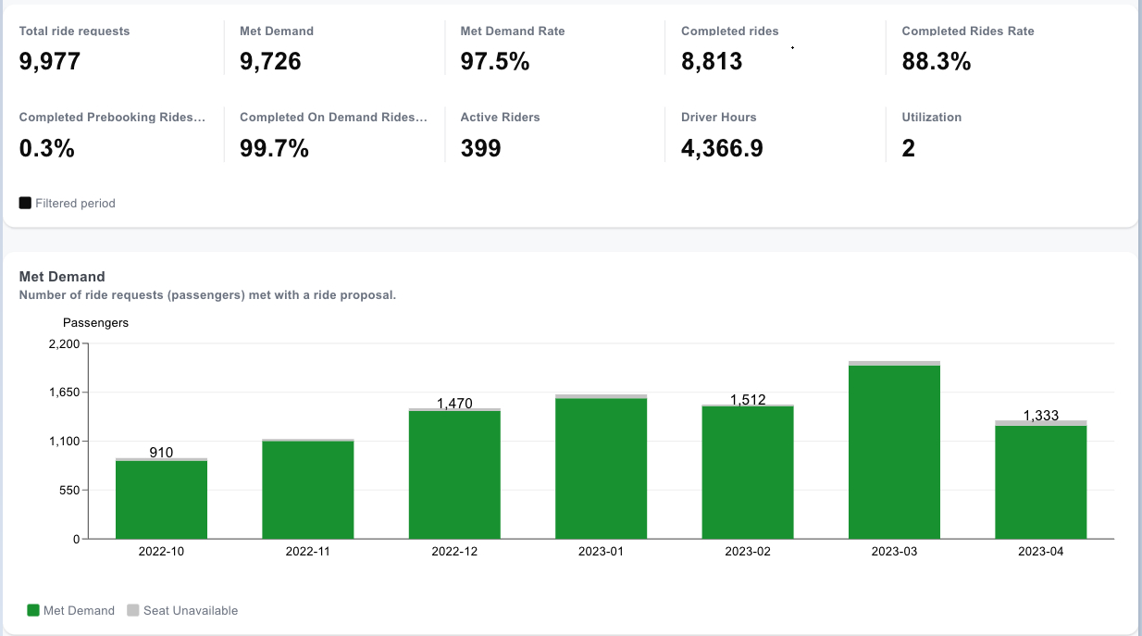
FY 2023 Operational KPIs from 10/1/2022 to 4/23/2023
Notes:
Through almost seven months of FY 2023, nearly 9,000 rides have been completed, including a record 1,793 in March.

Slide 17
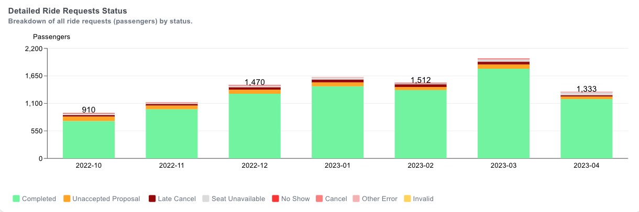
Monthly Ride Requests by Status
Notes:
On average, 88.3% of all ride requests are completed! The remaining 11.7% are not because of no shows, requests outside of the service zone, and cancellations.

Slide 18
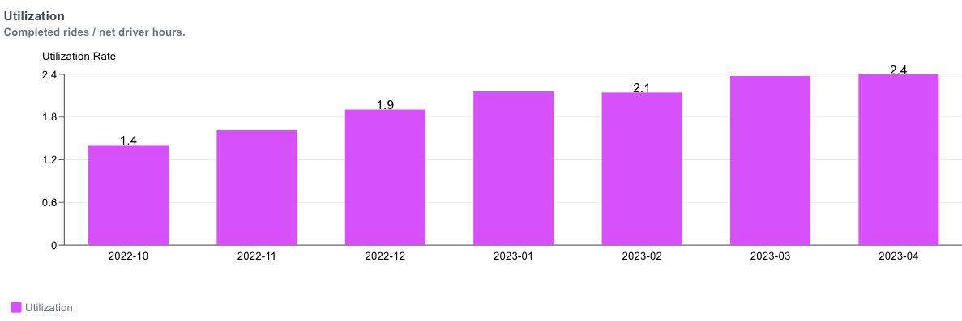
Utilization, completed rides per vehicle-hour, surges 71%
Notes:
Utilization is a similar metric to Productivity. Productivity is the average number of passengers per revenue-hour and is a measure of the efficiency of Bay Transit Express. However, utilization uses vehicle-hours, not revenue-hours, as the denominator and as a result is about 10-15% lower typically than productivity because it includes some non-revenue hours (deadhead) at the beginning and end of driver shifts as they travel to/from the maintenance facility and the first pickup / last drop-off location. The 2.4 completed rides per vehicle-hour in March and April is 71.4% better than in October of 2022.

Slide 19
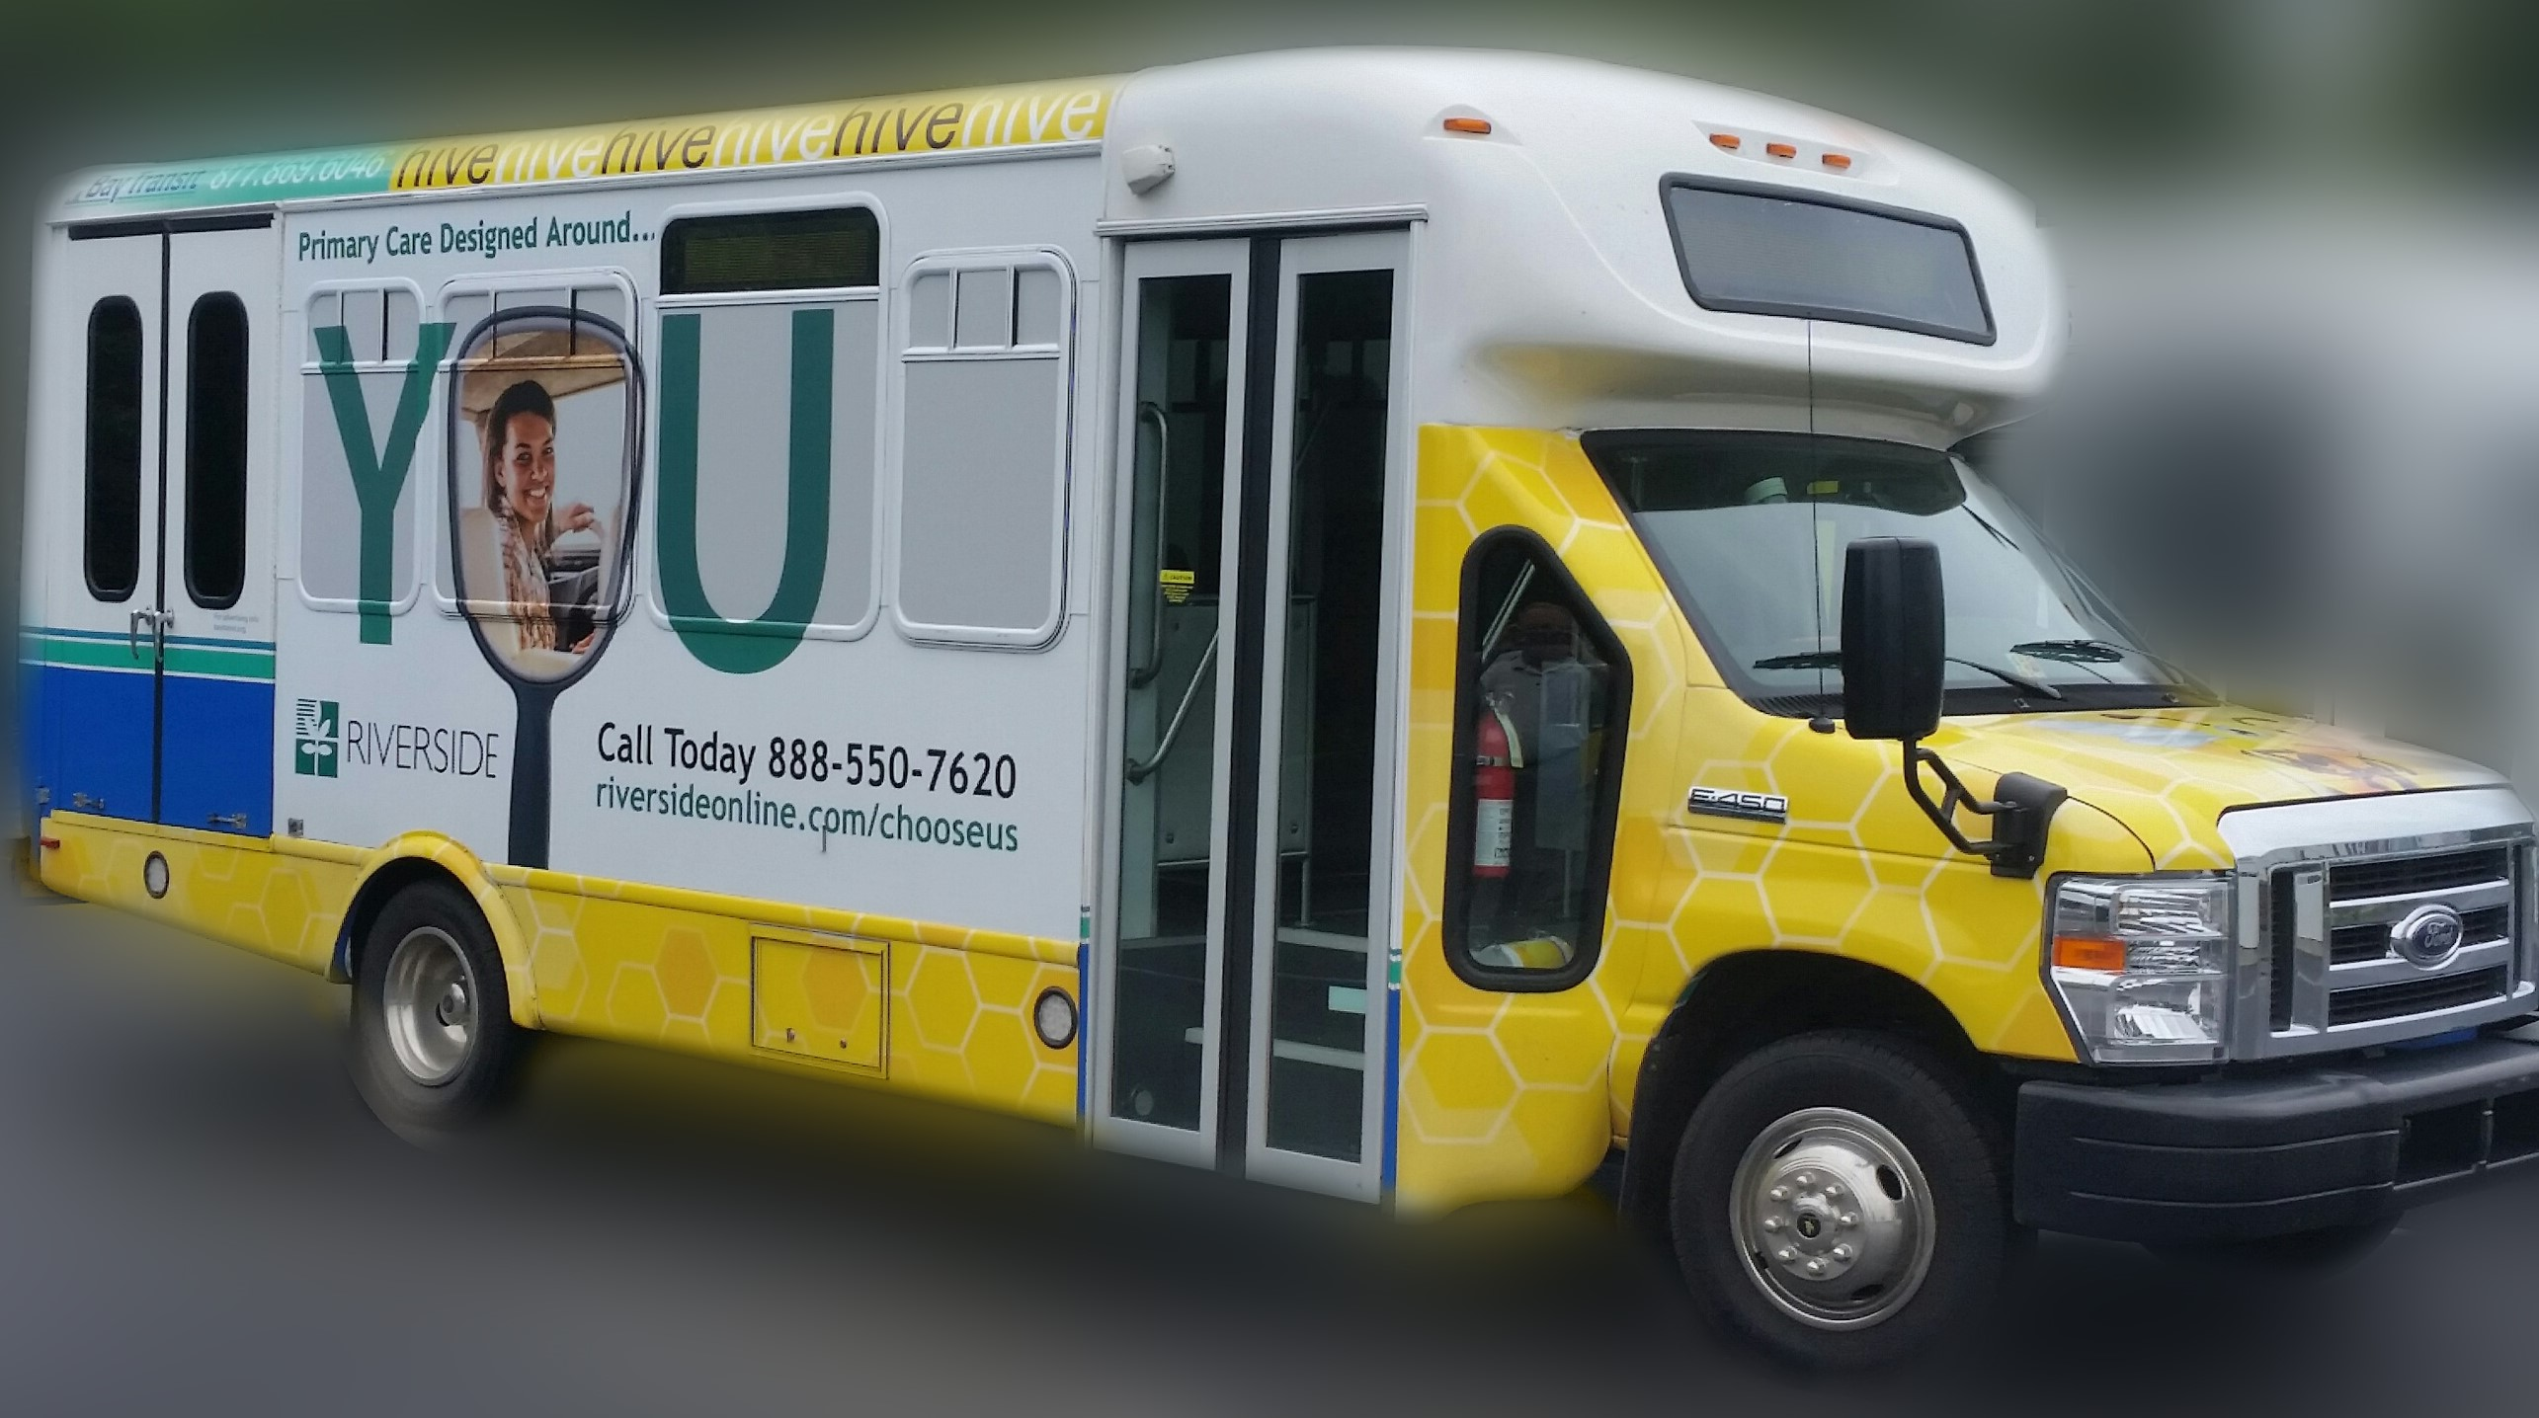
Notes:
As far back as April of 2022, monthly ridership on Bay Transit Express regularly eclipsed the deviated fixed-route service, called the HiveXpress, in Gloucester. Coupled with the operating efficiency of Bay Transit Express, we decided to expand the Bay Transit Express service zone and discontinue the HiveXpress in October. Today, Bay Transit Express’ monthly ridership is typically triple the monthly number of rides taken on the discontinued HiveXpress service.

Slide 20
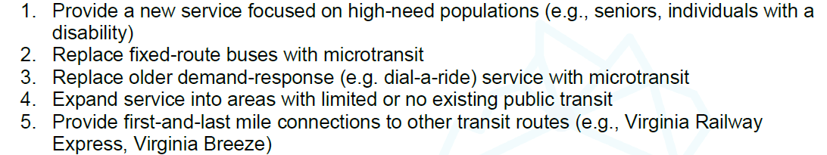
Applications For Microtransit

