Slide 1







Bus Stops and Shelters
Planning and Design
Raquel Aguirre, Bethel Kefyalew, Alan Saunders
May 23, 2023

Slide 2

GOALS & PURPOSE
Detail the approval process for shelters on State ROW
Share GRTC Case Study of Transit Stop Improvement Prioritization
Define Design Considerations for Shelters
Identify Funding Sources

Slide 3
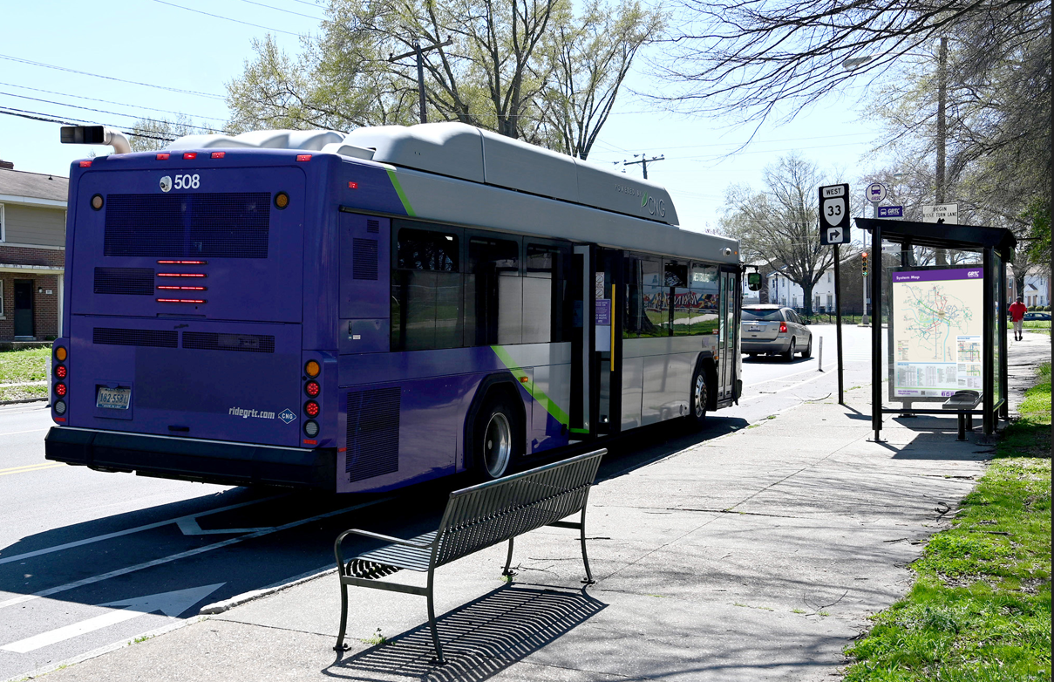
GRTC
Essential Transit Infrastructure (ETI): benches, trash cans, landing pads, shelters
"ETI elements are intended to provide comfort, convenience, accessibility, safety, and dignity to riders."

Slide 4
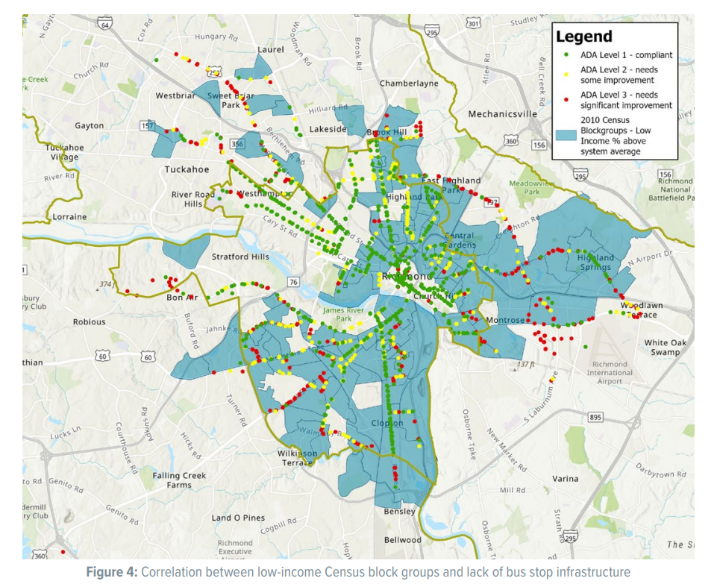
Current Conditions
1,609 active local stops
  26% have either a bench or shelter
  <50% have ADA compliant landing pads

Slide 5
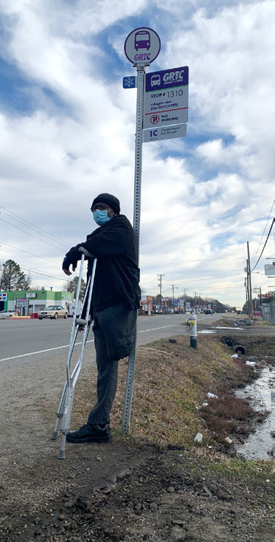
GOALS
​
for 75% of stops to have a shelter or seating by 2027​
Improve ADA Compliance

Slide 6
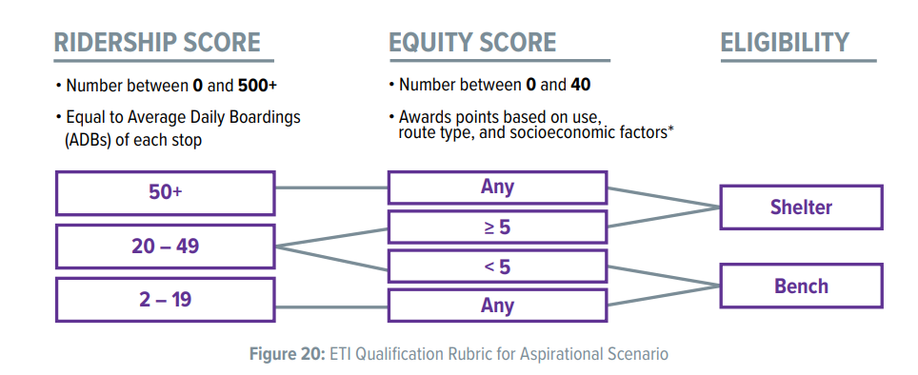
Identification & Evaluation of Stops
Prioritization of Stops
Development of a qualification rubric that addresses both ridership and equity

Slide 7


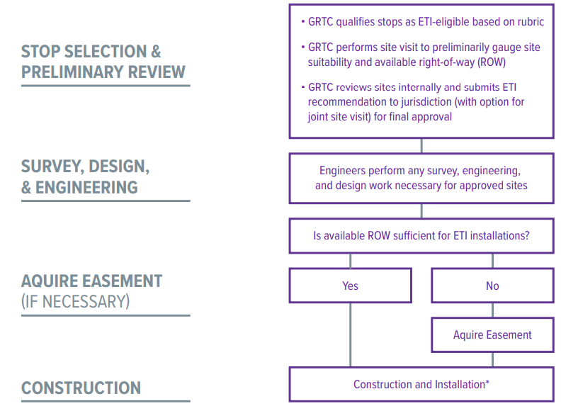
GRTC Bus Stop Improvements Workflow

Slide 8
General Project Schedule
The process has additional requirements if the project is on State right of way
On Private or Public right of way, guidelines are set by the Local Building Official and/or the Public Right-of-Way Accessibility Guidelines (PROWAG)
Projects on State ROW must be reviewed by:
  COV Art and Architectural Review Board
  VDOT Captial Outlay Facilities Management Division
  VDOT Land Use Office
  DGS Department of Engineering and Buildings
Identify Stops for Improvement
Determine ROW Owner
Design Project
Obtain Permits
Install Amenities
Final Inspection & Occupancy Permit

Slide 9
Terms & Definitions
CO-17: Building Permit for Construction on State Property
VUSBC: Virginia Uniform Statewide Building Code
WD-1: Working Drawing Review (following submittals are referred to as WD-2, WD-3,... DEB has 28-days to review and respond to each submittal)
VDOT-LUP: Land Use Permit authorizing the applicant to encroach or use VDOT’s right-of-way to place a structure
CO-13.1a: Certificate of Completion by A/E
CO-13.3: Certificate of Use and Occupancy
BITS: DEB’s Building Information Tracking System
VDOT Annual Permit Authority Holder (to whom the COFM issues the project permits and certificate and who coordinates project close out)

Slide 10
New Shelters – No Existing CO-17
Phase 1
Develop concept plans w/ shelter prototype drawings
Obtain VDOT Land Use conditional approval for proposed locations
Request 11-digit State Project Code from COFM
Submit Plans to AARB for approval
Submit Plans to COFM/DEB for review and approval
DEB/COFM will issue CO-17 Building Permit for Construction

Slide 11
Approved Shelters Designs– Existing CO-17
Phase 2
Finalize Design Package including designs at each site location
Submit full project package & VDOT's conditional approval to COFM for review
COFM will issue the VDOT Annual Permit Authority Site Adaption Project Permit and notify DRPT & VDOT
Phase 3
Submit VDOT LUP-A to local Land Use permitting office and obtain permit
Phase 4
Construct project in accordance with all conditions and requirements in CO-17, Site Adaption Permit, and Land Use Permit
Perform Final Inspection and submit a CO-13.1a Certificate to COFM
COFM will apply to DEB for the CO-13.3 Certificate of Use and Occupancy
Notify local VDOT permitting office for final inspection and close out of permit

Slide 12
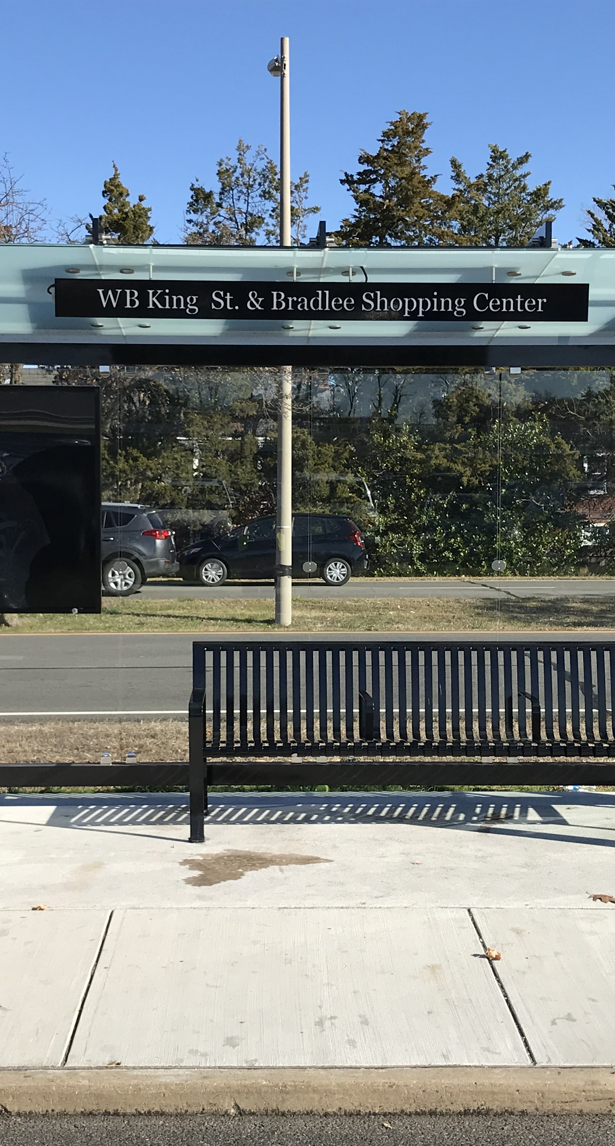
Notes
CO-17s must be renewed annually
Every 3 years the Virginia Uniform Statewide Building Code is updated, and all Shelter Designs must be updated to reflect changes to the USBC
VDOT is reimbursed for DGS-DEB's costs to review shelter packages
DRPT is working to:
  Gain feedback from a statewide stakeholder group
  Maintain a statewide list of approved CO-17s
  Develop a statewide contract for shelter procurement
  Compile planning and design resources for transit stops

Slide 13
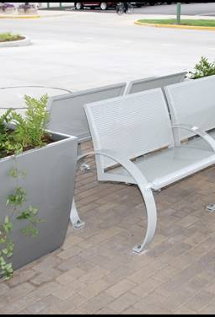
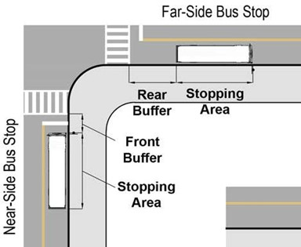
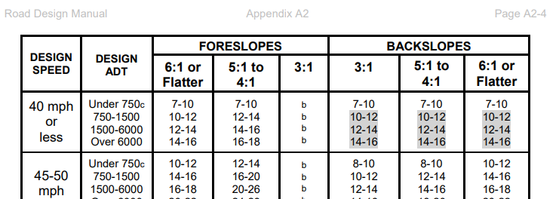
Site Planning
Benches & Trash Cans
Landing Pads
Shelters
Prioritize Site Improvements
Plan 4 Today & Tomorrow
Don’t forget about NEPA/NHPA/SERP…

Slide 14
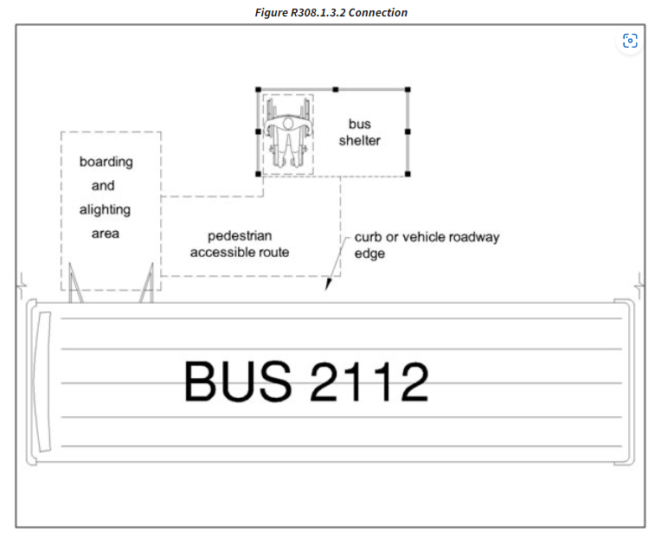
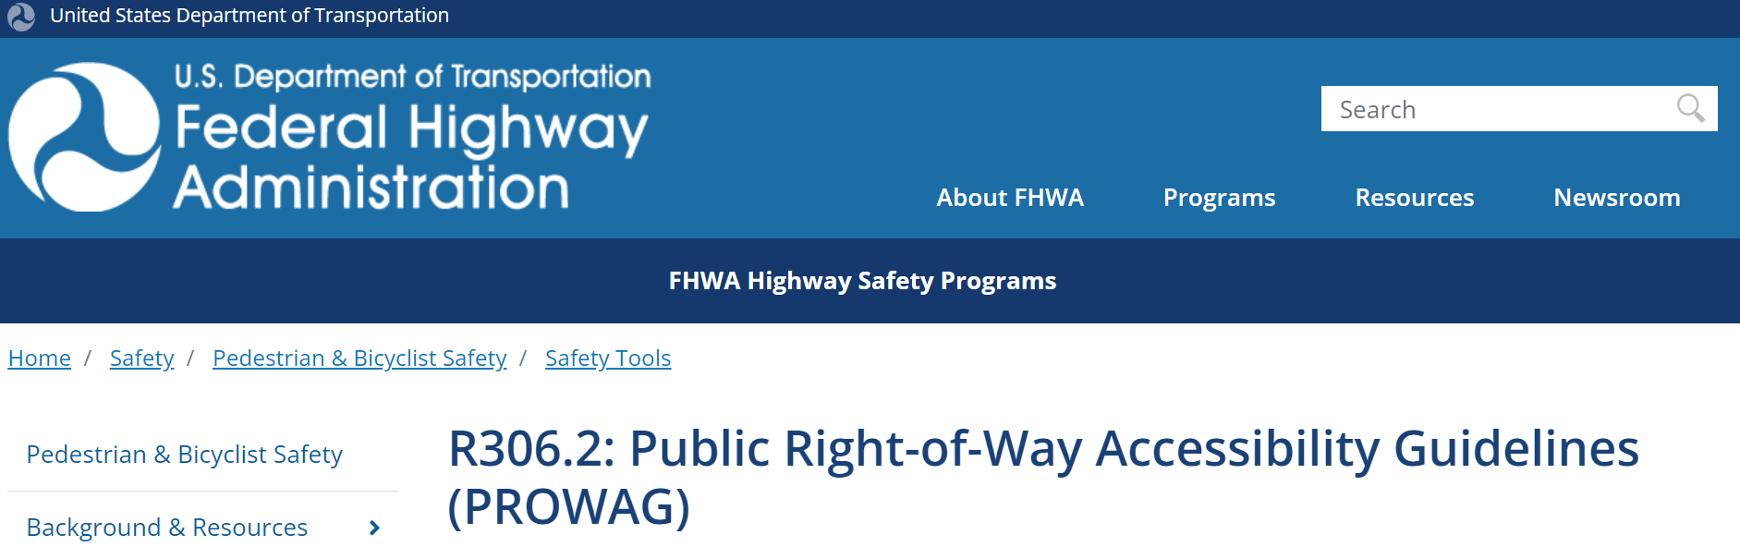
Design Considerations
Landing Pads
Clear Zone Requirements
Breakaway Structures
Accessibility
Detectable Warning Surfaces
Boarding Platform
Boarding and Alighting Area
Existing or New Stop?
Near or Far Side of Intersection?
AASHTO
PROWAG-ADA
NACTO
VDOT
TCRP
Notes:
AASHTO—Geometric Design of Highways and Streets
Farside bus stops have also proven to be effective in reducing collisions involving pedestrians. Sight distance conditions generally favor far-side bus stops, especially at unsignalized intersections;

Slide 15

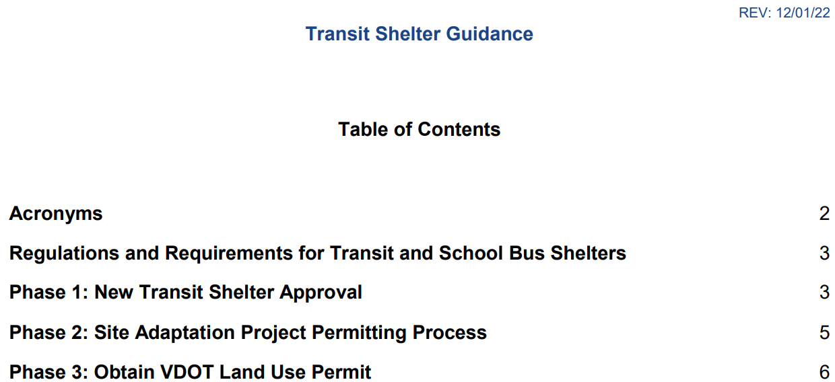
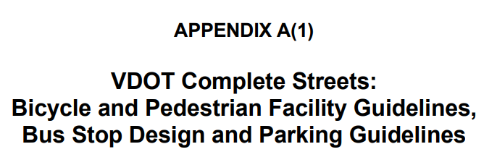
VDOT Right-Of-Way
VDOT Road Design Manual
  Appendix A2 Clear-Zone
  Appendix A(1) VDOT Complete Streets
VDOT Land Use Permits
  Appendix 13 Transit Shelter Guidelines
Notes:
AASHTO—Geometric Design of Highways and Streets
Farside bus stops have also proven to be effective in reducing collisions involving pedestrians. Sight distance conditions generally favor far-side bus stops, especially at unsignalized intersections;

Slide 16
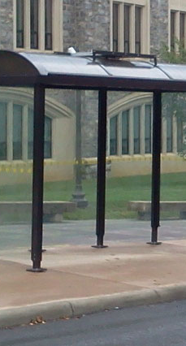
Funding Sources
Infrastructure Investment and Jobs Act (IIJA)
FTA Section 5307 and 5339 grants
CMAQ
Smart Scale
VDOT Transportation Alternatives
DRPT Merit Grant
Private discretionary funding/partnerships

Slide 17

Questions?

