Slide 1


present
2023 Annual Conference & Expo
Awards Luncheon

Slide 2
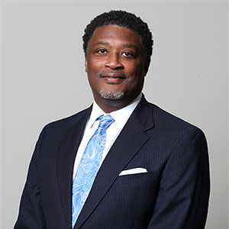

William Harrell
VTA Treasurer
CEO of Hampton Roads Transit

Slide 3










Thank you to our incredible Platinum Sponsors

Slide 4
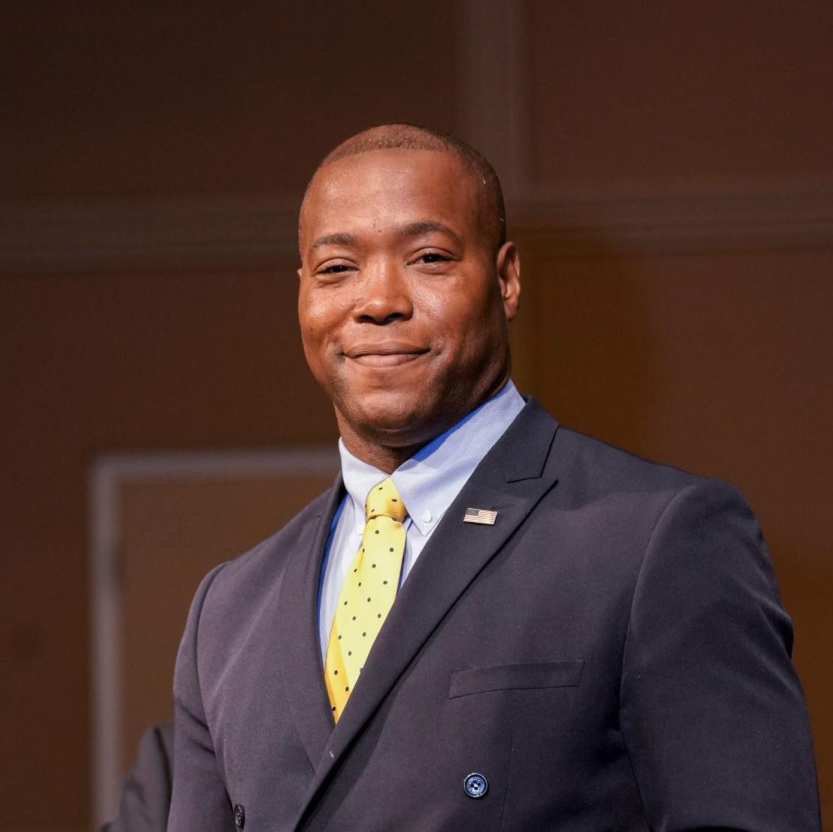
Sen. Aaron Rouse
State Senate District 7

Slide 5
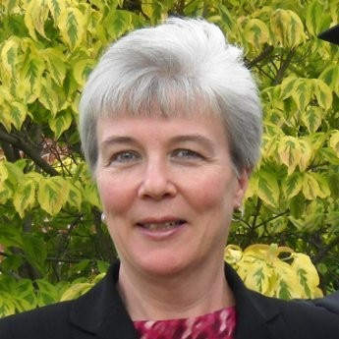
Karen Finucan Clarkson
Public Affairs Administrator,
Virginia Railway Express

Slide 6
‘The Joe Alexander
Distinguished Public Official
Leadership’ Award

Slide 7
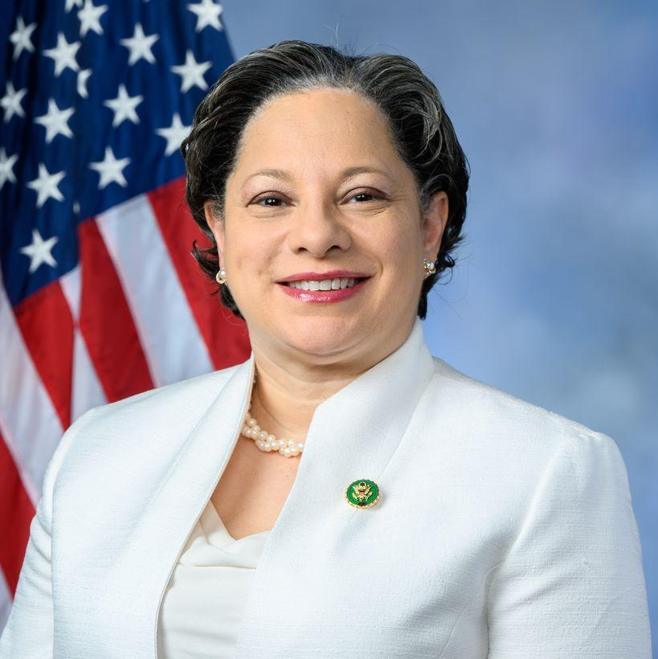
‘The Joe Alexander
Distinguished Public Official Leadership’ Award
The Honorable Jennifer McClellan

Slide 8
‘Outstanding Contribution
by an Individual’ Award

Slide 9
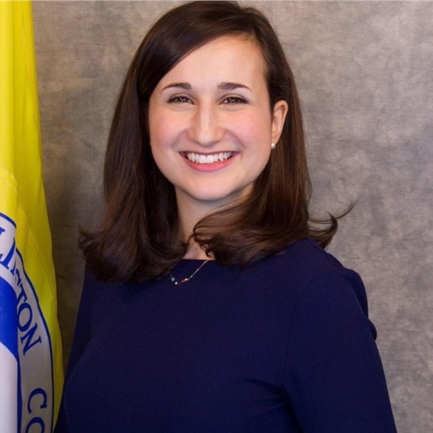
‘Outstanding Contribution by an Individual’ Award – Public Official
Katie Cristol
Arlington County Board Member

Slide 10
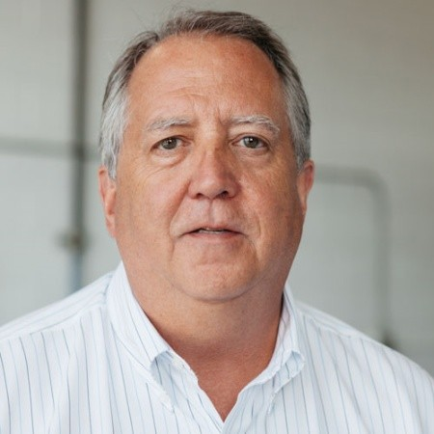
‘Outstanding Contribution by an Individual’ Award – Private Sector
Mark Roberts
Sonny Merryman, Inc.

Slide 11
‘The Helen Poore
Transit Professional
Distinguished Service’ Award

Slide 12
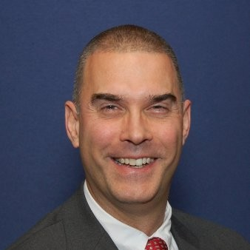
‘The Helen Poore
Transit Professional Distinguished Service’ Award
Tom Biesiadny
Fairfax County DOT

Slide 13
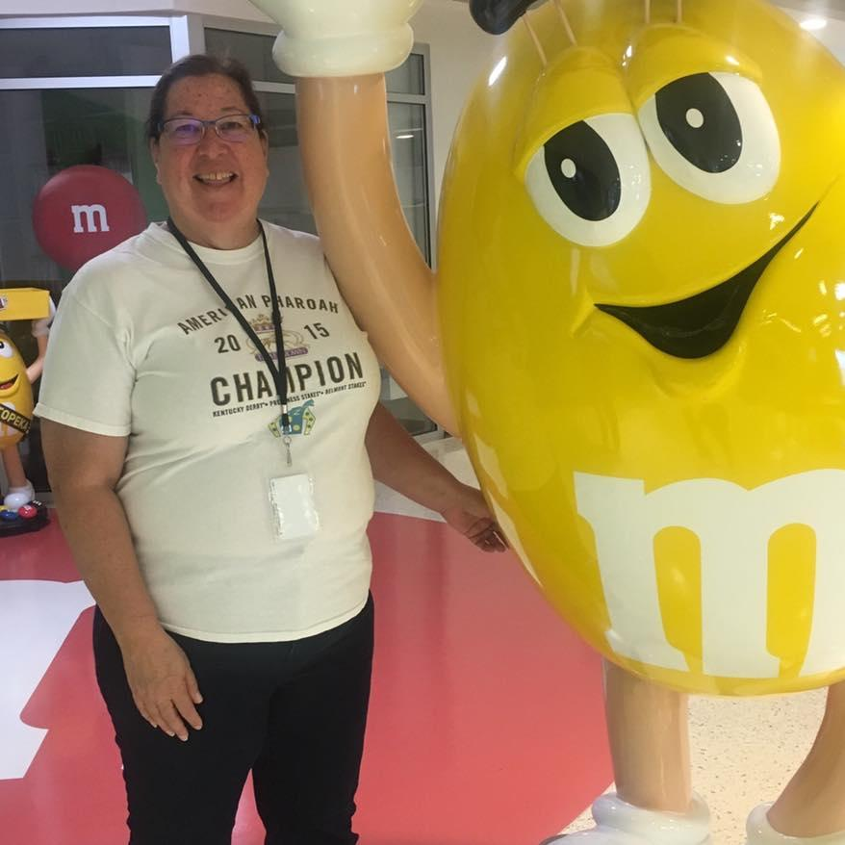
‘The Helen Poore
Transit Professional Distinguished Service’ Award
Marie Arnt
Hampton Roads Transit

Slide 14
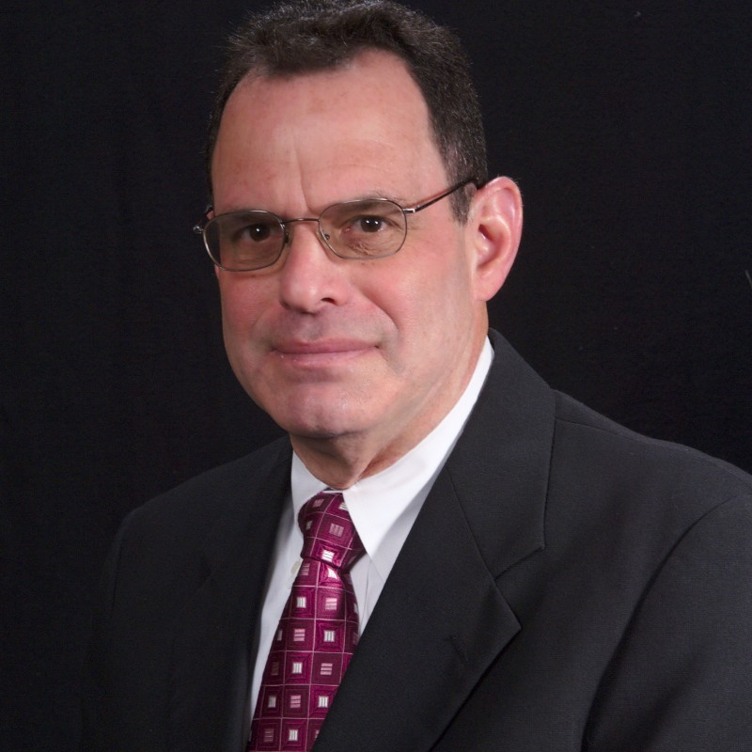
‘The Helen Poore
Transit Professional Distinguished Service’ Award
Neil Sherman
Va. Dept. of Rail and Public Transportation

Slide 15
‘The Public Transportation
Outstanding Community
Program’ Award

Slide 16


‘The Public Transportation
Outstanding Community Program’ Award – Regional Program
Fairfax County DOT / Fairfax Connector
Free Student Bus Pass

Slide 17

‘The Public Transportation
Outstanding Community Program’ Award – Large System
OmniRide
Art in Transit

Slide 18

‘The Public Transportation
Outstanding Community Program Award’ – Small System
Bay Transit
Art in Transit

Slide 19
‘Outstanding Contribution
by a Business’ Award

Slide 20

'Outstanding Contribution by a Business’ Award
Transurban
Northern Virginia Express Lanes

Slide 21
‘The Public Transportation
Outstanding Marketing’ Awards

Slide 22

‘The Public Transportation
Outstanding Marketing’ Award – Regional Campaign
WMATA & Fairfax County DOT / Fairfax Connector
Metro Silver Line Extension campaign

Slide 23
‘The Public Transportation
Outstanding Marketing’ Award – Large System
OmniRide
Sunday Service

Slide 24


‘The Public Transportation
Outstanding Marketing’ Award – Small Agency
Blacksburg Transit
Operator Attainment Bonus Program

Slide 25

‘The Public Transportation
Outstanding Marketing’ Award – TDM
TRAFFIX
Commute Differently campaign

Slide 26
‘The Public Transportation
Unsung Hero’ Awards

Slide 27
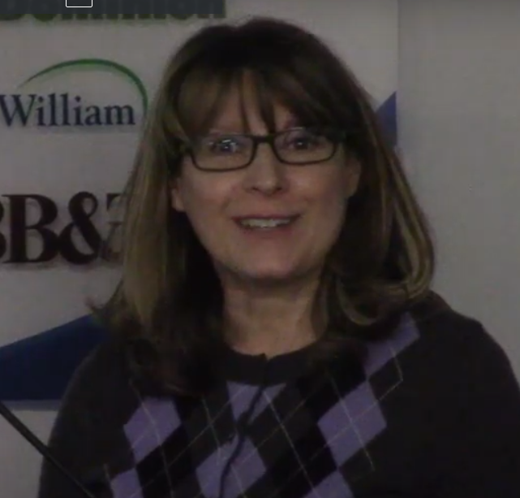
The Public Transportation
Unsung Hero Award
Holly Morello
OmniRide

Slide 28
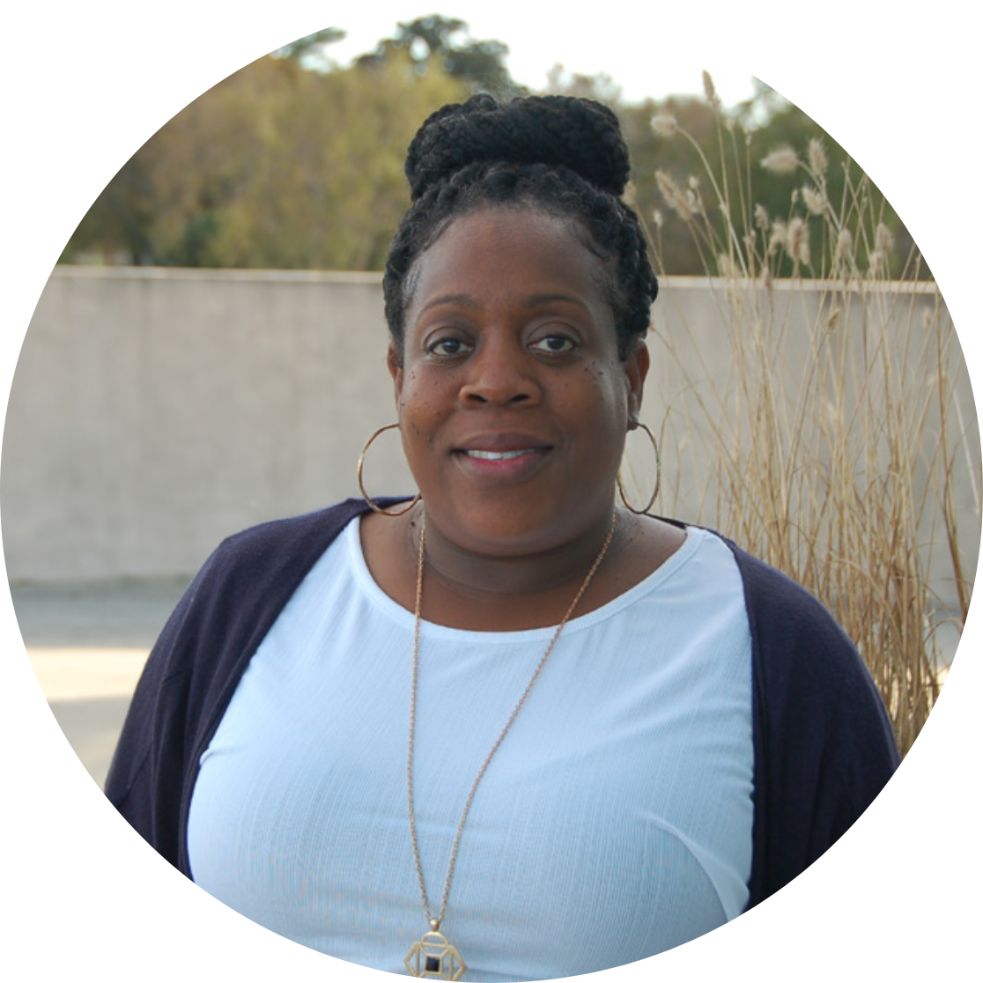
The Public Transportation
Unsung Hero Award
Latwana McClure
TRAFFIX

Slide 29
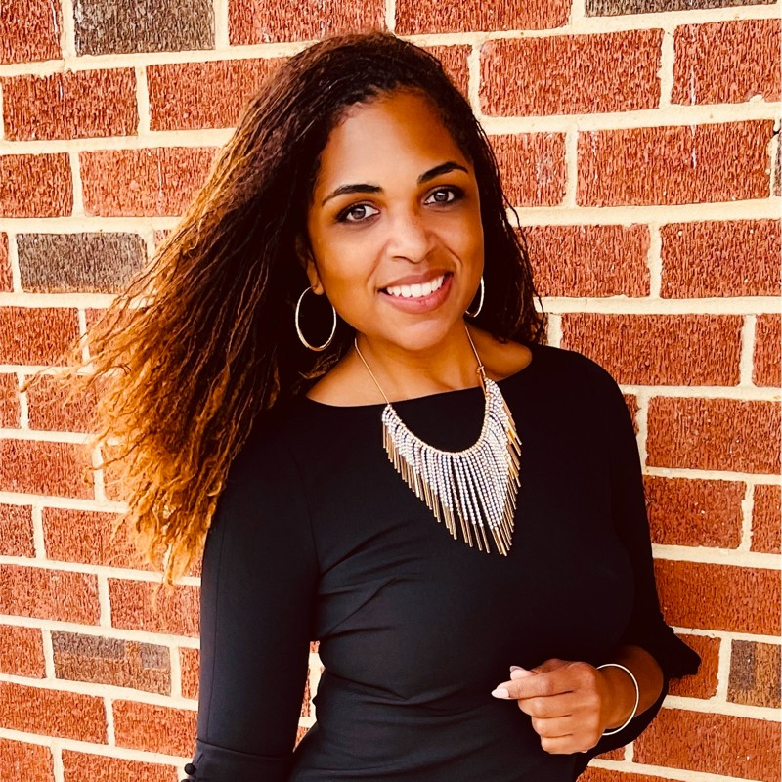
The Public Transportation
Unsung Hero Award
Tajuana Smith
Alexandria’s DASH

Slide 30
‘The Lisa Guthrie & Linda McMinimy Public Transit Advocacy’ Award

Slide 31

‘The Lisa Guthrie & Linda McMinimy
Public Transit Advocacy’ Award

Slide 32
Thank you to our incredible Platinum Sponsors

Slide 33
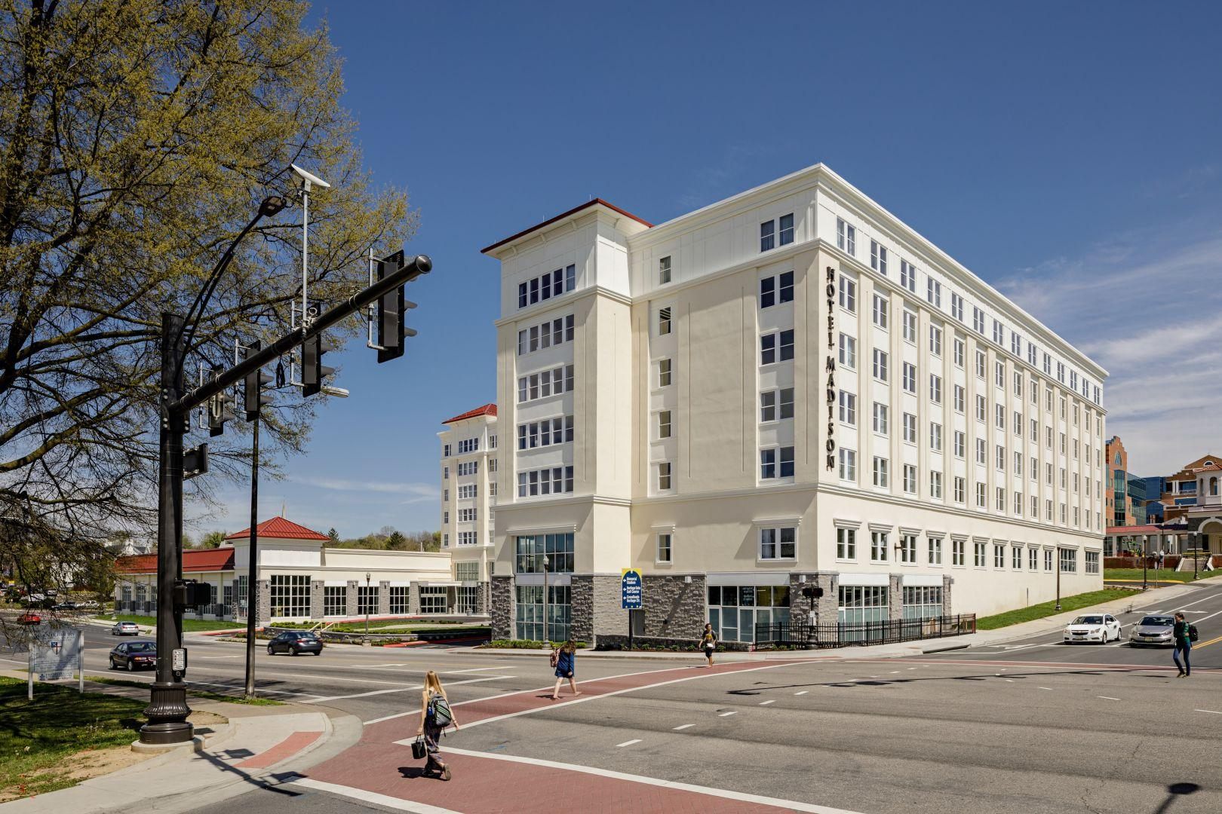
Thank you to our sponsors for making our 2023 Annual Conference & Expo possible.
Don’t forget to
MARK YOUR CALENDARS:
2024 VTA Conference & Bus Expo
May 22-23, 2024
Hotel Madison, Harrisonburg, Virginia

Slide 34
present
2023 Annual Conference & Expo
Awards Luncheon

